Slide 1
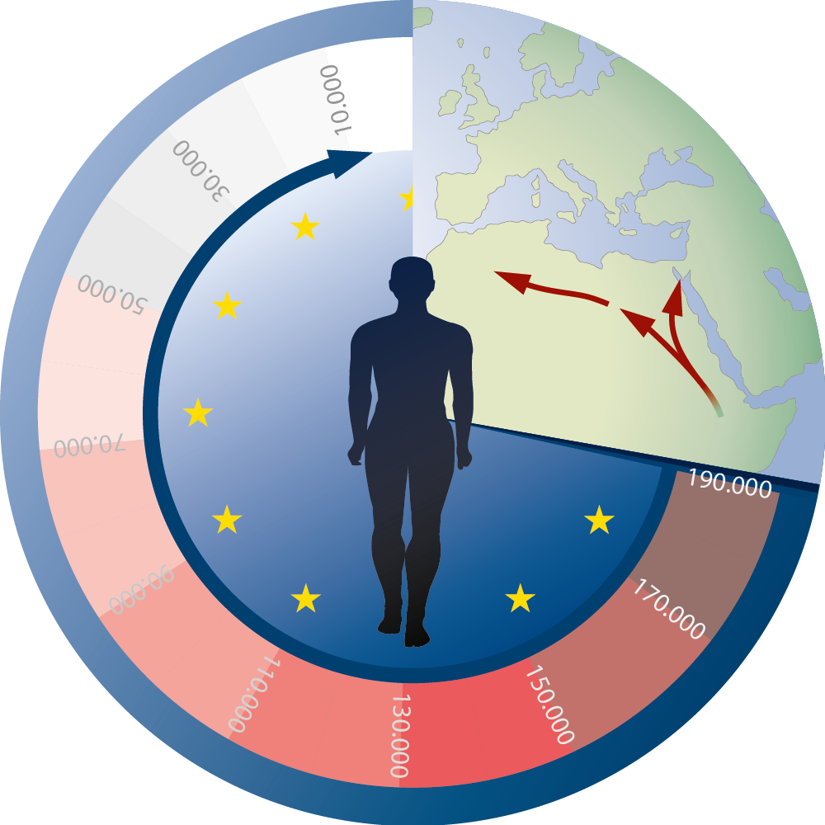
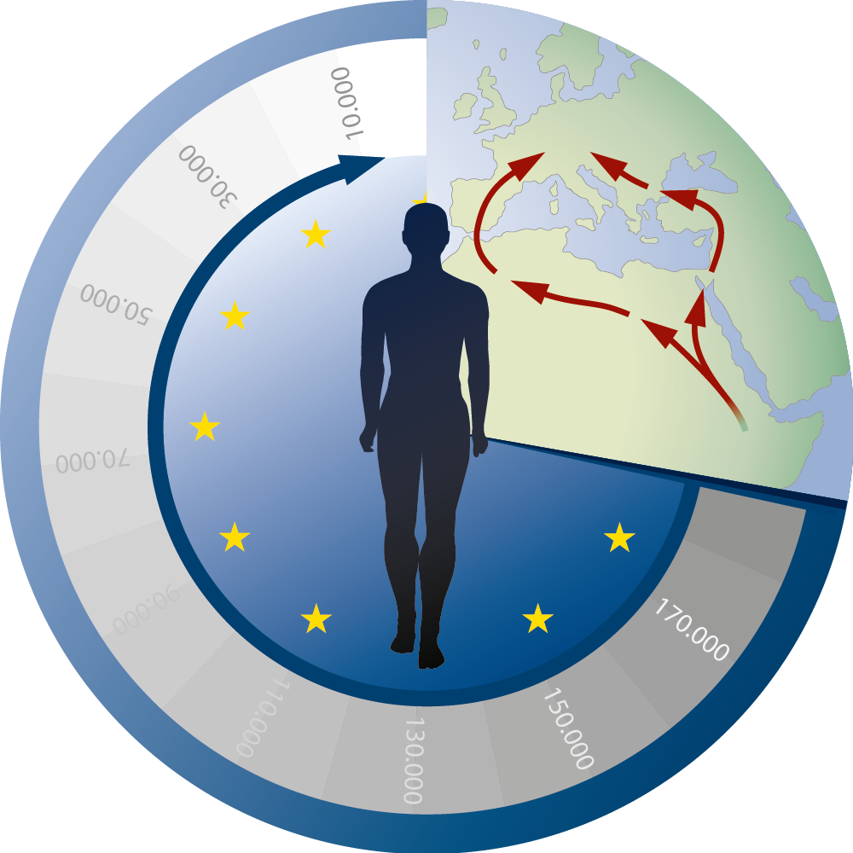

Source area in the CRC 806

Slide 2
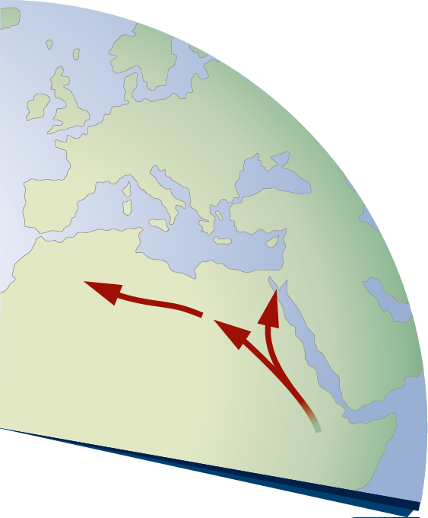
Source area in the CRC 806

Slide 3




Outline
ssumptions
lready done
Case studies
head

Slide 4
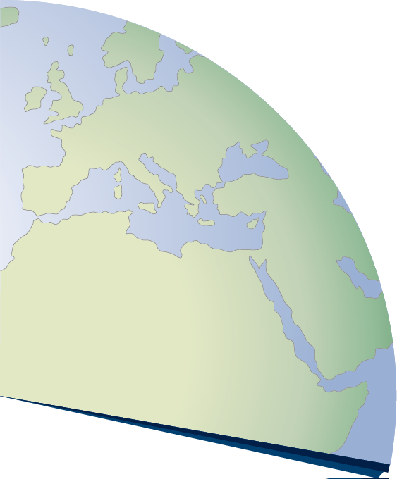




Working hypotheses
adaptive cycle
growth /
interaction
r-phase
decline / collapse
Ω-phase
reorganization
α-phase
stagnation specialization rigidity
K-Phase
ssumptions
Technology?
lready done
Case studies
Migration?
Climate?
nach Widlok et al. 2012
head
Environment?

Slide 5
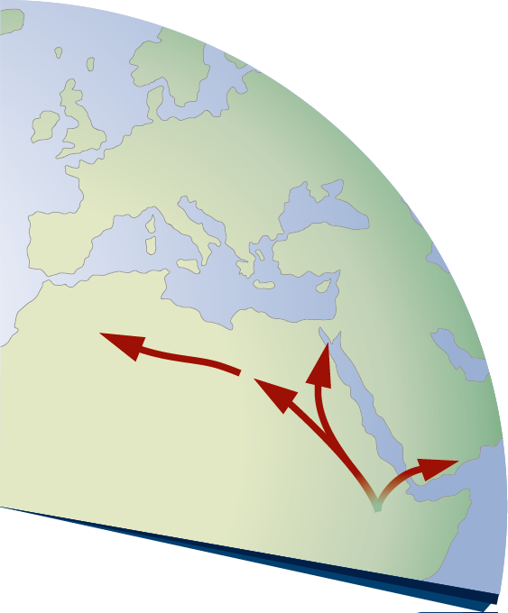
MIS 5/6 – Out of Africa IIa
150 - 110 ka
ssumptions
lready done
Case studies
Southern Route
(~80 AND ~130 ka)
Armitage et al. 2011
10.1126/science.1199113
Levant caves
Shea 2008
10.1016/j.quascirev.2008.08.015
Nile Valley
Derricourt 2005
10.1007/s10963-006-9002-z
Kirbish Formation (~190 ka)
McDougall et al. 2005
10.1038/nature03258
head

Slide 6
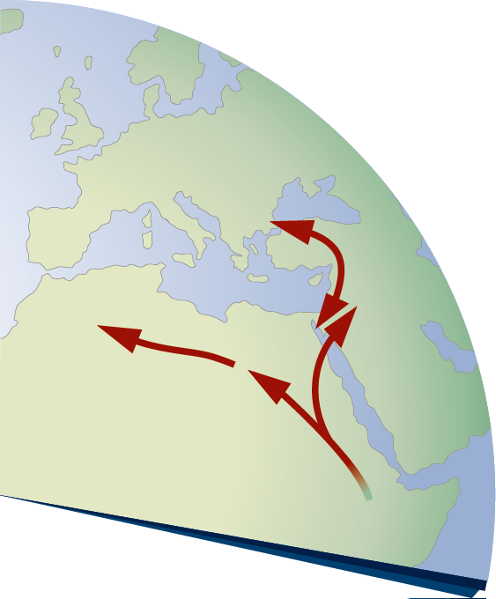
MIS 3/4 – Out of Africa IIb
60 - 40 ka
ssumptions
Colonization of Europe
e.g., Hublin 2012
10.1073/pnas.1211082109
lready done
Manot Cave (~55ka)
Hershkovitz et al. 2015
10.1038/nature14134
Case studies
head

Slide 7
MIS 5/6 – Out of Africa IIa
ssumptions
lready done
Case studies
Soreq Cave (185ka)
Bar-Matthews et al. 2003
10.1016/S0016-7037(02)01031-1
GeoB3004-1 (190ka)
Schmiedl & Leuschner 2005
10.1029/2004PA001044
Lake Malawi 1C (145ka)
Scholz et al. 2011
10.1016/j.palaeo.2010.10.028
head

Slide 8
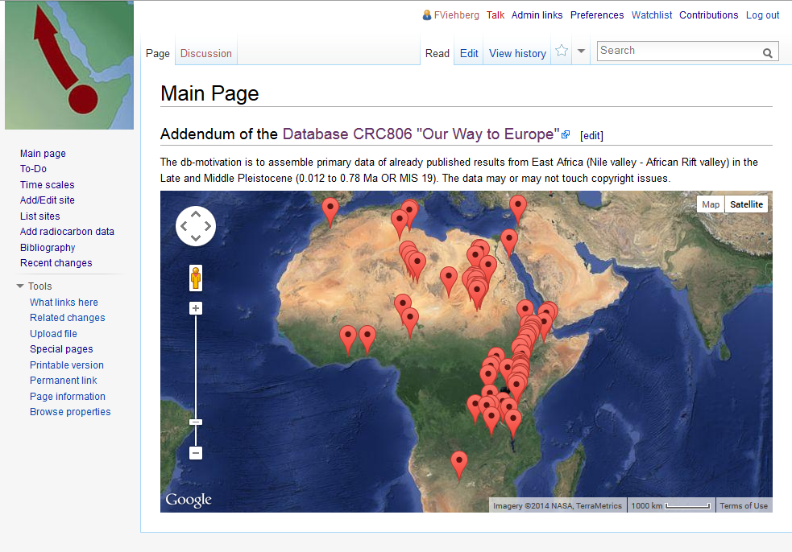
Afriki (Semantic Wiki)
ssumptions
lready done
Case studies
head
cooperation with Christian Willmes

Slide 9
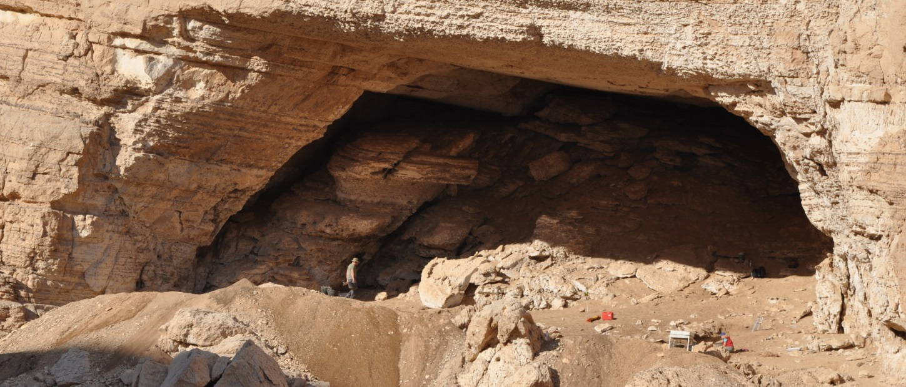
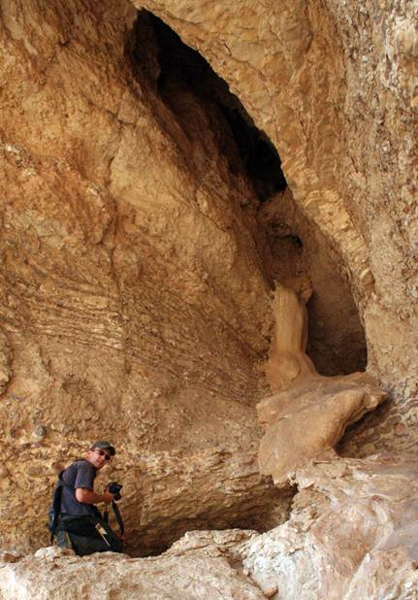
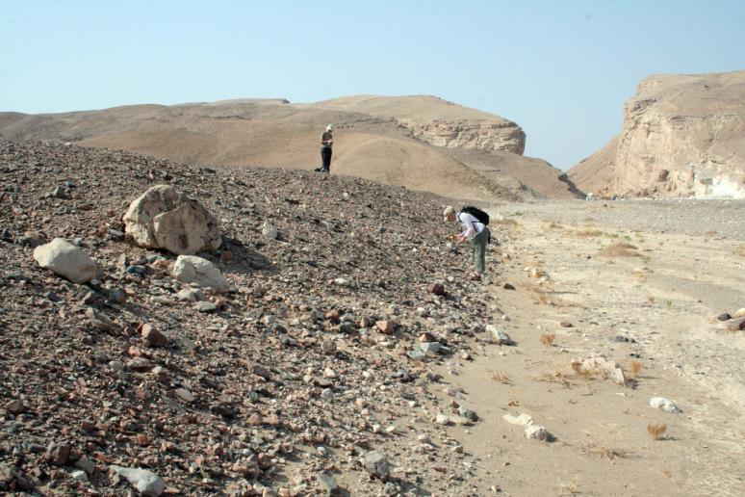
CRC 806 – A-Cluster sites
ssumptions
lready done
Case studies
Sodmein Cave
Egypt:
Sodmein Cave
Saqia Cave
Sodmein Terraces
head
Saqia Cave
Notes:
Old terrace surfaces with open air sites MIS 5 to 3 (?)
with Levallois-, Nubian- and Taramsan technology

Slide 10
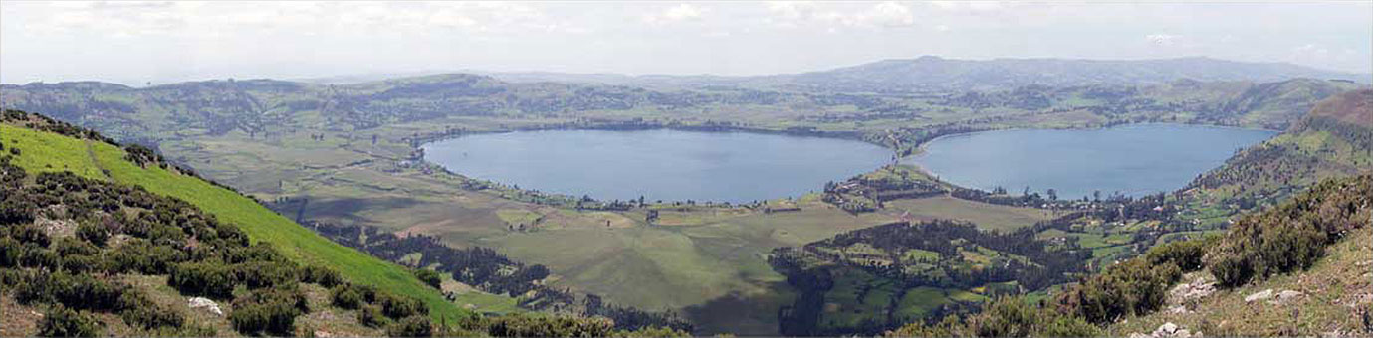
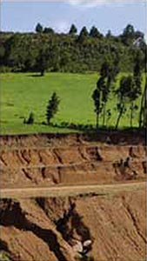
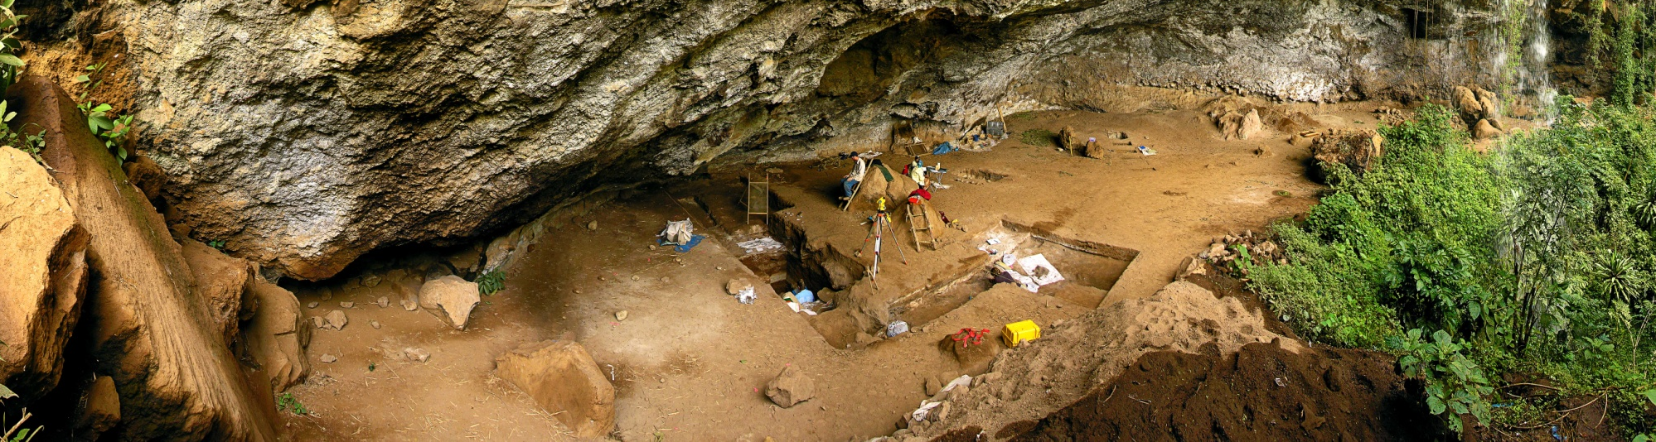
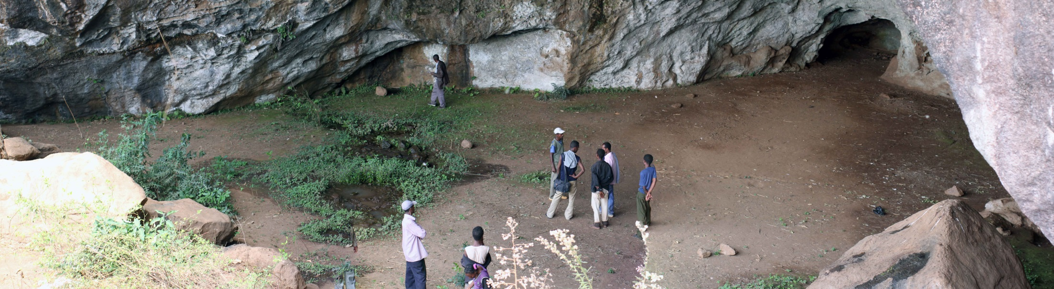
CRC 806 – A-Cluster sites
ssumptions
lready done
Dendi crater
Case studies
Egypt:
Sodmein Cave
Saqia Cave
Mochena Borago
Ethiopia:
Dendi crater
Mochena Borago
Sodicho Rockshelter
head
Sodicho Rockshelter

Slide 11
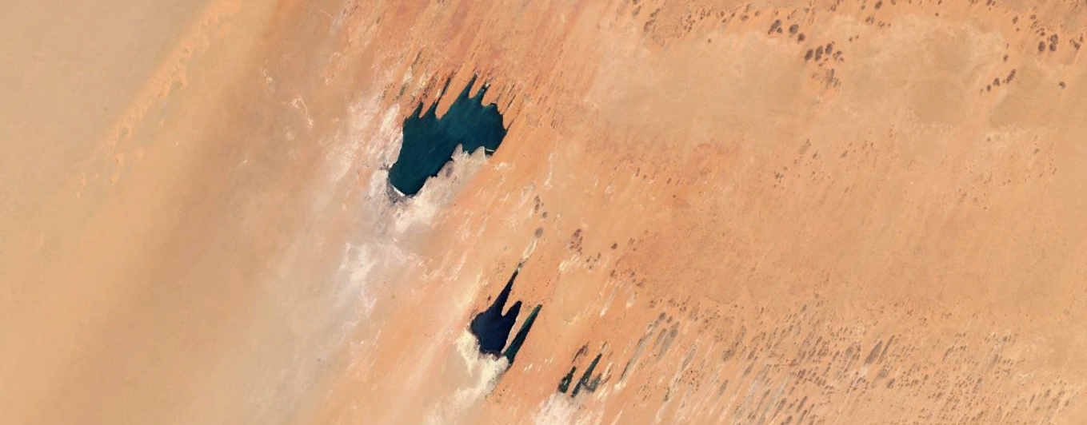
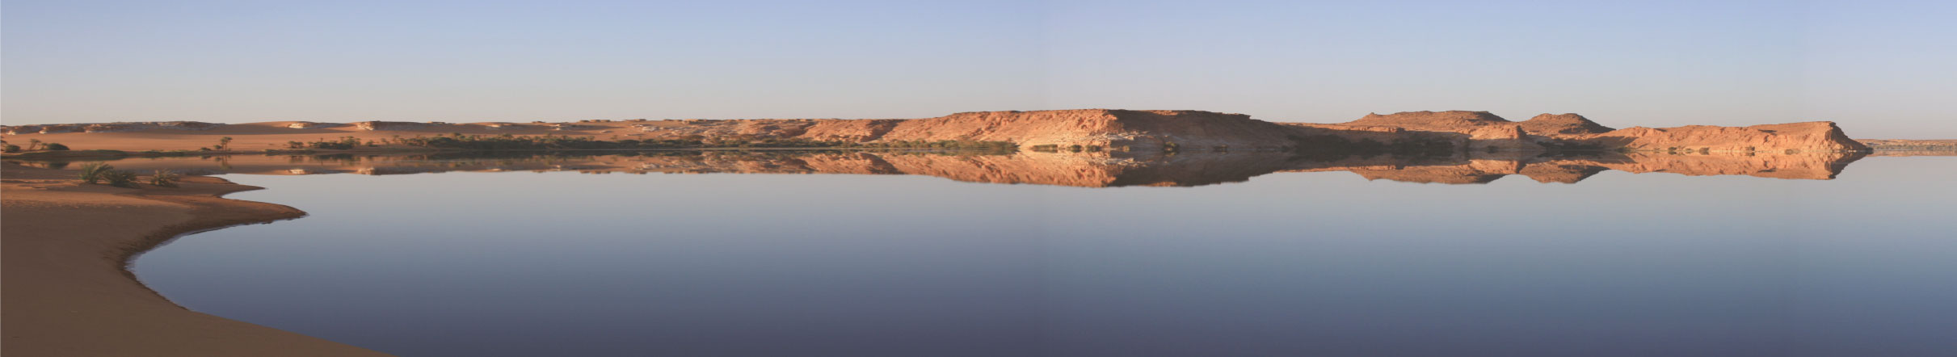
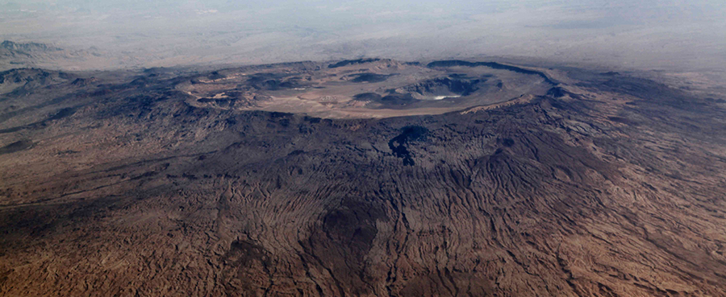
CRC 806 – A-Cluster sites
ssumptions
lready done
Lake Yoa
Case studies
Egypt:
Sodmein Cave
Saqia Cave
Chad:
Lake Yoa
Emi Koussi
Ethiopia:
Dendi crater
Mochena Borago
Sodicho Rockshelter
head
Emi Koussi

Slide 12
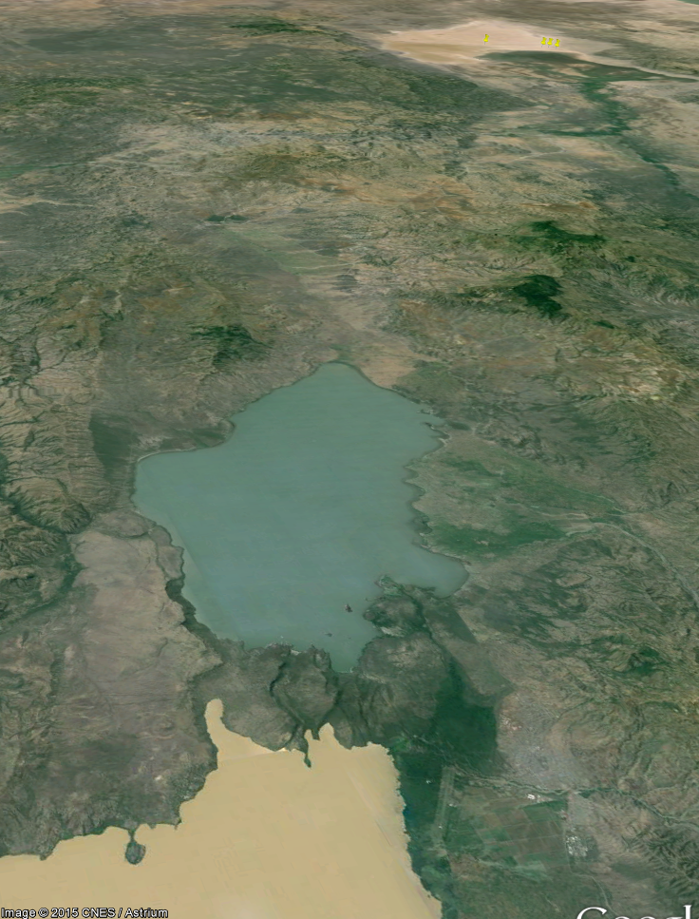
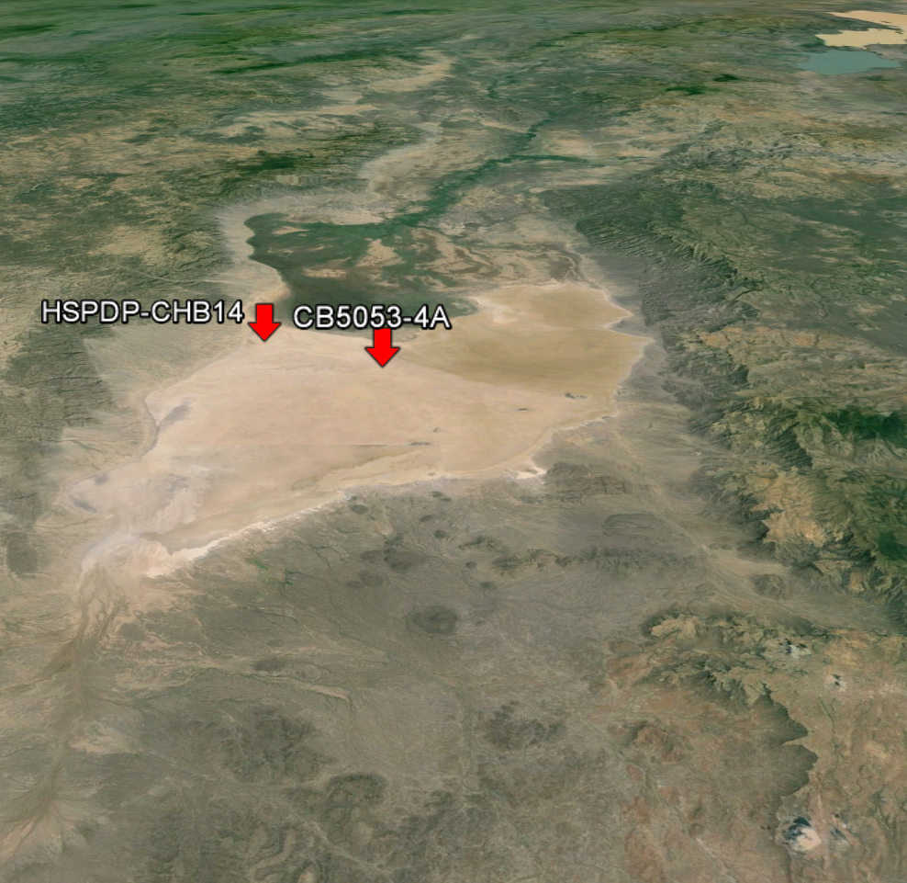
CRC 806 – A-Cluster sites
ssumptions
lready done
Dendi lakes
Case studies
Lake Chamo
Egypt:
Sodmein Cave
Saqia Cave
Chad:
Lake Yoa
Emi Koussi
Ethiopia:
Dendi crater
Mochena Borago
Sodicho Rockshelter
N
N
Ethiopia:
Lake Chamo
Dendi lakes
Chew Bahir
head
Chew Bahir

Slide 13
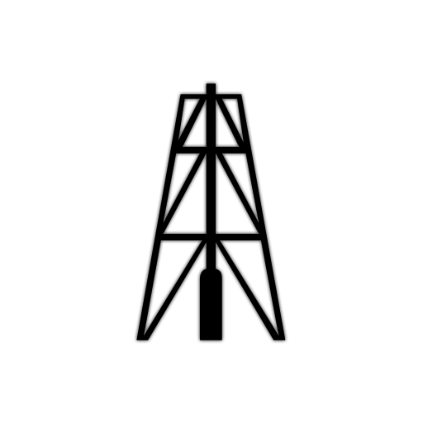

Archives we have
ssumptions
Sodmein Cave
Mochena Borago
Chew Bahir
20m
Chew Bahir
40m
Chew Bahir
280m
Saqia Cave
Dendi crater
Lake Chamo
Dendi lakes
Lake Yoa
lready done
?
MIS 3
Case studies
4
Upper
Palaeolithic
artifacts
5
a
.1
b
.2
c
.3
d
.4
e
.5
?
?
6
head
Notes:
3/4 57 4/5 71 5.1(peak) 82 5.2(peak) 87 5.3(peak) 96 5.4(peak) 109 5.5(peak) 123 5/6 130 6/7 191

Slide 14
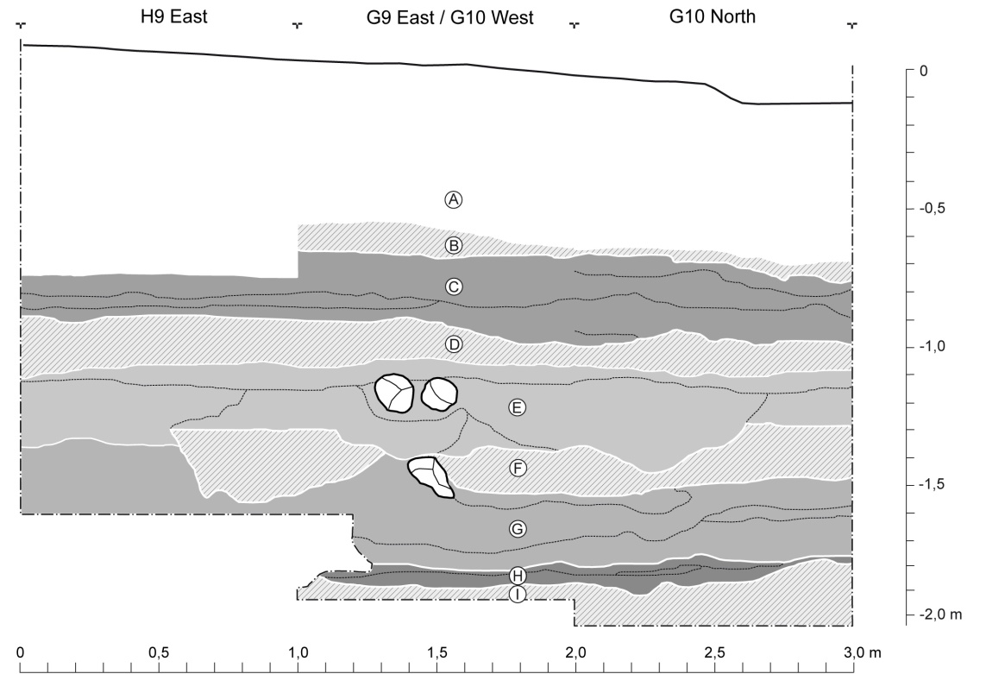
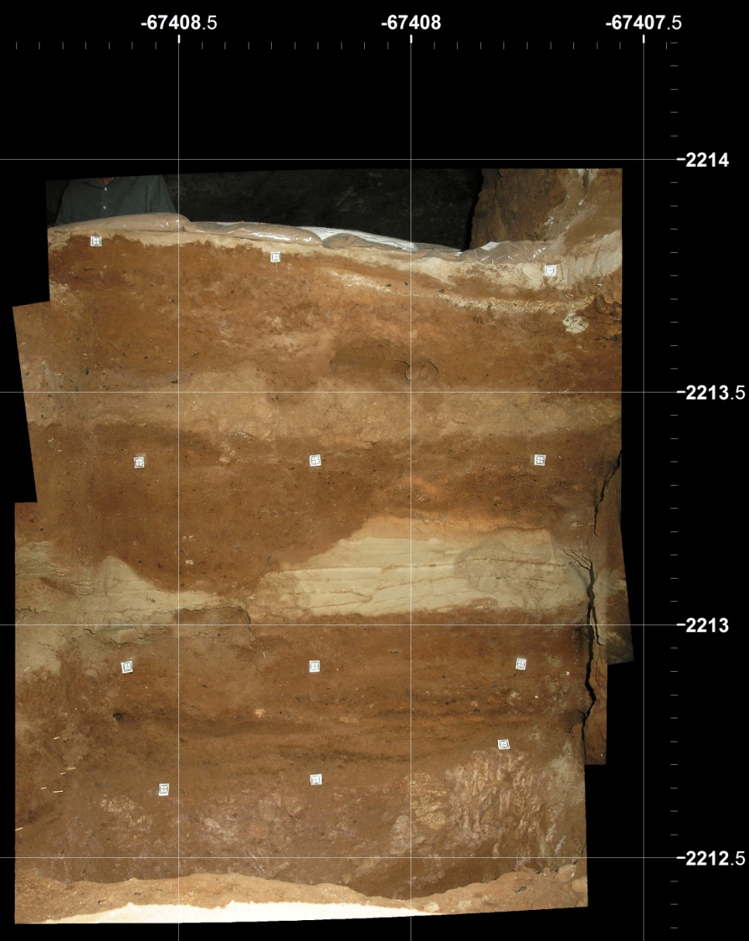
A1 Ethiopia – Mochena Borago
ssumptions
lready done
Case studies
BWT tephra
Upper-R-Group: ~ 41 ka
Lower-R-Group: ~ 43 ka
R-Group
YBS mud-flow
S-Group
S-Group: ~ 44 ka
YBT tephra
Upper-
T-Group
Lower-
Upper-T-Group: ~ 46 ka
Lower-T-Group: ~ 51 ka
head
Notes:
Section drawing H9 East, G9 East/G10 West, G10 North, showing the major stratigraphic groups: (A) Holocene deposits, (B) BWT tephra, (C) R-Group, (D) YBS mud-flow, (E) R-Group, (F) YBT tephra, (G) Upper T-Group, (H) Lower T-Group, (I) DF-Group.

Slide 15
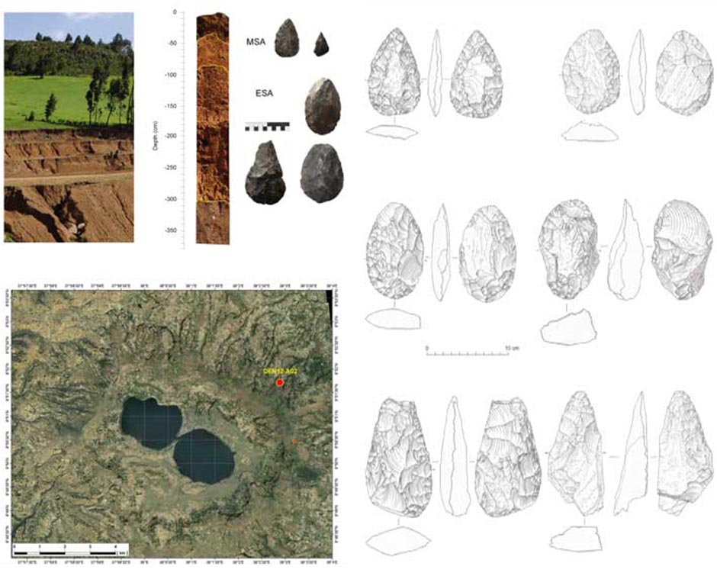
A1 Ethiopia – Dendi crater
ssumptions
lready done
Case studies
head

Slide 16
Archives we have
ssumptions
Sodmein Cave
Mochena Borago
Chew Bahir
20m
Chew Bahir
40m
Chew Bahir
280m
Saqia Cave
Dendi crater
Lake Chamo
Dendi lakes
Lake Yoa
lready done
?
MIS 3
Case studies
4
5
a
.1
b
.2
c
.3
d
.4
e
.5
?
?
6
head
Notes:
3/4 57 4/5 71 5.1(peak) 82 5.2(peak) 87 5.3(peak) 96 5.4(peak) 109 5.5(peak) 123 5/6 130 6/7 191

Slide 17
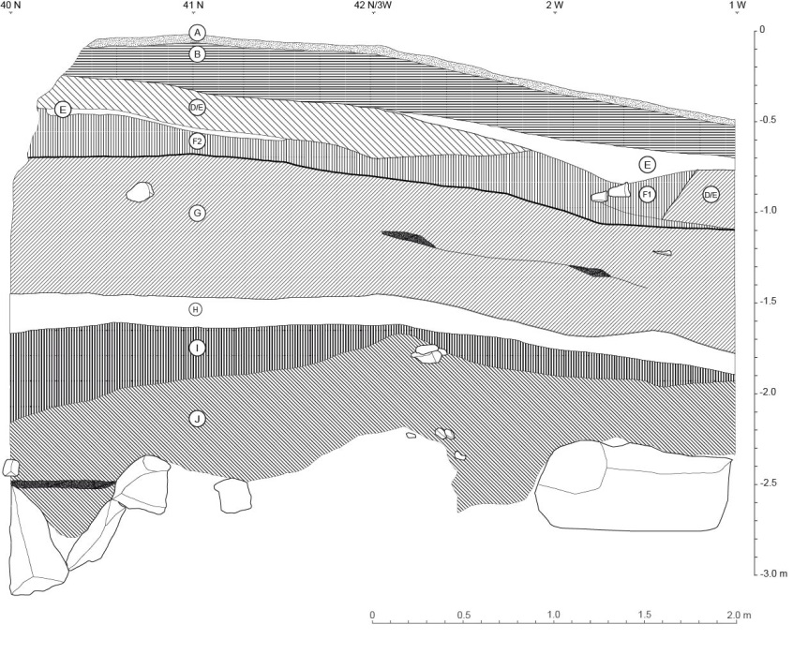
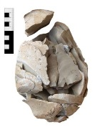
A1 Egypt – Sodmein Cave
ssumptions
Neolithic layers
~ 7.5 to 6.1 ka
lready done
Upper Palaeolithic
around 25 ka
Case studies
Nubian Complex
63.9 ± 4.4 ka
Interstratification
flake- & blade-like
technologies
78.2 ± 9.3 ka
Early Nubian Complex
86 ± 9 ka and 123 ± 15 ka
head
Notes:
Stratigraphy with settlement remains
MIS 5 to MIS 1
Two tephren layer ~ 7.5 and
> 63.9 ± 4.4 kyr BP
CRC data
MIS 3 (layer G) and MIS 5 (layer I, J)

Slide 18
A1 Egypt – Saqia Cave
ssumptions
lready done
Th/U – dating:
83.2 ± 2.1 ka (MIS 5a)
103.8 ± 3.6 ka (MIS 5c)
123.3 ± 1.8 ka (MIS 5e)
Case studies
head

Slide 19
Archives we have
ssumptions
Sodmein Cave
Saqia Cave
Lake Chamo
Dendi lakes
Chew Bahir
20m
Chew Bahir
40m
Chew Bahir
280m
Lake Yoa
lready done
?
MIS 3
Case studies
4
5
Holocene
sequence
a
.1
b
.2
c
.3
d
.4
e
.5
?
6
head
Notes:
3/4 57 4/5 71 5.1(peak) 82 5.2(peak) 87 5.3(peak) 96 5.4(peak) 109 5.5(peak) 123 5/6 130 6/7 191

Slide 20
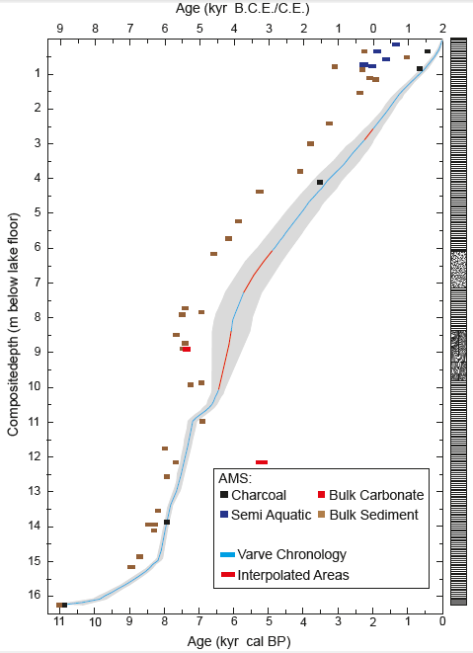
Lake Yoa – age-depth model
11 ka
9 ka

Slide 21
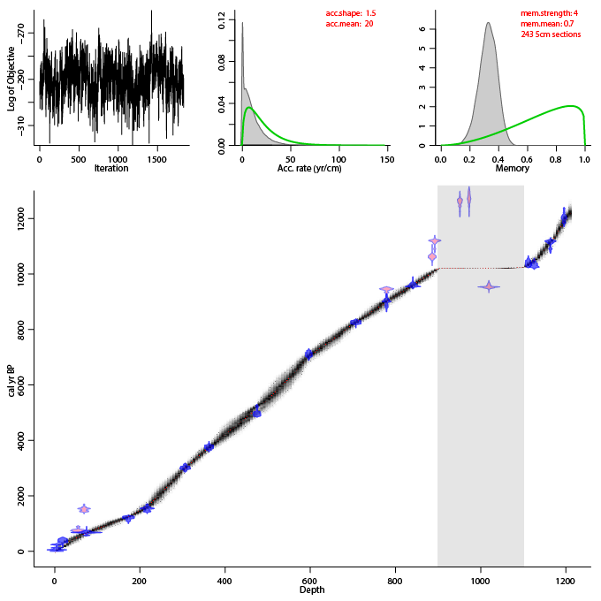
Dendi lake – age-depth model
12 ka
10 ka
8 ka
Tephra
Layer
(2m)

Slide 22
Lake Chamo – age-depth model
8 ka
10 ka

Slide 23
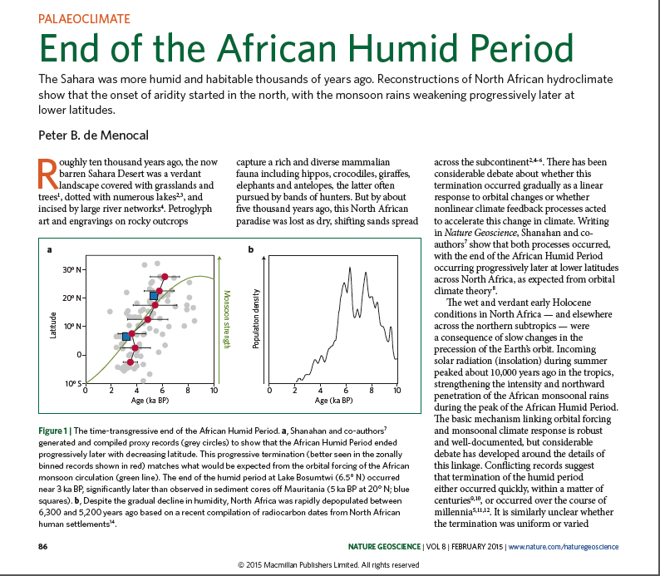
African Humid Period
de Menocal 2015
10.1038/ngeo2355

Slide 24
Archives we have
ssumptions
Sodmein Cave
Saqia Cave
Lake Chamo
Dendi lakes
Chew Bahir
20m
Chew Bahir
40m
Chew Bahir
280m
Lake Yoa
lready done
?
MIS 3
Case studies
4
5
a
.1
b
.2
c
.3
d
.4
e
.5
?
6
head
Notes:
3/4 57 4/5 71 5.1(peak) 82 5.2(peak) 87 5.3(peak) 96 5.4(peak) 109 5.5(peak) 123 5/6 130 6/7 191

Slide 25
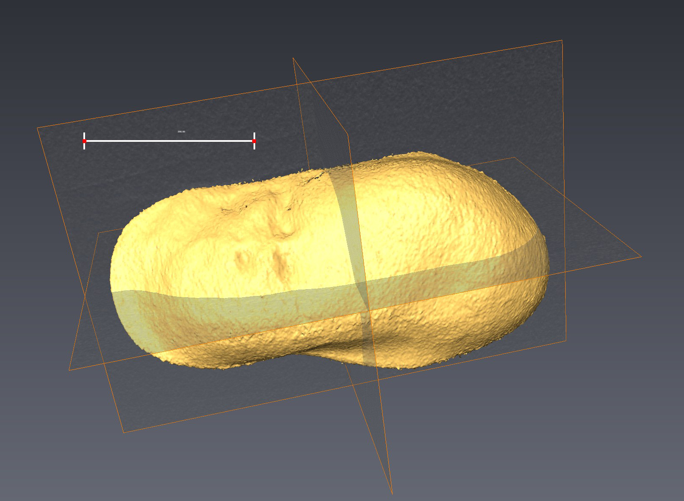
Chew Bahir 5053-4A
R2: X=0.72
MQ: X=1.03
ssumptions
9,551 ± 33 a cal BP
Next four months:
grain size
mineralogy
CNS
TIC/TOC
Carbonate
Ostracods
  palaeoecology
  stable isotopes
  element ratios
lready done
37,572 ± 688 a cal BP
33,686 ± 321 a cal BP
Case studies
Lachamps 41 ka
F-Cluster
Talk
Blake 110 ka
head
OSL 130 ± 7 ka
0.1 1.0
p [Ωm]

Slide 26
Chew Bahir 5053-4A
ssumptions
lready done
Case studies
head

Slide 27

Deep Drilling 2.0
0
ssumptions
HSPDP-CHB14-2A
HSPDP-CHB14-2B
Core sampling:
in April 2015
New PhD student:
Raphael Gromig
50
recovered material
lready done
core loss
CRC806 (<200 ka)
proxies/parameters:
XRF
MSCL
grain size
mineralogy
CNS
TIC/TOC
Ostracods
  palaeoecology
  stable isotopes
  element ratios
Case studies
100
150
- ~ 20 m apart
- aim at continuous record
- optimised choice of tool for 2B
- cover section breaks of 2A
- depth control: no downhole logging
- composite core almost 90 % recovery
200
head
280
depth in mbs
[meters below surface]

Slide 28
archives we might have just in time
ssumptions
Sodmein Cave
Saqia Cave
Dendi crater
Chew Bahir
40m
Chew Bahir
280m
Sodicho
Emi Koussi
Dendi lakes
!
!
lready done
MIS 3
Case studies
4
5
a
.1
b
.2
c
.3
?
d
.4
e
.5
!
?
?!
6
head
Notes:
3/4 57 4/5 71 5.1(peak) 82 5.2(peak) 87 5.3(peak) 96 5.4(peak) 109 5.5(peak) 123 5/6 130 6/7 191

Slide 29
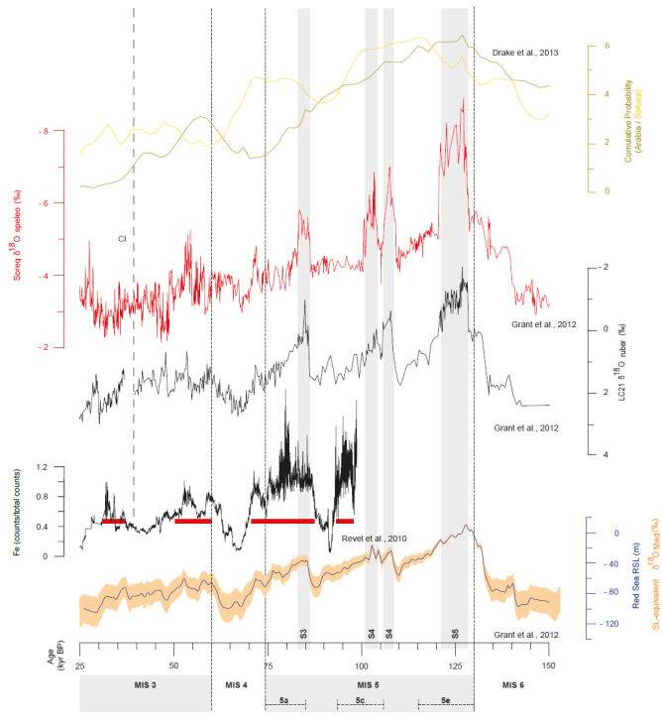
Future directions
Egypt/Ethiopia – Climate reconstruction
ssumptions
PDF climate Arabia
PDF climate Sahara
lready done
Dripstone growth
in the
Saqia Cave
Case studies
Kindermann et al. unpubl.
Nile discharge
Maximum Nile
flood periods
Red Sea
level
head
head
Notes:
3/4 57 4/5 71 5.1(peak) 82 5.2(peak) 87 5.3(peak) 96 5.4(peak) 109 5.5(peak) 123 5/6 130 6/7 191

Slide 30
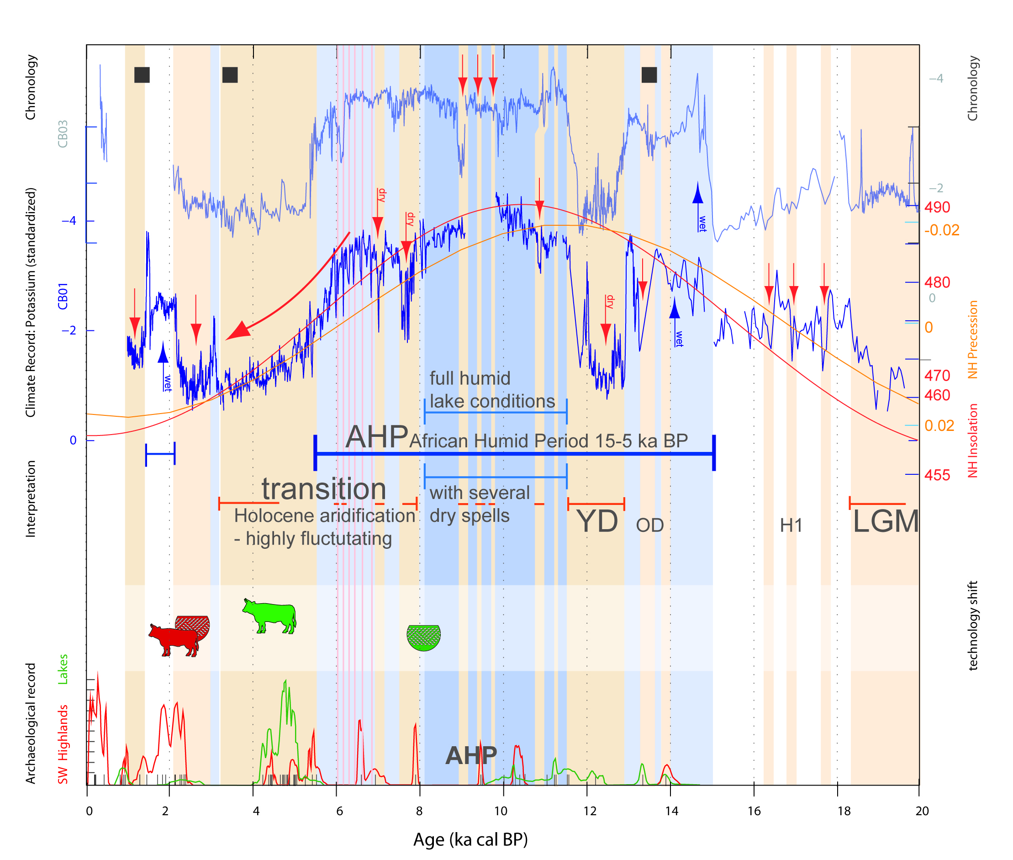
Future directions
ssumptions
lready done
Case studies
but MIS 5/6
head
head
Förster et al. unpubl.

Slide 31
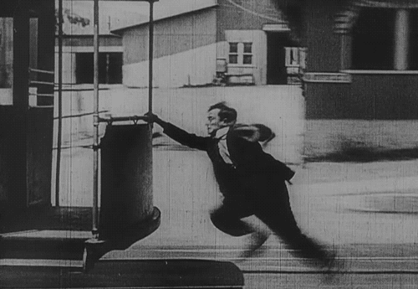
Conclusion
ssumptions
lready done
Case studies
head
head

Slide 32













Cooperation
Thank you!

