Slide 1
Incorporating ‘Culture’ in the ABM of Mobile Hunter-Gatherers
Considering Cultural Complexity in ABM
2015
Cologne
Martin Solich
University of Cologne
CRC 806 Our Way to Europe

Slide 2
1
Hunter-Gatherer Mobility
2
‘Optimality’ Models
3
Social Dimension of Mobility
4
The Cultural Factor
5
Modeling Mobility

Slide 3
Hunter-Gatherer Mobility
1

Slide 4
Hunter-Gatherers
0
1
Hunter-Gatherer Mobility
Flexibility versus Specialization
Introduction
Common Features among Contemporary Hunter Gatherers:
Small Groups
Individual Autonomy
Common Property Regime
Generalized Reciprocity
High Mobility
Mobility-Relevant Features:
Frequent Moves of Settlements
Aggregation and Dispersal Patterns
Flux in Group Compositions
Circuarity of Settlement Move Patterns

Slide 5
Hunter-Gatherer Mobility
0
2
Hunter-Gatherer Mobility
Flexibility versus Specialization
Introduction
Variations
Mean Frequencies and Distances of Moves
Relation of Residential and Logistical Mobility
Sedentary Societies
Societies without considerable aggregation-dispersal phases
Similarities
Frequent Moves of Settlements
Aggregation and Dispersal Patterns
Flux in Group Compositions
Circularity of Settlement Move Patterns

Slide 6
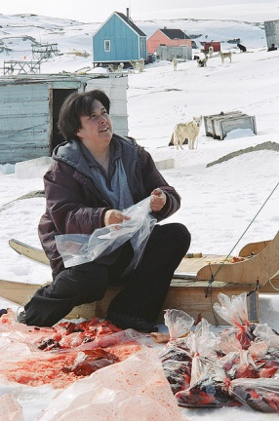
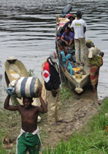
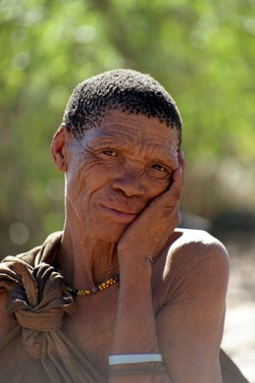
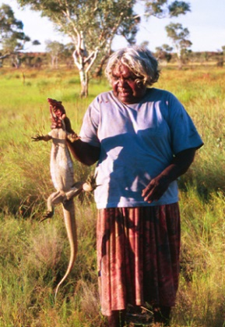
Examples I
0
3
Introduction
Hunter-Gatherer Mobility
Flexibility versus Specialization
Introduction
Similar Mobility Patterns

Slide 7
Ideal-Typical Mobility Patterns
4
Hunter-Gatherer Mobility
Introduction
Inter-Group Mobility
Nomadism
Fission-Fusion

Slide 8
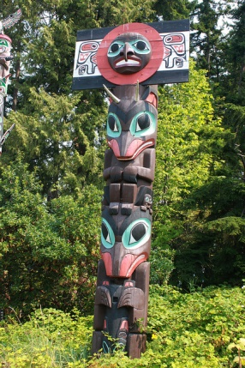
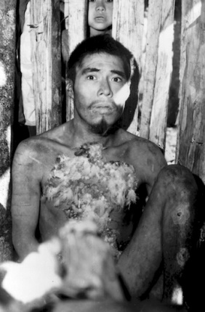
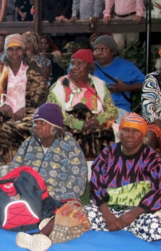
Examples II
0
5
Introduction
Hunter-Gatherer Mobility
Flexibility versus Specialization
Introduction
Variability in Mobility Patterns

Slide 9
Variations in HG Mobility
6
Hunter-Gatherer Mobility
Introduction
Residential Mobility
Stay
Optimal Moment to Move
Net Foraging Return Rate (kcal/hr)
Move
Logistical Mobility
Minimum Return Rate
One-Way Distance to Foraging Area (km)
Binford 1980
Kelly 1995

Slide 10
Question
7
Hunter-Gatherer Mobility
Introduction
How to explain and model the emergence of similarities and variations in mobility patterns among contemporary hunter-gatherers?

Slide 11
‘Optimality’ Models
2

Slide 12
Human Behavioral Ecology
0
8
Flexibility versus Specialization
Introduction
Human Behavioral Ecology
Possible fitness relevant proxies/‘currencies‘:
Net Return Rate per Unit Foraging Time (Adaptation)
Risk related to Thirst, Starvation or Predators (Survival)
Nr of Offspring / Surviving Offspring (Reproduction)
Humans‘ behavioral strategies – especially the one of hunter-gatherers – tend to be optimal adapted to their environmental conditions
Best options are calculable by using fitness proxies like net foraging return rates

Slide 13
Modeling Mobility
9
Human Behavioral Ecology
Residential Mobility
Optimal Moment to Move
Net Foraging Return Rate (kcal/hr)
Move
Stay
Minimum Return Rate
One-Way Distance to Foraging Area (km)
Kelly 1995

Slide 14
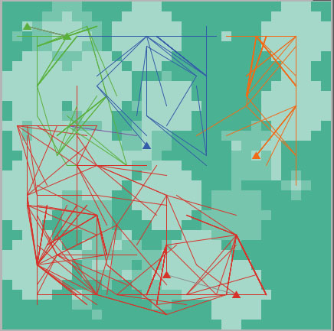
Modeling Individual Behavior
0
9
Behavioral Strategies
Flexibility versus Specialization
Introduction
Human Behavioral Ecology
Consider Residential Moving Options
STAY
MOVING CAMP
LEAVING GROUP
(FISSION)
JOINING GROUP
(FUSION)
CHANGINGGROUP
Calculate Costs and Benefits for all Options
Compare Option Outcomes and Select Best One

Slide 15
0
10
Limits of ‚Optimality‘ Models
Flexibility versus Specialization
Introduction
Human Behavioral Ecology
ABM ‚Optimality‘ Models
It is possible to reproduce Kelly‘s and Binford‘s model in respect to
Camp move frequencies in environments with homogenous distributed resources
Residential and logistical mobility ratio dependent on resource distribution (homogenous or ‘patchy’)
Limits
Converting currencies
Operationalization of social costs and benefits
Evaluating long-term benefits by agents
Conflicting short- and long-term benefits
‚Optimal‘ adaptation vs. Flexibility

Slide 16
The Social Dimension of Hunter-Gatherer Mobility
3

Slide 17
The Social Human
0
12
Flexibility versus Specialization
Introduction
The Social Dimension
Individual
Social Relations
Social Interactions

Slide 18
Social Interactions
0
13
Flexibility versus Specialization
Introduction
The Social Dimension
Benefits
Protection/ Provisioning
Cooperation in Childcare
Cooperative Subsistence Strategies
Safety Nets due to Sharing
Information Exchange
Avoiding Conflicts: Moving if tensions arise
Moving to Reproduce: Finding a mating partner
Maintaining Networks: Visitations to ascertain the relations to others

Slide 19
Decision Making
0
14
Flexibility versus Specialization
Introduction
The Social Dimension
Consider Residential Moving Options
LEAV GROUP
REDUCE OR DISMISS INTER-ACTIONS
JOIN GROUP
ESTABLISH OR REINFORCEINTER-ACTIONS
CHANGE GROUP
ESTABLISH OR REINFORCEINTER-ACTIONS
MOVE CAMP
NO CHANGES
STAY
NO CHANGES
Evaluate Relations
Identify Relation Relevant Goals and Strategies to Fullfill the Goals

Slide 20
Modeling ‘Social‘ Mobility
0
15
Flexibility versus Specialization
Introduction
The Social Dimension
Evaluate Relations: Number and Quality
Roles
Quality
Balance

Slide 21
The Cultural Factors
3

Slide 22
Culture
0
16
Flexibility versus Specialization
Introduction
The Cultural Factors
Culture..
“… is that complex whole which includes knowledge, belief, art, morals, law, custom, and any other capabilities and habits acquired by man as a member of society." (Tylor 1871)
“… is a system of shared knowledge, beliefs, procedures, attitudes and artifacts that exists among a group of humans.”
(Gill 2013)

Slide 23
Decision Making
0
17
Flexibility versus Specialization
Introduction
The Cultural Factors
Norms
Values
Motivations / Goals
Institutions
Options
Worldview
Selection Procedure
Techniques
Knowledge

Slide 24
0
18
Cultural Agents
Flexibility versus Specialization
Introduction
The Cultural Factors
Socially Transmitted Cultural Complexes
Bounded ‚Rational‘ Actors

Slide 25
Modeling Mobility by Incorporating Culture
5

Slide 26
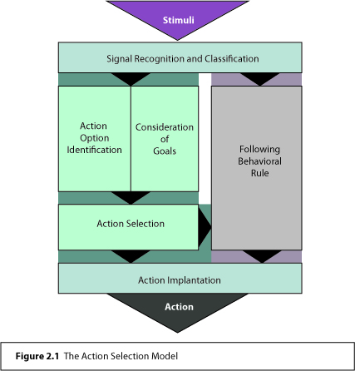
Cultural-sensitive Modeling
0
19
Flexibility versus Specialization
Introduction
Incorporating ‘Culture’
G

Slide 27
Cultural Transmission
0
20
Flexibility versus Specialization
Introduction
Incorporating ‘Culture’
Socialization
offspring adopts at least partly values and norms
Social Learning
adopting norms and values of others

Slide 28
Incorporating ‘Culture’ in the ABM of Mobile Hunter-Gatherers
Considering Cultural Complexity in ABM
2015
Cologne
Martin Solich
University of Cologne
CRC 806 Our Way to Europe

