Slide 1
How does mobility affect sharing, cooperation and group size?
CHAGS
2015
Vienna
Martin Solich
University of Cologne

Slide 2
Hypothesis
0
1
Introduction
Flexibility
versus
Specialization
Introduction
Residential
Mobility
Group
Size
Sharing
Cooperative
Hunting

Slide 3
Hypothesis
2
Introduction
Residential
Mobility
Group
Size
high
high
Example
low
low

Slide 4
Theoretical and
Methodological
Approach

Slide 5
Assumptions
3
Approach
Residential Mobility Frequency, Group Sizes, Cooperation and Sharing Rules are…
…Reflections of Individual Behavioral Strategies?
…Patterns emerging due to individuals interacting with their social and natural environment?
Individuals move to enable or avoid Interactions
Group sizes are principally dynamic outcomes of social interactions coming along with particular advantages and disadvantages
Foraging cooperation and sharing are specific kinds of social interaction

Slide 6
Interactions
4
Approach
Society / Social Structure / Social System
Social-Ecological System
Non-Human World

Slide 7
Agent-Based Modeling
5
Approach
Artificial hunter-gatherer society compounded by heterogeneous individuals (age, sex, relations)
(Explanatory) laboratory to analyze the interdependence of different behavioral regimes

Slide 8
Examples of
Simulation Results

Slide 9
Grouping
0
6
Behavioral Strategies
Flexibility
versus
Specialization
Introduction
Relationship between mobility frequency and group sizes
Some kind of optimal combinations of mobility and grouping variables appear
No simple gradual correlations
Foraging Return Rates

Slide 10
Cooperation
0
7
Behavioral Strategies
Flexibility
versus
Specialization
Introduction
Relationship between mobility and hunting cooperation/ communication
Small differences in return rates considering mobility – still differences in trends are observable
Instead increasing cooperation appears to be of decreasing efficiency -
case specific problem
Foraging Return Rates

Slide 11
Sharing
0
8
Behavioral Strategies
Flexibility
versus
Specialization
Introduction
Relationship between mobility and sharing behavior
Return rates vary not considerably for the specific strategies – only weak trends are observable
Please note that sharing rules can considerably affect survival success
Foraging Return Rates
Survival Rates

Slide 12
Mobility
0
9
Behavioral Strategies
Flexibility
versus
Specialization
Introduction
Residential
Mobility
Relatively Low Interdependence
Group
Size
Cooperative
Hunting
Sharing

Slide 13
Implications

Slide 14
Behavioral Systems
0
10
Implications
Flexibility
versus
Specialization
Introduction
Residential
Mobility
Feedback Dynamics
Resilience of Systems
Sharing
Group
Size
Cooperative
Hunting
Residential
Mobility
Sharing
Group
Size
Behavioral
Systems
Cooperative
Hunting

Slide 15
Implications
0
11
Implications
Flexibility
versus
Specialization
Introduction
Triggers of Shifts: Environmental and social changes
Adaptive Processes: Behavioral systems have to come along with some resistance regarding behavioral regime changes
Path Dependence: Behavioral systems have to „favor“ changes concerning specific behavioral regimes

Slide 16
How does mobility affect sharing, cooperation and group size?
Martin Solich
University of Cologne

Slide 17
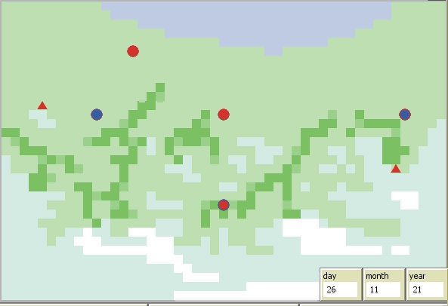
Simulation Example

