Slide 1
Metaphors for Köln
Metaphors for the anthropology of time
Metaphors for the anthropology of decision making
David Zeitlyn
Institute of Social and Cultural Anthropology,
Oxford
December 2017

Slide 2
Metaphors
Background: studies of divination and decision making in Cameroon
Interference
Ghosts and haunting
Promissory notes and dutching

Slide 3
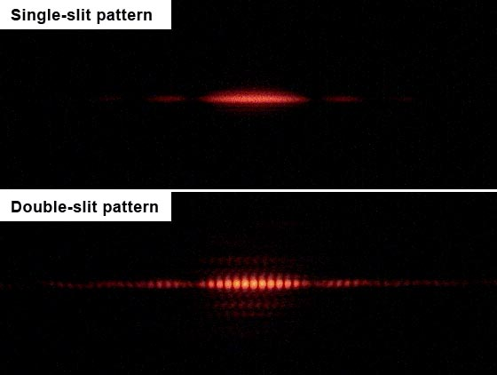
Interference Patterns

Slide 4
Metaphorical interferences
Pasts
Futures
Interfere in present decision making
Bad driving as an example? p14
But physicists hate it when social scientists go on and on about entanglement…

Slide 5
Ghosts and haunting
Derrida’s pun in Spectres of Marx
Hauntolgie <=> ontologie
An answer to the ontological turn
(disclosure: I am not a true believer)

Slide 6
Hauntings
Futures as well as Pasts
Both haunting the presents
Paralysis of the precautionary principle?
Fear of Unintended Consequences
haunting and inhibiting action

Slide 7
Speech acts
John Austin (and John Searle)
Social contexts around utterances
Conditions to give them ‘force’

Slide 8
Speech acts 2
Felicity conditions
An underage person cannot make a legally enforceable bet; and in the UK adults can only marry if the officiant and the venue are properly licensed. The speech act ‘I declare you married’ only has force if performed by a sanctioned person in a sanctioned place. The ceremonies performed by a fake priest are not deemed as legal marriages.

Slide 9
Promissory notes and dutching
‘I promise to pay the bearer’
Bank notes are Promissory Notes
Similarity to speech acts – fake notes not accepted:
They cannot be “cashed out”
They do not have monetary force
(qv fake priests and marriages)

Slide 10
Promissory notes 2
Idle or empty promises
leeres Versprechen - promesse vide
Eg ‘I promise it will snow on Xmas Day’
Idle or empty forecasts/ predictions
e.g. “there will be an earthquake in SF in the next 400 years”
Cannot be “cashed out”:
not a guide to action

Slide 11
Dutching, dutch betting, dutch books
Hedging bets or making side bets
Classic dutch book: bet on every horse in inverse ratio to their odds (bet high on low odds /favourite, bet low on high odds outsider – which ever wins you get same return)

Slide 12
Dutching uncertainty
Risk vs Uncertainty (Knight)
Can you dutch uncertainty?
(no odds so no book?)
Dealing with unquantified worlds
(or worlds quantified only after the fact)
Metaphorical extension? Vague dutch books

Slide 13
Divinatory logics
Stop dithering
Inaction is often worse choice (Buridan’s ass)
Informal forms of dutching – do lots of stuff, ‘win some, loose some’ is a good strategy!

Slide 14
Divinatory Logics
Gambling in H/G populations
Divination as a decision making solution
Answer to a quandary/ dilemma?
Do Stuff!

Slide 15
Refs
‘Divinatory logics: diagnoses and predictions mediating outcomes’ 2012 Current Anthropology 53:525-546
Haunting and other metaphors for the anthropology of time – draft: copies on request
http://era.anthropology.ac.uk/Divination
Zeitlyn, D. & R. Just 2014. Excursions in Realist Anthropology: a merological approach Newcastle : Cambridge Scholars Publishing.

Slide 16
David Zeitlyn Contact / Web
david.zeitlyn@anthro.ox.ac.uk
www.mambila.info (and other sites)

Slide 17
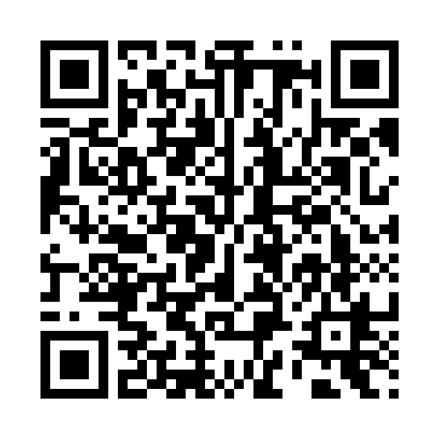
DZ ORCID AS QR

