Slide 1
Flexibility versus Specialization
Martin Solich
Marcel Bradtmöller
Álvaro Arrizabalaga
Aitor Calvo
Maria Jose Iriarte

Slide 2
Flexibility versus Specialization
1
Introduction
2
Theoretical Model
3
Simulation Model
4
Discussion
5
Outlook

Slide 3
Research Problem
1
Flexibility versus Specialization
Introduction
Gravettian technocomplex of the Western Pyrenees forms according to our knowledge a homogenous unit showing a broad bandwidth of local adaptation covering nearly 10.000 years (34.000-24.000)
For the same timeframe at least five global climatic events are expected to have had a significant effect on the environment of the Western Pyrenees

Slide 4
The Gravettian of the Western Pyrenees
2
Flexibility versus Specialization
Introduction
How have Gravettian hunter-gatherers been affected by the environmental fluctuation?

Slide 5
Research Problem
3
Flexibility versus Specialization
Introduction
The Gravettian hunter-gatherer society was relatively unaffected and had to be therefore highly resilient toward environmental fluctuations
Significant changes happened, that are not visible in the archaeological record. The Gravettian hunter-gatherers have actually been affected and were repeatedly forced to adapt to altered environments

Slide 6
Theoretical Model
Flexibility versus Specialization

Slide 7
Adaptation
0
4
Flexibility versus Specialization
Theoretical Model
Flexibility versus Specialization
Introduction
Behavioral Strategies of
Gravettian Hunter-Gatherers
System Properties?
Adaptive Cycles?
time

Slide 8
Behavioral Systems
0
5
Flexibility versus Specialization
Theoretical Model
Flexibility versus Specialization
Introduction
Individual Behavior
Connectivity
Resilience
Size
Interaction Strategies
Heterogeneity
Adaptation Capacity
Behavioral Patterns on Group and Society Level

Slide 9
Adaptive Cycles
0
6
Flexibility versus Specialization
Theoretical Model
Flexibility versus Specialization
Introduction
Exploitation (α)
Adaptation Process
Release (Ω)
Environmental Change
‘Dissolved’ System:
Autonomous and Flexible Subunits
Renewal (r)
System of highly interconnected Subunits Conservation (K)

Slide 10
Typology
0
7
Flexibility versus Specialization
Theoretical Model
Flexibility versus Specialization
Introduction
‚Opportunistic‘/Flexible HG
Specialized Hunter-Gatherer
Autonomous
Small Groups
Highly Mobile
Fluctuations in Group Size and Composition
Generalized Foraging Strategies
No or Low Territoriality
Strong Social Networks (quality against quantity)
Stable seasonal dependent Group Sizes and Compositions
Stronger interconnectivity of indiviuals
Higher Territoriality and lower Residential Mobility due to stronger interconnectivity to particular localities
Specialized Foraging Strategies

Slide 11
Models for the WP Gravettian
0
8
Flexibility versus Specialization
Theoretical Model
Flexibility versus Specialization
Introduction
connectedness
specialized
Flexible
Behavioral
Systems
flexible
time
The Flexibile Hunter-Gatherer
The Specialized Hunter-Gatherer

Slide 12
Simulation Models
Flexibility versus Specialization

Slide 13
Agent-Based Modeling
0
9
Flexibility versus Specialization
Simulation Model
Flexibility versus Specialization
Introduction
Simulating the behavior of ‘independent’ entities
Assumption: system dynamics emerge due to the interaction of agents
Spatially and temporally explicit
Spatial environment modeled by patch agents with own properties
Heterogeneous agents with different behavioral strategies
Modeling of dynamic social networks

Slide 14
General Assumptions
0
10
Flexibility versus Specialization
Simulation Model
Flexibility versus Specialization
Introduction
Agents representing hunter-gatherer Individuals
Primary goal of hunter-gatherers is to ensure regular food intake
Physical and natural Environment is represented by a 2-dimensional grid of ‘patches
Patches provide seasonal and climate-dependent resources

Slide 15
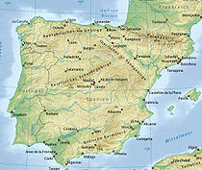
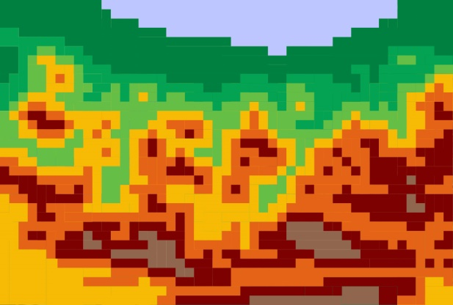
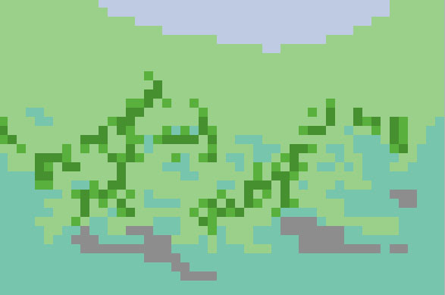
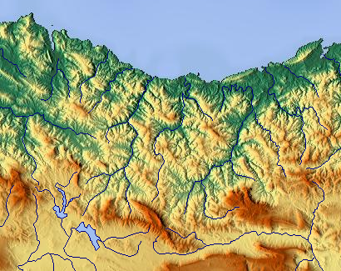
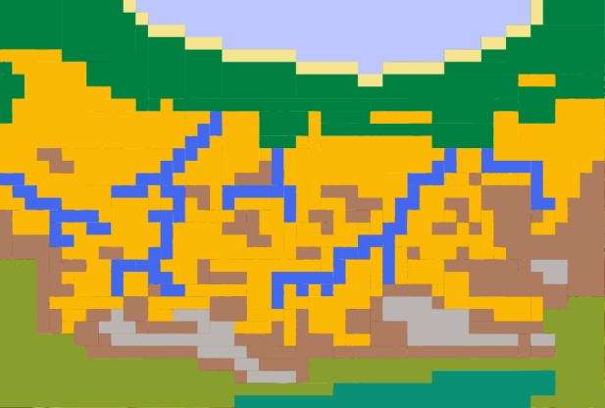
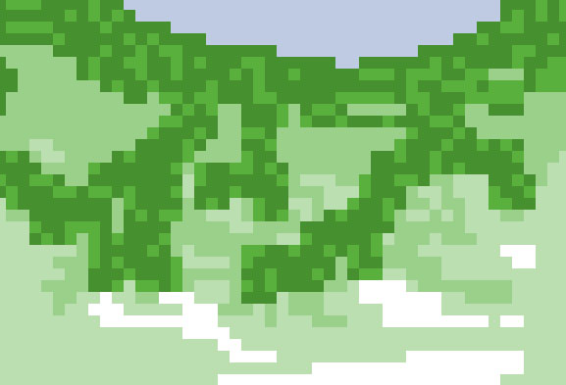
The Environmental Model
0
11
Flexibility versus Specialization
Simulation Model
Flexibility versus Specialization
Introduction

Slide 16
Differences
0
15
Flexibility versus Specialization
Simulation Model
Flexibility versus Specialization
Introduction
‚Opportunistic‘/Flexible HG
Specialized Hunter-Gatherer
Exploiting resources in a one-day moving range
Following specialized foraging, grouping and mobility strategy according to season
IF yes THEN move
Check if a better location in a one-day moving range is available
IF no THEN stay
How is the general food situation?
IF very good THEN consider to merge with another group
IF bad THEN consider to split
IF bad THEN relax specialization
IF good THEN check behavioral rule update
How is the general food situation?

Slide 17
The Process of Specialization
0
18
Flexibility versus Specialization
Simulation Model
Flexibility versus Specialization
Introduction
Specializations toward:
Social Relations
Local Areas
Resource Types

Slide 18
Implications
0
19
Flexibility versus Specialization
Flexibility versus Specialization
Introduction
Concerning the Theoretical Model
The Adaptive Cycle Model in general appears to be plausible in relation to behavioural system approach
Even simple simulation models addressing one dimension of connectivity demonstrate the emergence of unilinear and dynamic processes

Slide 19
Implications
0
20
Flexibility versus Specialization
Flexibility versus Specialization
Introduction
Regarding Western Pyrenees Gravettian
The bad news: very different scenarios are actually possible and current data could reflect adaptive cycles
The good news: Simulation models reveal probabilities for specific land-use strategies. Example: East-West movements of nomadic small group hunter-gatherers versus South-North movements of specialized river valley occupants

Slide 20
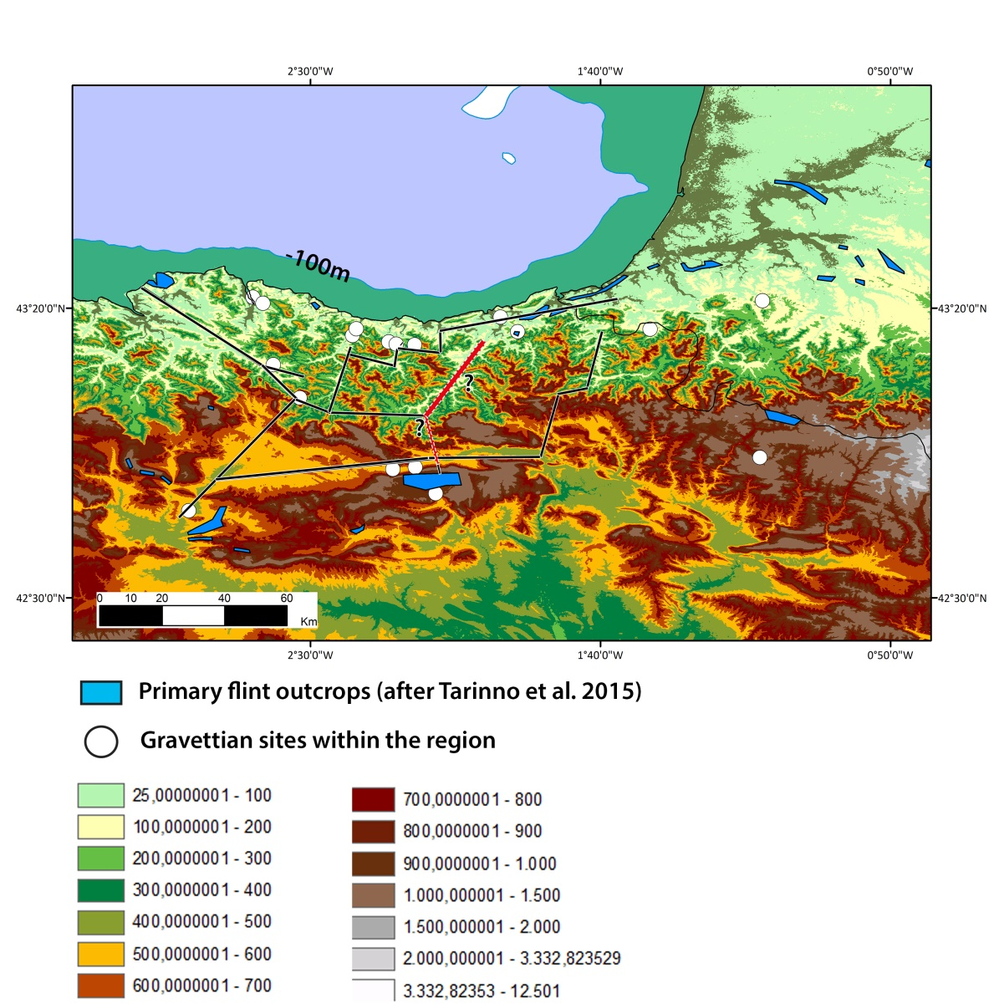
Outlook
0
21
Flexibility versus Specialization
Flexibility versus Specialization
Introduction

Slide 21
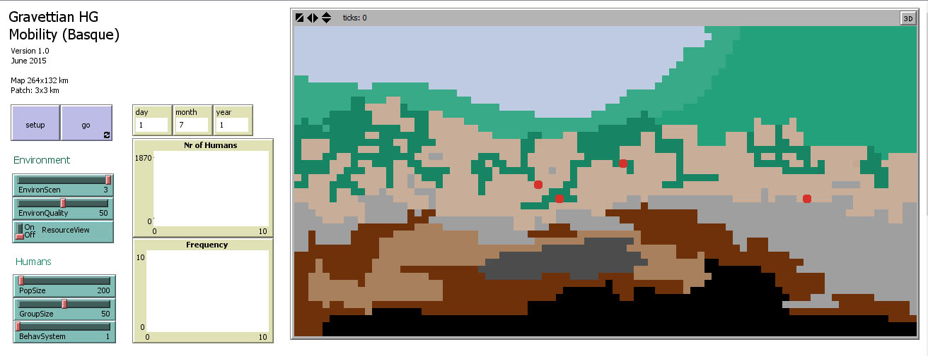
Outlook
0
22
Flexibility versus Specialization
Flexibility versus Specialization
Introduction

Slide 22
„Essentially, all models are wrong, but some are useful.“ George E. P. Box (1919-2013) Thank You

Slide 23
Flexibility versus Specialization
Martin Solich
Marcel Bradtmöller
Álvaro Arrizabalaga
Aitor Calvo
Maria Jose Iriarte

