Slide 1
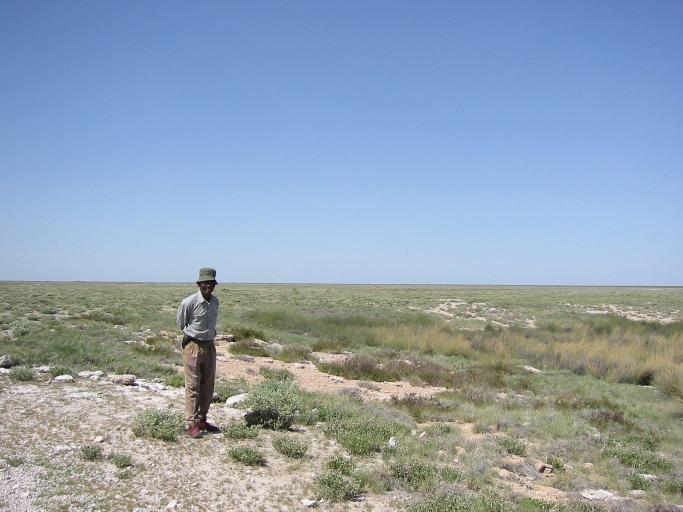
Cultural mapping with Hai||om in the Etosha National Park, Namibia
Harald Sterly (University of Bonn)
Ralf Vogelsang (University of Cologne)
Ute Dieckmann (University of Cologne)
Kickoff Workshop CRS 806 / E3
Perspectives on spatial mobility of hunter-gatherers
Cologne, 15.12.2017

Slide 2
Roadmap
Background and purpose: why cultural mapping in Etosha?
Mapping what? What kind of mapping?
Outputs and Outcomes
Reflections

Slide 3
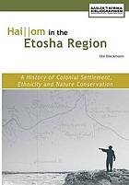
Background: documenting Hai||om cultural heritage in Etosha
Research project at University of Cologne (PhD project Dr. Ute Dieckmann), University of Cambridge, Hai||om elders
(seemingly objective) linguistic & geographic representations
Rich cultural history,
Etosha = “Cultural Landscape“
Elandsdraaikoppie
Olifantsbad
Gemsbokvlakte
Leeubron
Halali
…
https://honeyguidepublications.com/wp-content/uploads/2017/02/Etosha-National-Park.png

Slide 4
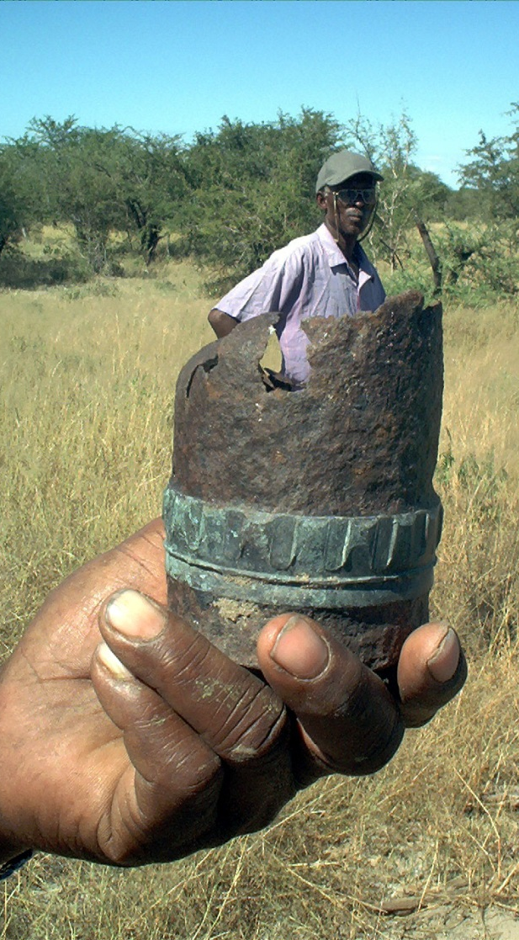
Background: documenting Hai||om cultural heritage in Etosha
Cultural mapping of Etosha (~2000-2003)
Project funded by British NGO Openchannels and ComicRelief; Ute Dieckmann/University of Cologne, with the Working Group of Indigenous Minorities in Southern Africa (WIMSA) and Strata360 (Canada)
Objective: assessing and documenting the Hai||om cultural and environmental heritage of the Etosha National Park and its surrounding area
Later (~2003) turned into “Xoms |Omis Project” (“Etosha Heritage Project”), now managed by the Legal Assistance Centre (LAC) in Windhoek

Slide 5
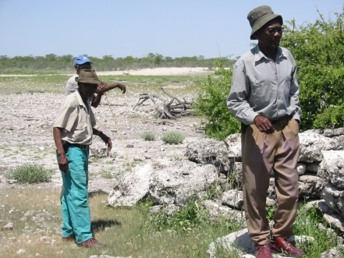
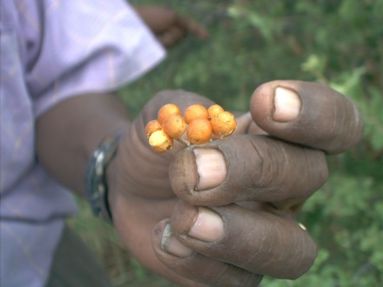
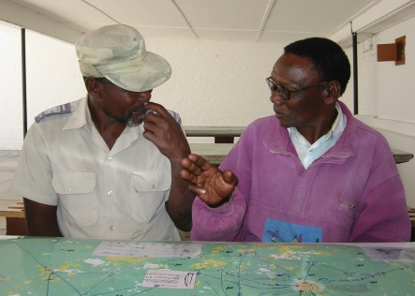
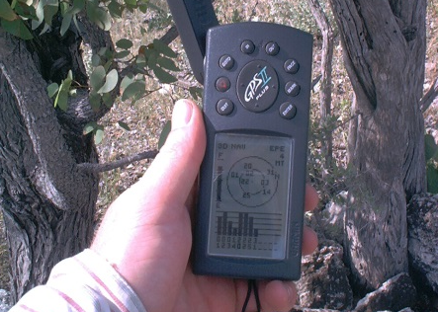
Mapping what? And what kind of mapping?
Landscape features, material artefacts
Plant & animal resources: position/ seasonality
Places, territories
Seasonal mobility
Exchange relations
Life trajectories
Placenames
Meaning, myths
Stories
Mapping practices:
Archeological data collection
GPS data
Photographs
Joint field visits/explorations
Interviews
Recordings (songs, stories)
Discussing map results
Structures
Practices
‘Meaning‘
Sources: Dieckmann 2004, Sterly 2002

Slide 6
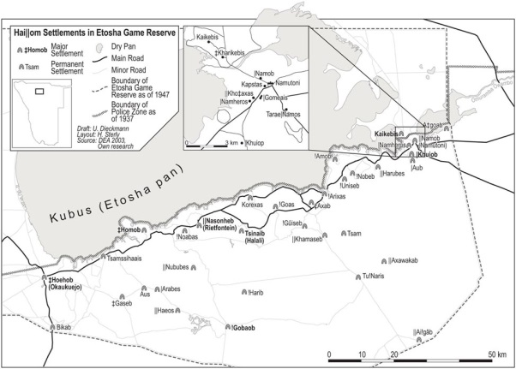
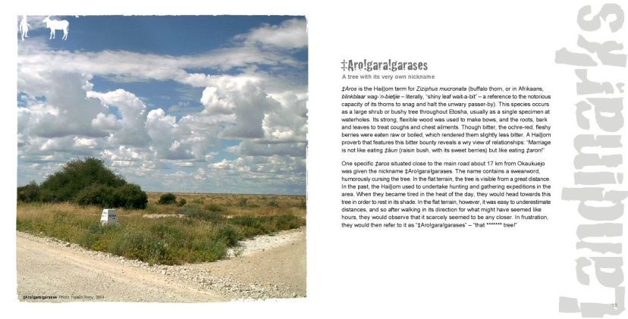
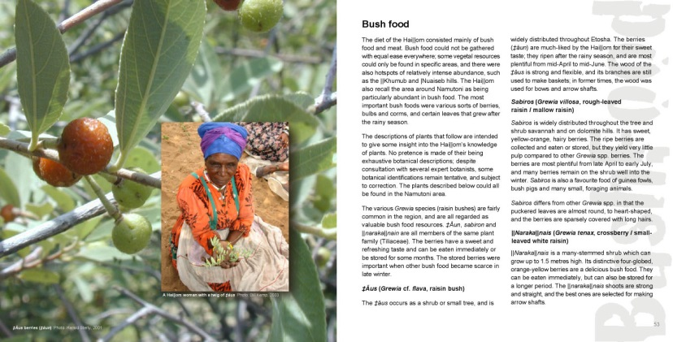
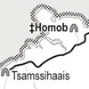
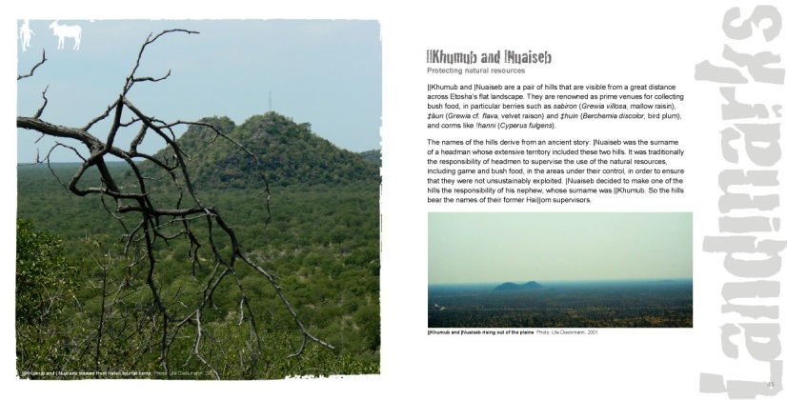
Outputs
Forms of representation
(databases, publications)
Name maps
Resource maps
(seasonal) Mobility maps
Life trajectory maps
Representation strategy
Display of map posters (in tourism information, exhibition for 100yrs celebration)
Booklets
T-Shirts, postcards
website

Slide 8
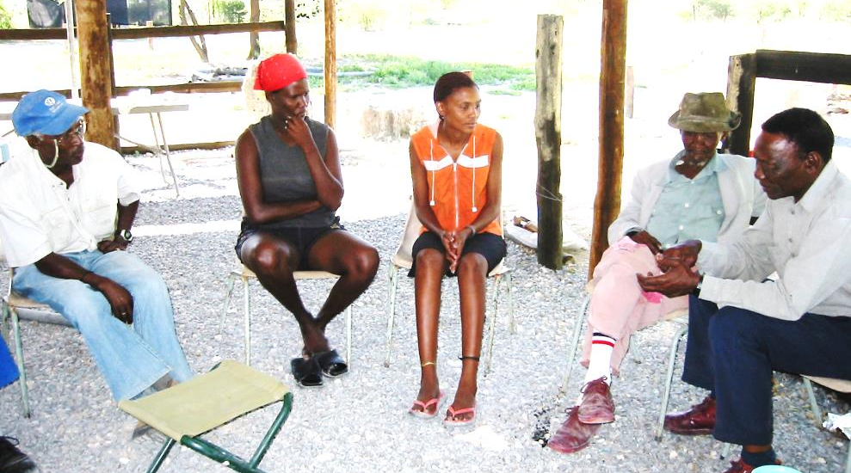
Outcomes
Mapping practices (visiting, storytelling, singing&dancing, “re-discovering“ places):
Re-focussing of attention on (value of) cultural history
Rasing of interest + involvement of the younger generation
Mapping products
Reports in newspapers and travel blogs on the cultural heritage → slightly better representation
Some conflicts in the Hai||om community over legitimacy of “belonging“ to “Etosha Hai||om“
Database (places, settlements, resources, etc.): employed in (potential) land claims through LAC
Sources: Dieckmann 2004

Slide 9
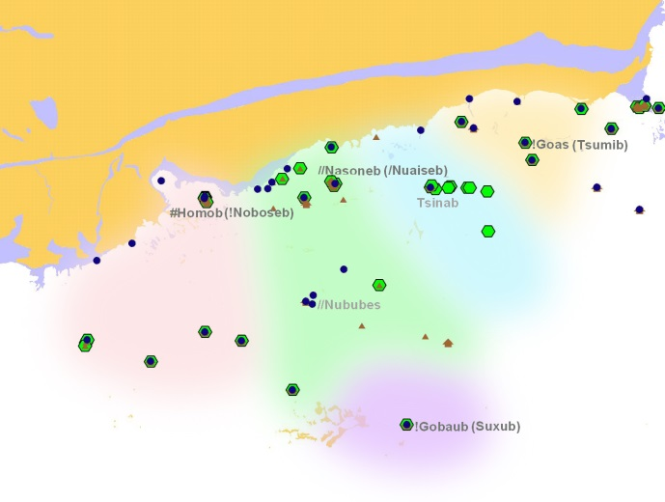
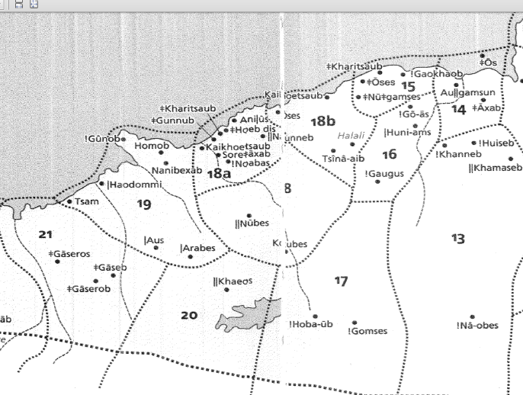
Reflections
Ontological: What do/can we map (put on a map)? What is space? What is a landscape? A territory?
cognition of space (language & social practices, e.g. ego- /geo-centric; ‘topo-graphical gossip‘, cf Widlok 1997, mobility)
Whose ontology? (e.g. spirits, meaning)
Epistemological: How can we map it? How to categorize a rich inventory of spatial knowledge, practices, meaning?
not all places can be (easily) mapped (=represented) with ‘our‘ systems: material objects, social structures, practices, stories, imaginations, …
Stability over time?
Territoriality + boundaries
?
Sources: Xoms |Omis project, Friedrichs
Notes:
Well what can be mapped what is there to the world so we have an ontological question here
To some extent the things that we want to map our
There are things that we want to map that we can classify as natural material features, things, e.g. springs and landscape features.
Then there are material features that are products of human activities and social practices, e.g. houses, streets, stone heaps.
And then there's space and place that is socially and culturally produced - meaning it is no less existing - e.g. administrative areas, territories
Then there is space & places constituted through daily or otherwise patterned practices structuring space and producing places;
These depend to certain extent on continuous reproduction, through talk, movement, etc.
And we are really good in doing that for material objects and social constructions with distinct extent and unequivocal membership to ontological categories and that are stable in time; e.g. streets, houses, administrative boundaries; we’re not so good in doing that for things that have unclear boundaries, overlapping memberships; this is because our systems (and their epistemologies) are designed for capturing, storing and representing things from our ontological sphere;
There are lots of making practices that we did not attempt to map at all, maybe it is not even possible to do this , unless you would be equipped with lots of resources and time.

Slide 10
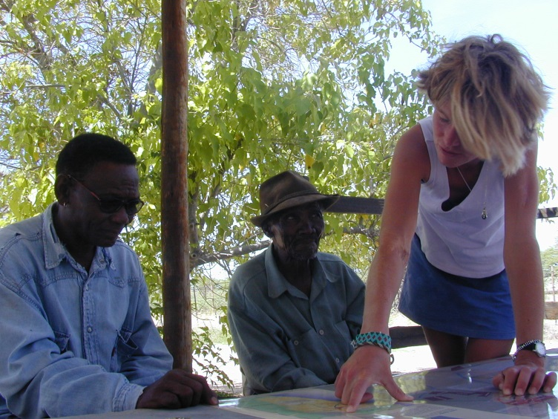
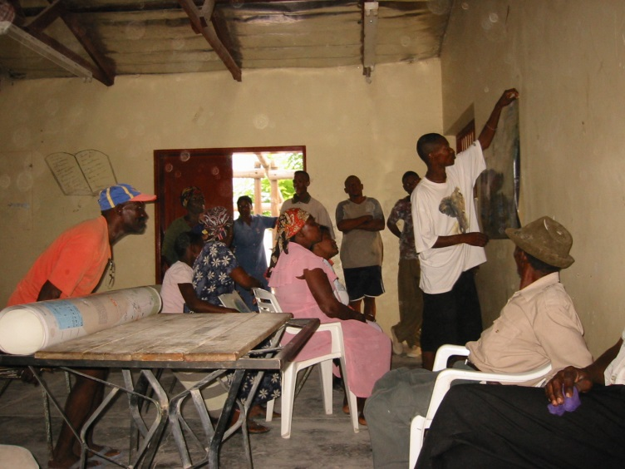
Reflections
Ethical:
What is represented: mapping --- and essentializing --- a unitary and static ‘Hai||om culture‘?
Whose knowledge is really represented: heterogeneity, conflicts, interests of different groups – whose maps, whose emancipation?
Roles - how to drive such a process without patronizing the stakeholders?
Separation/unity of nature and culture: ontological question, but also ethical: resource use, sustainability
Positionality / relation of humans, nature, animals: ‘the lion is our colleague‘ (Jan Tsumeb)
Sources: Dieckmann 2004, Sterly 2002
Notes:
Well what can be mapped what is there to the world so we have an ontological question here
To some extent the things that we want to map our
There are things that we want to map that we can classify as natural material features, things, e.g. springs and landscape features.
Then there are material features that are products of human activities and social practices, e.g. houses, streets, stone heaps.
And then there's space and place that is socially and culturally produced - meaning it is no less existing - e.g. administrative areas, territories
Then there is space & places constituted through daily or otherwise patterned practices structuring space and producing places;
These depend to certain extent on continuous reproduction, through talk, movement, etc.
And we are really good in doing that for material objects and social constructions with distinct extent and unequivocal membership to ontological categories and that are stable in time; e.g. streets, houses, administrative boundaries; we’re not so good in doing that for things that have unclear boundaries, overlapping memberships; this is because our systems (and their epistemologies) are designed for capturing, storing and representing things from our ontological sphere;
There are lots of making practices that we did not attempt to map at all, maybe it is not even possible to do this , unless you would be equipped with lots of resources and time.

Slide 11
Conclusion/ Food for thought
current approaches for Q(ualitiative) GIS, e.g. in elderly care (e.g. Mennis et al. 2013), or social work (e.g. Teixeira 2016)
example of ‘countermapping‘: production of alternative representations
participatory mapping as an emancipatory act: meaningful for stakeholders, impactful
essentializing maybe rather fluid conceptualizations; replacing one ‘objective representation‘ by another?
Ontology & epistemology,
(methodology)
Our role as researchers?
For whom? (un)intended impacts?
truthfulness, responsibility?

Slide 12
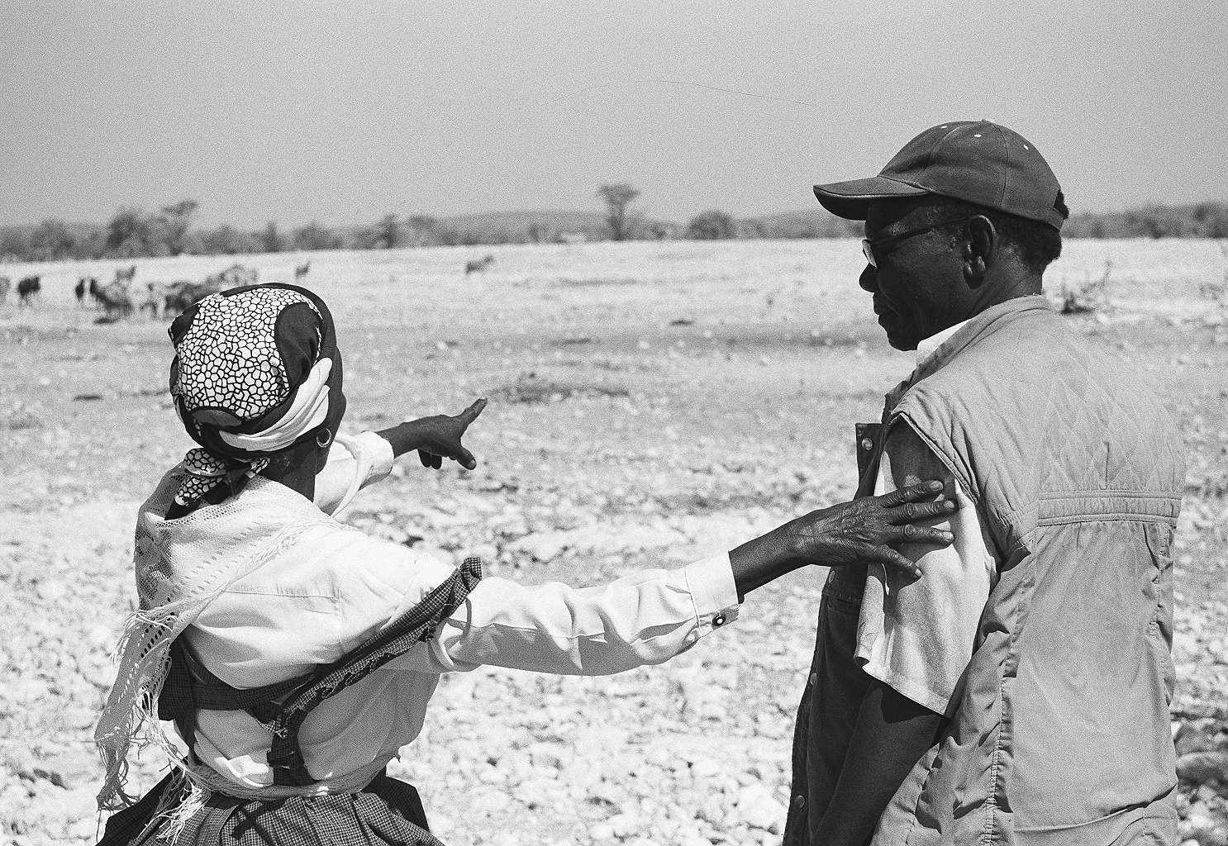
Thank you
Photo: Dieckmann 2004

Slide 15
Bagheri, N. (2014): What qualitative GIS maps tell and don't tell: insights from mapping women in Tehran's public spaces. Journal of Cultural Geography 31(2): 166-178. doi: https://doi.org/10.1080/08873631.2014.906848
Mennis, Mason, Chao (2013): Qualitative GIS and the Visualization of Narrative Activity Space Data. Int J Geogr Inf Sci. 2013; 27(2): 267–291. Published online 2012 Jul 3. doi: 10.1080/13658816.2012.678362
Cope, M., Elwood, S. (2009): Qualitative GIS. A Mixed Methods Approach. Sage.
Milton, S., Pliakas, T., Hawkesworth, S., Nanchahal, K., Grundy, Ch., Amuzu, A., Casas, J-P., Lock, K. (2015): A qualitative geographical information systems approach to explore how older people over 70 years interact with and define their neighbourhood environment. Health & Place 36, doi: https://doi.org/10.1016/j.healthplace.2015.10.002
M.-P. Kwan, G. Ding Geo-Narrative: extending geographic information systems for narrative analysis in qualitative and mixed-method research Prof. Geogr., 60 (4) (2008), pp. 443-465
Geo-ethnography: coupling geographic information analysis techniques with ethnographic methods in urban research Cartograph.: Int. J. Geogr. Inf. Geovis., 40 (4) (2005), pp. 75-90
Jeremy Mennis , Michael J. Mason & Yinghui Cao : Qualitative GIS and the visualization of narrative activity space data; International Journal of Geographical Information Science Volume 27, 2013 - Issue 2 https://doi.org/10.1080/13658816.2012.678362
Qualitative Geographic Information Systems (GIS): An untapped research approach for social work : Samantha Teixeira: First Published June 16, 2016 ; https://doi.org/10.1177/1473325016655203

