Slide 1
Narratives of Decision Making in Trading Advice Literature
Prof. Dr. Helene Basu, Ethnologie / Social Anthropology

Slide 2
Decision Tree

Slide 3
Outline
The Field of Financial Markets – Arena of Decision Making
Popular Trading in Germany
Narratives of decision making by Claus Gerdes and Alexander Elder
The Decision Tree – Two readings

Slide 4
Field of Financial Markets – Practices of Speculation
Banks, Pension Funds, States, Insurance corporations, more or less wealthy families/individuals
Investors controlling different amounts of capital
Professional traders employed by banks, Hedgefonds etc., Self-employed professional traders,
Traders: professional & amateurs
Life-ticker, trading desks & charting software, chatrooms, sentiment index etc.
Digital Technologies
amateur traders, ‚self-deciders‘
Circulating Knowledge:
Theories of market
efficiency,
Behavioural Finance,
Biological Finance, etc.

Slide 5
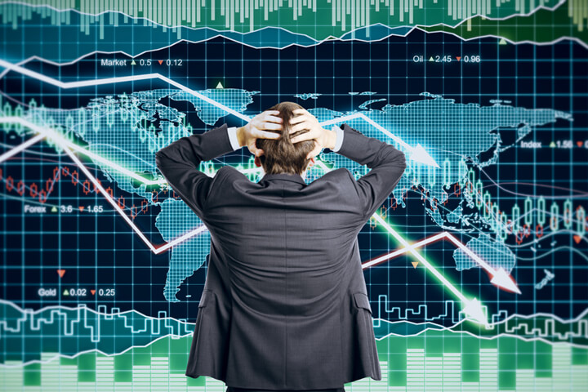

Slide 6
Narrators
Alexander Elder, USA
Claus Gerdes, Germany

Slide 7
Emotional Capital - Emotional Intelligence
Self-Awareness
Control of Emotions
Management of Interpersonal Relationships

Slide 8
Lack of emotional intelligence – loss aversion
„A loser cannot cut his losses quickly. When a trade starts going sour, he hopes and hangs on. He feels he cannot afford to get out, meets his margin call, and keeps hoping for reversal. His paper loss grows until what seemed like a bad loss starts looking like a bargain. Finally, his broker forces him to bite the bullet and take his punishment. As soon as he gets out of a trade, the market comes roaring back“ (Elder 1993: 255).

Slide 9
Elder‘s Experience
“Learning to trade has been a long journey – with soaring highs and aching lows. In moving forward – or in circles – I repeatedly knocked my face against the wall and ran my trading account into the ground. Each time I returned to a hospital job, put a stake together, read, thought, did most testing, and then started trading again.” (1993: 2).

Slide 10
The trader and the market according to Elder
Der Markt hypnotisiert die Trader wie ein Magier, der eine Schlange hypnotisiert, indem er seine Flöte rhythmisch auf und ab bewegt. Je schneller die Kursbewegungen sind, umso stärker werden die Gefühle. Je emotionaler ein Markt ist, umso mehr verliert er an Effizienz...
Elder 2005, 20)
The market is among the most entertaining places on the face of the Earth
Trading is the most dangerous human endeavor, short of war
Your success or failure in the market depends on your thoughts and feelings. It depends on your attitudes towards gain and risk, fear and greed, and how you handle the excitement of trading and risk.

Slide 11
Skirting the dangers posed by the market
Turning emotional intelligence into intelligent trading
Strategic decision-making to circumvent the hypnotic pull of the market
Control of greed and fear
Ability to discriminate between the trader‘s self & the market
Control of emotions → control of money management

Slide 12
Elder, Come into My Trading Room (German translation)
„Ein reifer Trader holt sich sein Geld aus dem großen Loch in der Theorie des effizienten Marktes, der Annahme, dass Investoren und Trader rationale Menschen sind. Die meisten Menschen sind nicht rational – nur die Gewinner.“ (p. 20)

Slide 13
Trading Goal: Self-realization & self-improvement
Elder
Gerdes
“The goal of a good trader is not to make money, his goal is to trade well… Trying to reach their personal best is more important to them than making money.”
(1993/2012: 11-12)
“Wir haben (...) Trading als Meditation genutzt und uns dabei beobachtet. Wir haben über uns und die anderen Trader viel gelernt. Wir geben das gern weiter. Das gibt uns ein noch besseres Gefühl als der Gewinn von Geld... Unser letztendliches Ziel: Das Genie freisetzen“ (2013: e-book, Pos. 125; 140)

Slide 14
Flawed emotional intelligence of amateur traders
Lack of self-awareness / lack of management of emotions
Impulsive trading, no trading plan (money management, risk control)
Feelings of anxiety, elation or humiliation before/during/after a trade
Search for thrill, seeking to overcome individual psychological conflicts/crisis
Confounding trading with gambling
Addiction
Putting blame for failure on others

Slide 15
Decision-Making Tree
(according to A. Elder)
Step 8: Decision & Record keeping
Step 7: Tactic decisions:
Where to buy? Profit target? Stop loss? Etc....
Step 9: Continue to monitor the market...
Step 6: Strategic decision:
Bull? Bear? Undecided?
Step 5: Define time-frame
Day/week/month
Step 3: Find instruments according to your market assessment
Buy
sell
Step 4: Analyze instrument for risk
reward
Step 2: Am I
Bullish?
Bearish?
Step 1: Money Management: Does the 6% rule allow me to trade?
No? → go to papertrade
Yes? → go to step 2

Slide 16
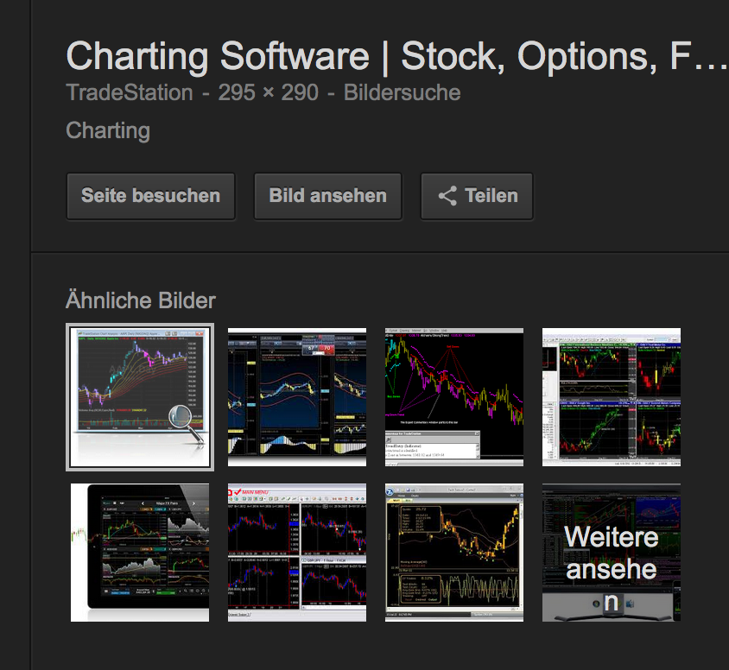
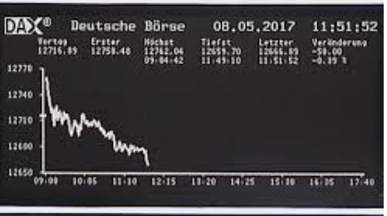
Muted actors – Distributed decision making
The market:
Charting software
Financial instruments: stocks, funds, derivatives, futures etc. :
A trader / embodied mind
Capital

Slide 17
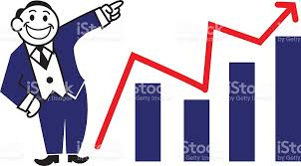
Thank you for your attention!

