Slide 1
Agent-Based Modeling of
Hunter-Gatherer Adaptive Strategies
Inside-
Outside
Workshop
2016
Cologne
Martin Solich
Marcel Bradtmöller

Slide 2
Introduction
“Integrating Spatial Contexts”
Spatial Context: topography, potential resource sources, neighboring sites showing human activities
Aimes of the Presentation
Argue for the importance of regional perspectives to get a better understanding about wider socio-ecological contexts and dynamics
Discuss a theoretical and an associated methodological approach to describe and analyze regional-scale and long-term socio-ecological dynamics to embedd local findings (from cave and open air sites) into larger contexts
Notes:
Expecting that focusing on site-specific archeological records is very limited in tell us much about
Drawing conclusions from catchment areas and land-use strategies

Slide 3
Hunter-Gatherer Societies as Complex
Adaptive Systems
1
The Case of
Northern Iberia Gravettian
2
Modeling
Adaptive Hunter-Gatherer Societies
3

Slide 4
Hunter-Gatherer
Societies as
Complex Adaptive
Systems
1

Slide 5

Hunter-Gatherer Adaptation
0
1
Adaptation reflected in efficient or even optimal behavioral strategies of individuals for a given environment
Towards optimality tending adaptive behavioral strategies are driven by:
  (1) evolutionary - evolved cognitive capacities to compare potential outcomes and/or
  (2) cultural trait selection
Adaptation as a individual-, group- and society-level process
Group and/or society-level properties coordinating human behavior
Institutionalization of social or human-nature interactions resulting in an increasing efficiency and/or a higher resilience

Slide 6
Complex Systems
0
1

Slide 7
Complex Adaptive Systems
0
1
Negative
Feedback
(e.e. loosing flexibility)
e.g. Cultural Institutions
affecting Behavioral Strategies
Positive
Feedback
(e.g. increasing efficiency)
Emergent
Properties
Intensification of Interaction Relations (usually specialization)
under Conditions of Predictability

Slide 8
Adaptation = Specialization?
0
1
‚Opportunistic‘/Flexible
Hunter-Gatherers
Specialized Hunter-Gatherer
Strong Social Networks (quality against quantity)
Stable season-dependent Group Sizes and Compositions
Stronger interconnectivity of indiviuals
Higher Territoriality and lower Residential Mobility due to stronger interconnectivity to particular localities
Specialized Foraging Strategies
Autonomous
Small Groups
Highly Mobile
Fluctuations in Group Size and Composition
Generalized Foraging Strategies
No or Low Territoriality

Slide 9
The Case of Northern Iberia
Gravettian
2

Slide 10
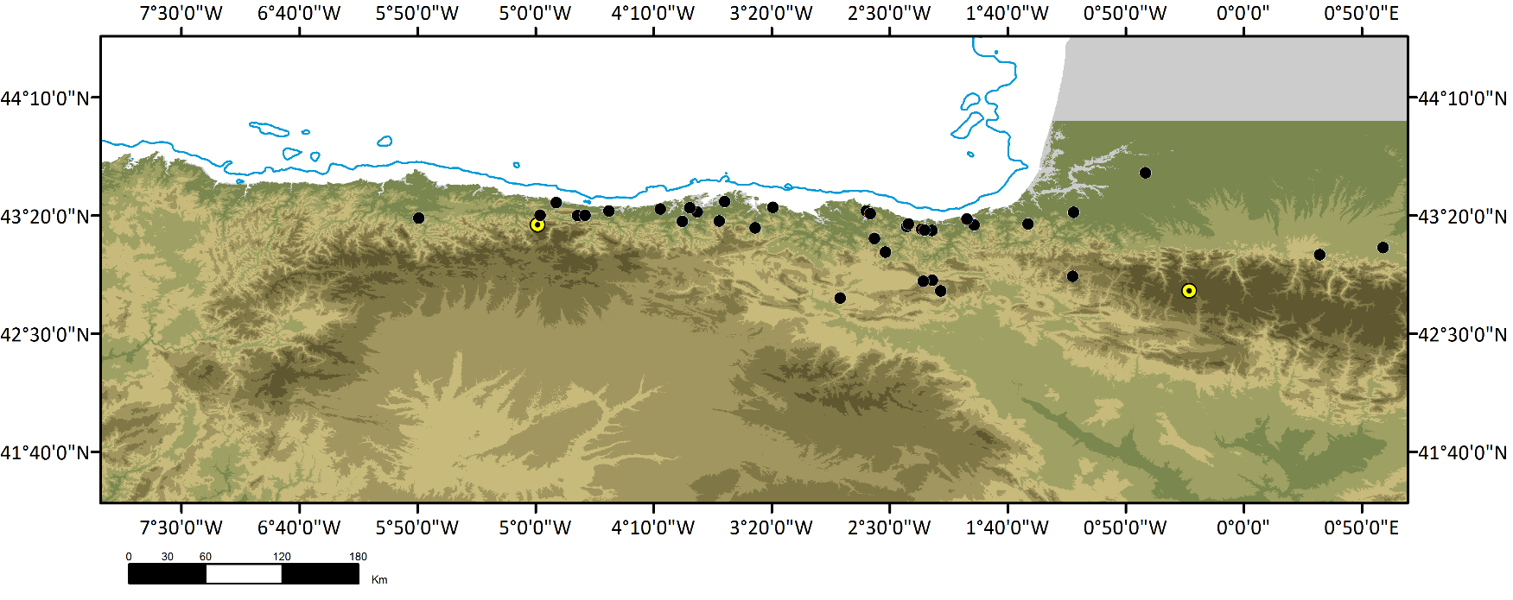
0
2
Northern Iberia Gravettian
Central Part
(Cantabria, Asturias)
Western Pyrenees
- 35 Sites in total
- 7 open-air sites
- 28 caves/ rockshelters
- ~ 60 Level
Notes:
The Gravettian technocomplex of the Cantabrian Region forms a homogenous unit covering nearly ~10.000 years. It´s archaeological legacy, especially the lithic material, exhibit a high degree of homogeneity concerning the diversity of technological organization or the appearance of distinct tool types. However, a deeper investigation of the internal variability or the diachronic investigation of settlement systems or other behavioural strategies is hampered by the preliminary character of many studies and especially the limited ¹⁴C chronology.

Slide 11
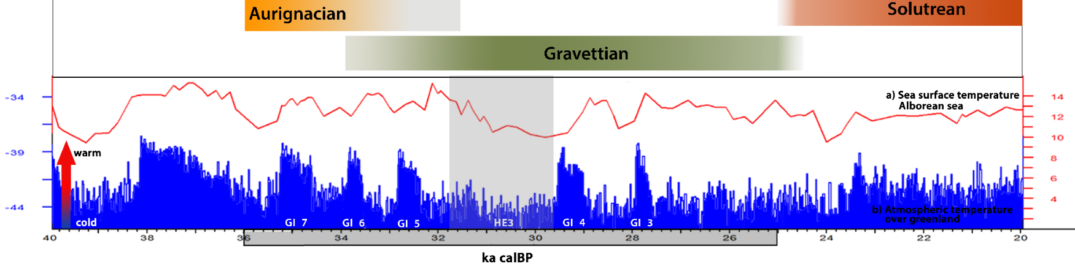
0
2
Northern Iberia Gravettian
- 60 ¹⁴C dates in total
- 42 AMS
Notes:
Of further importance, is that timeframe of our study covers at least five global climatic changes, which had most likely exerted a strong influence to the living conditions in the Cantabrian region.
Dansgaard Oeschger and Heinrich Event 3 = major ice-rafting dynamics

Slide 12
0
2
Situation
Gravettian technocomplex of the Cantabrian Region forms according to our knowledge a homogenous unit showing a broad bandwidth of local adaptation covering nearly 10.000 years (34.000-24.000)
For the same timeframe at least five global climatic events are expected to have had a significant effect on the environment of the Cantabrian Region

Slide 13
0
2
Question
(How) have Gravettian hunter-gatherers been affected by the environmental fluctuation?

Slide 14
0
2
Different Possible Scenarios

Slide 15
Two Hypotheses
0
2
The Gravettian hunter-gatherer society was relatively unaffected and had to be therefore highly resilient toward environmental fluctuations
Significant changes
happened, that are not clearly visible in the archaeological record. The Gravettian hunter-gatherers have actually been affected and were repeatedly adapting to altered environments- lower resilience

Slide 16
Modeling
Adaptive
Hunter-Gatherer
Societies
3

Slide 17
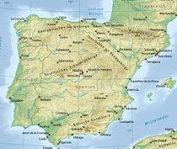
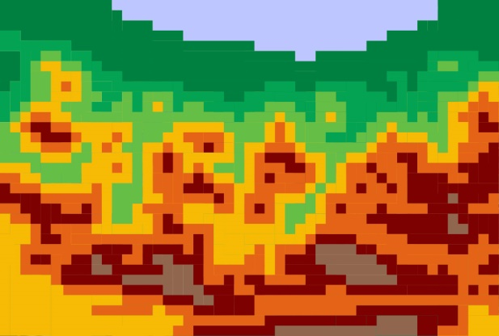
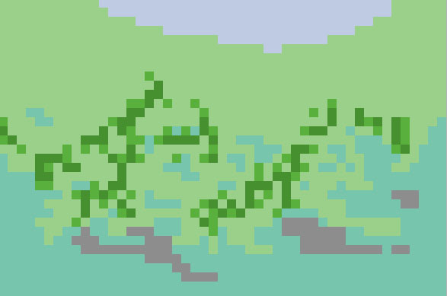
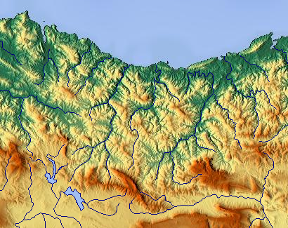
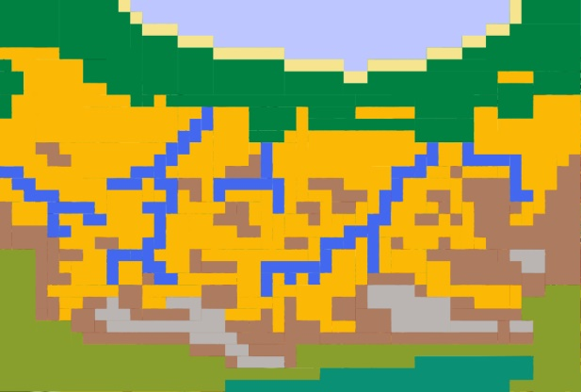

0
3
Modeling Environments
Vegetation Cover
Stadial – Interstadial Conditions
Topography
Eco Zones

Slide 18
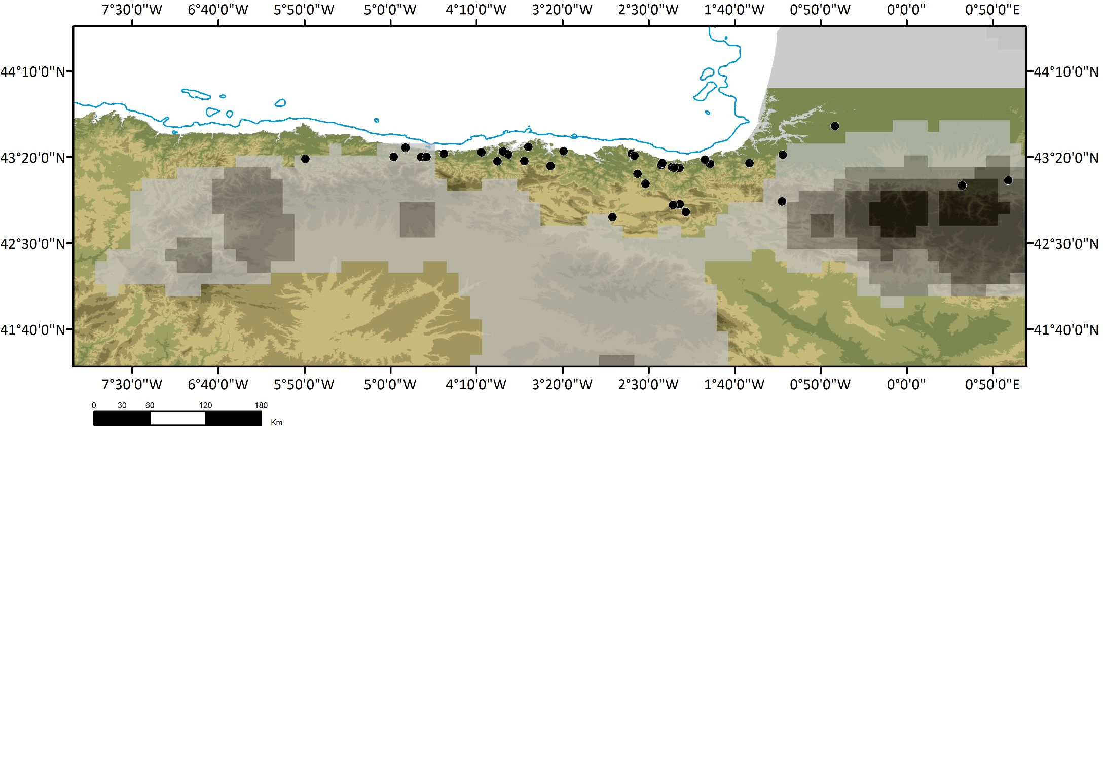
0
3
Environmental Data
90-120d
60-90d
Notes:
This alteration between stadial and interstadial conditions become also obvious with the reconstructed value for days of snow cover per year, which likely limited thethe human Settlement area especially for the colder months of the year

Slide 19
0
3
Modeling Environments
Topography
Vegetation Cover
Stadial–Interstadial Conditions
Eco Zones

Slide 20
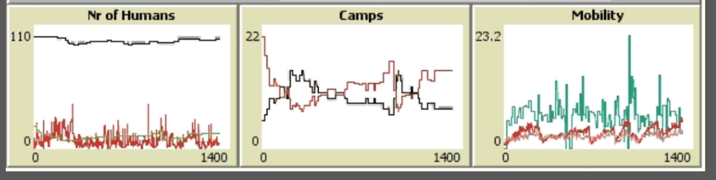
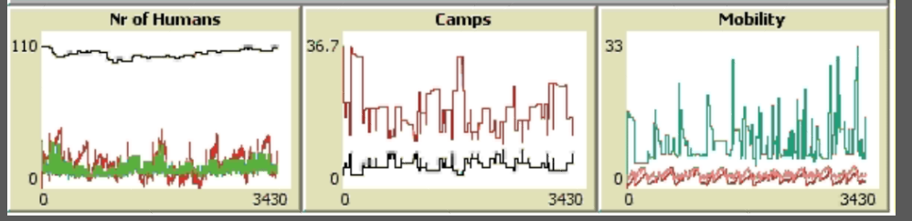
0
3
Simulating Scenarios
Testing scenarios of interstadial–stadial changes
Agents
representing
‘flexible’
hunter-gatherers
Agents
representing ‘specialized’
hunter-gatherers
Notes:
Small groups residential mobility

Slide 21
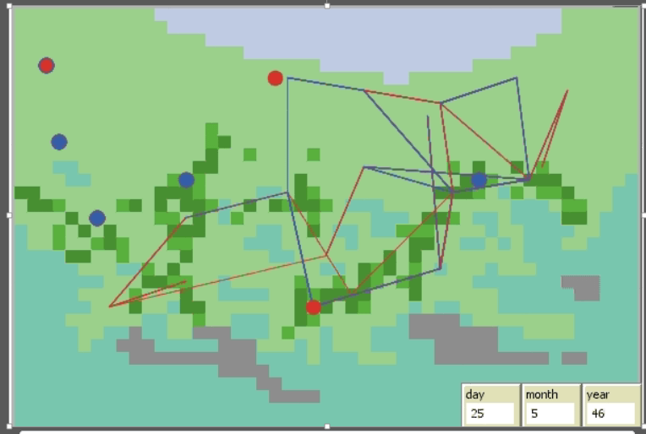
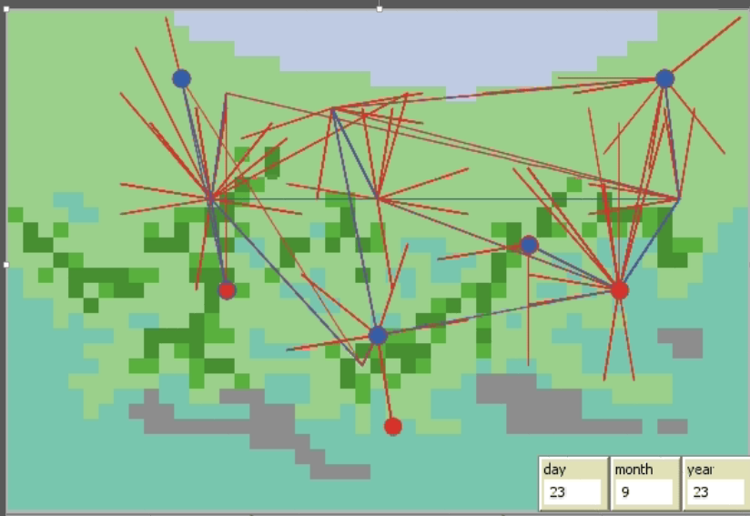
0
3
Emerging Mobility Patterns
Agents representing ‘flexible’ hunter-gatherers
Agents representing ‘specialized’ hunter-gatherers

Slide 22
0
3
Advantage of
Regional-Scale Modeling
Cave sites provide the most important archaeological source
Open air sites, exposed to harsher erosion conditions or covered under alluvial sediments, are more difficult to be identified and can rarely compete
Nevertheless, open air sites probably have been the quantitatively most relevant form of residence
Advantages of regional-scale agent-based simulation models
Modeling of archaeological – until now - not detectable open field sites
Accounting complex locally diversified land-use strategies and systems considering cave and open-field sites

Slide 23
Arrizaba
0
3
Back to the Archaeological Data
Ametzagaina- Arrizabalaga et al. 2014
Morín - Bradtmöller 2015

Slide 24
Summary
Why does it makes sense to consider always the ‚bigger‘ picture?
(1) Embedding local conditions and actions within wider relevant affecting systems. (2) More independence regarding local particularities.
How can archaeological interpretations benefit from Complex Adaptive System theory?
(1) To understand prehistorical phases of change and stability.
(2) Shifting attention towards general processes and dynamics.
(3) Providing an useful working concept/language (e.g. adaptive cycles, positive and negative feedback).
How can Agent-Based Modeling support archaeological interpretations?
(1) The description and analysis of complex systems requires computational support, (2) ABM provides a fantastic sandbox to conduct experiments to test hypotheses

Slide 25
Agent-Based Modeling of
Hunter-Gatherer Adaptive Strategies
Inside-
Outside
Workshop
2016
Cologne
Martin Solich
Marcel Bradtmöller

