Slide 1
Anthropological Approaches to Decision-Making
Michael Chibnik
Professor of Anthropology Emeritus
University of Iowa
Iowa City, Iowa, USA

Slide 2
First longer part of talk
Historical overview of anthropological approaches to decision-making
Includes discussion of approaches by economists and cognitive psychologists
Anthropologists have adopted some of these methods from other fields
Anthropological approaches have sometimes been reactions against approaches in these fields

Slide 3
Second shorter part of talk
Brief discussion of issues associated with looking at decision-making among foragers
Most (but far from all) anthropological research on choice has been among people involved to some extent in market societies (as are some foragers nowadays)
Not all the methods used in such research work well for foragers, especially those with little or no contact with markets

Slide 4
My background
Economic anthropologist – principal interest in decision-making and work organization
Most recent book (Anthropology, Economics, and Choice) detailed comparison of approaches to decision-making among anthropologists, economists, and cognitive psychologists
Fieldwork 1970s in Belize and 1980s in the Peruvian Amazon among people primarily small-scale farmers, 1990s to present among people primarily artisans in Oaxaca, Mexico, also various small projects in the US
No fieldwork experience with foragers
Editor-in-chief, American Anthropologist, 2012-2016

Slide 5
Prior to 1955 or so
Relatively little attention by anthropologists to decision-making
Assumption that much behavior (including decision-making) prescribed by “culture”
More attention to norms than behavioral variations (such as those resulting from differences in decisions)
Less research than now on economic and environmental anthropology – subfields in which decision-making is central

Slide 6
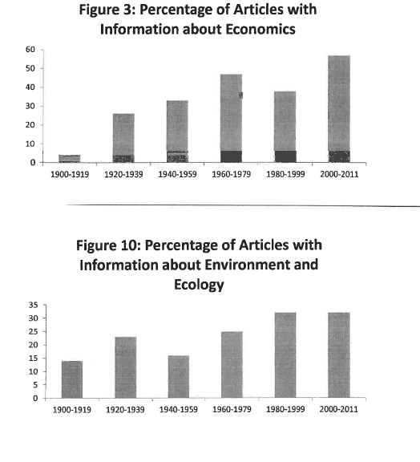
Articles in American Anthropologist

Slide 7
Formalists and Substantivists in Economic Anthropology – late 1950s to about 1980
Formalists thought methods from economics – in particular “rational choice” could be applied to all socieites, including those without markets
Substantivists thought choice in all societies (perhaps especially nonmarket societies) were “embedded” in social organization and “culture”

Slide 8
Influence of Formalists in anthropology
Directly influenced model-based mathematical approaches based on rational choice such as optimal foraging theory
Indirectly influenced critiques of rational choice and development of alternative quantitative empirical methods and topics such as decision trees, heuristics, and economic experiments

Slide 9
Similarities between substantivists and some subsequent anthropological approaches deemphasizing choice
Substantivists – limited direct influence on subsequent research
But two approaches share substantivists’ de-emphasis of decision-making
“culturalists” such as Marshall Sahlins and Mary Douglas – look at how choices are constrained by cultural ideologies
World systems theorists/dependency theories/globalists such as Eric Wolf and Sidney Mintz looking at how economic and political relations between “centers” and “peripheries” constrain choice

Slide 10
Rational Choice
Based on “expected utility”
Assumption that decision-makers are able to make approximations of the expected utilities (payoffs) associated with alternative choices
Basic idea – individuals select the option that provides the greatest expected utility

Slide 11
Problems with Rational Choice - Utility
How can utility be measured or observed?
Multiple goals
Combining different types of outcomes (e.g. money, physical pleasure or pain, time away from home) into a single measure of utility

Slide 12
Problems with rational choice – estimating probabilities of different outcomes
Do people really estimate such probabilities when making most decisions?
Even if they do try to make such estimates, how good are they at that?
Many probabilities are difficult to estimate (e.g. chances of a new restaurant being “successful”)

Slide 13
Other problems with rational choice
Short-term vs long –term
Who makes decisions (unit of analysis) – individuals? Groups? What happens when people in a group disagree?

Slide 14
Cognitive Psychology
Since late 1960s, cognitive psychologists have shown (at least in laboratory experiments) are not good at making the probabilistic judgments required by rational choice theorists
Instead people use “heuristics” (rules of thumb)
Daniel Kahneman – 2002 Nobel Prize, based on experiments with Amos Tversky
Good recent popular book by Michael Lewis about their collaboration (The Undoing Project: A Friendship That Changed Our Minds)

Slide 15
Two issues associated with cognitive psychology
To what extent can the results of laboratory experiments be extrapolated to real-life decision-making?
Perhaps many heuristics are reasonable – being “selected for” over time (a view many anthropologists have taken)

Slide 16
Influence in anthropology by cognitive psychologists (starting in 1970s)
Attempt to elicit heuristics (Naomi Quinn on women market fish in Ghana; Allen Johnson on crop choices)
Decision trees and flowcharts

Slide 17
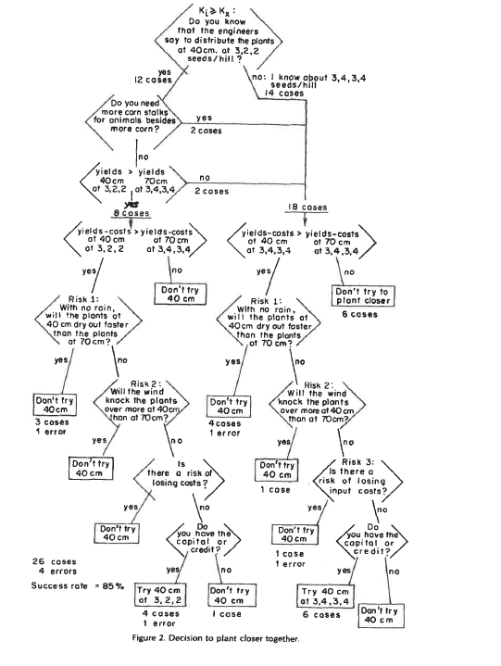

Slide 18
Critiques
Do heuristics match actual behavior?
Are some of the nodes in the decision tree tautological?
To what extent are people aware of all the factors that influence their decisions?

Slide 19
Behavioral Economics
Some economists have long challenged rational choice theories (e.g., Keynes 1937)
These critiques have been especially prominent after worldwide financial crisis starting around 2007 in which many decisions made by consumers, investors, bankers, and policy makers seemed “irrational” in their underestimation of the possibility of disastrous outcomes
Behavior economists look at how people actually make choices (usually in laboratory settings)
Most recent Nobel Prize in economics given to Richard Thaler, a proponent of behavioral economics

Slide 20
Differences between behavioral economists and most economic anthropologists looking at choice
Behavioral economists, like most economists, generally rely on mathematical models using relatively few variables
They assume that decisions are made by individuals or groups acting as a unit
They deemphasize history and ethnography and usually separate “economy” and “society” in their analysies
Their examples usually confined to decision-making in industrial countries

Slide 21
Experimental Economics in Anthropology
Influential in past 15 years – more so perhaps ten years ago than now, big grant from National Science Foundation
Conduct economic experiments in diverse societies – often “games” (especially Ultimatum Game)
Part of inspiration – behavioral economics – do findings from industrial societies hold true in other kinds of societies (often where anthropologists conduct research)
But much of inspiration (probably more) from evolutionary biology

Slide 22
Questions in evolutionary biology and sociocultural anthropology
To what extent do non-human animals engage in cooperative and altruistic behavior that entails a cost to them but benefits others
If so, how did this behavior evolve (usual explanation “kin selection” and “inclusive fitness”)
Sociocultural anthropologists have made the obvious observation ath human beings cooperate (often altruistically) with others who are not closely related
One focus of interest is the evolution of such behavior among our forager ancestors

Slide 23
Economic experiments by anthropologists
Games among groups of different types (often regarded as cultural evolutionary levels) designed to see:
Under what circumstances people are willing to cooperate altruistically
How people punish non-cooperators

Slide 24
Critiques
Can the results of these experiments be extrapolated to real world behavior (increasing amount of research on this)?
To what extent can contemporary foragers and shifting cultivators be regarded as representative of human groups in the past?

Slide 25
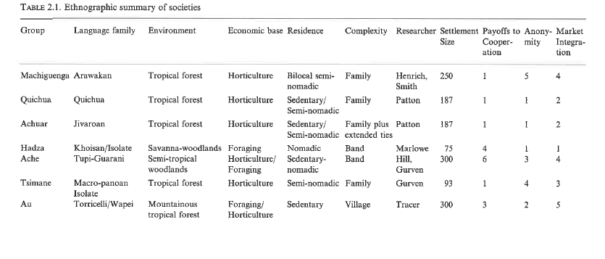

Slide 26
Approaches placing less emphasis on decision making -culturalists
Sahlins – objecting to reductionist explanations of cultural practices based on usefulness to individuals and groups (“economism of the rationalizing individual” or “ecologism of selective advantage”)
Mary Douglas – when people estimate probability and credibility, their judgments are influenced by culturally learned conventions, expectations, and categories

Slide 27
Approaches placing less emphasis on decision making - power, centers, and peripheries
Constraints on decision-making by power relations among and within local communities, regions, and nation-states (Wolf, Mintz)
Debates about how much “agency” poor, powerless individuals and households have

Slide 28
Two quotes
The difference between economics and sociology is very simple. Economics is all about how people make choices. Sociology is why they don’t have any choices to make. (Duesenberry 1960)
A theory of how people make their economic choices is without interest and probably impossible until we have tackled the question of the factors determining the choices available to them (White 1976)

Slide 29
Other Issues
Risk and uncertainty
Gender
Units of analysis

Slide 30
Foragers Past and Present
Key question in looking at choices by recent foragers – to what extent is it possible to make inferences about foragers in the distant past.
These has often been the goal of forager studies (e.g. use of San in introductory anthropology classes)
As mentioned, such inferences not restricted to the last century – often made by anthropologists doing economic experiments

Slide 31
Methodological problems associated with looking at decision making among past foragers
Often done by archaeologists
They lack the tools of ethnographers and historians looking at decision-making – no interviews, observations, archives
They therefore have often used methods that do not involve interviews, observations, archives such as optimal foraging theory
Another common method is ethnoarchaeology

Slide 32
Examining decision-making among contemporary foragers
Almost always partly involved in market economies, tied to nation-states, not solely foraging
Many of the methods ethnographers looking at decision-making among other kinds of groups seem applicable.
Not clear why methods for looking at foraging decision-making should differ much in principle from those used in analyses of choice of other groups living in the hinterlands of nation-states (each with their own particular economic, ecological, political, and historical circumstances)

Slide 33
What can anthropology contribute to the study of decision-making
Ethnography
Holism
Realism
Complement to formal model-based approaches emphasizing a few variables

