Slide 1
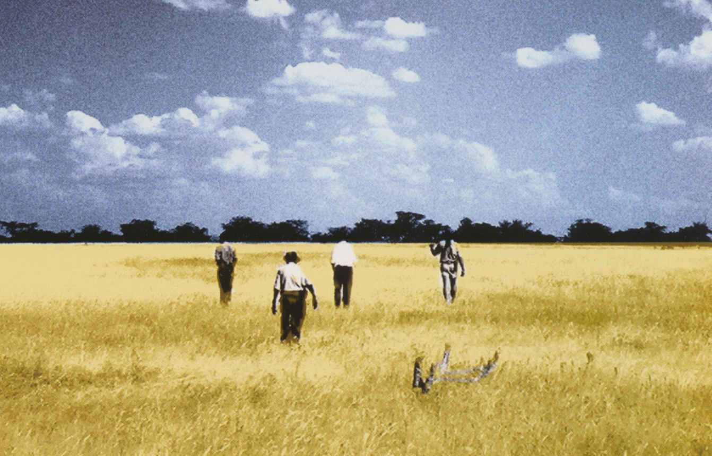
Loosing the spoor:
HaiIIom settlements in the Etosha National Park
The archaeological approach
Dr. Ralf Vogelsang
Institute of Prehistoric Archaeology
University of Cologne

Slide 2
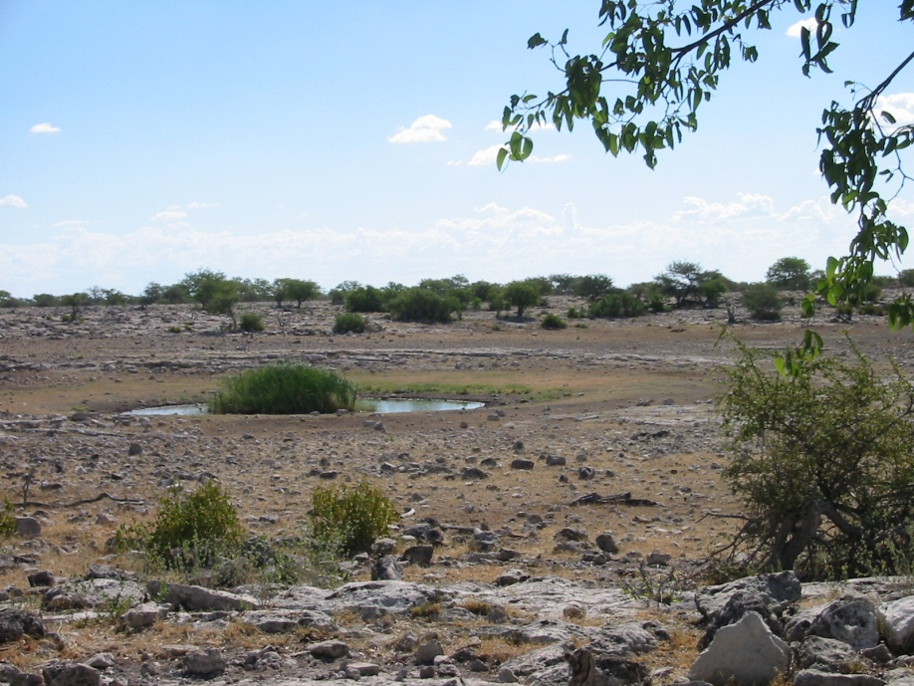
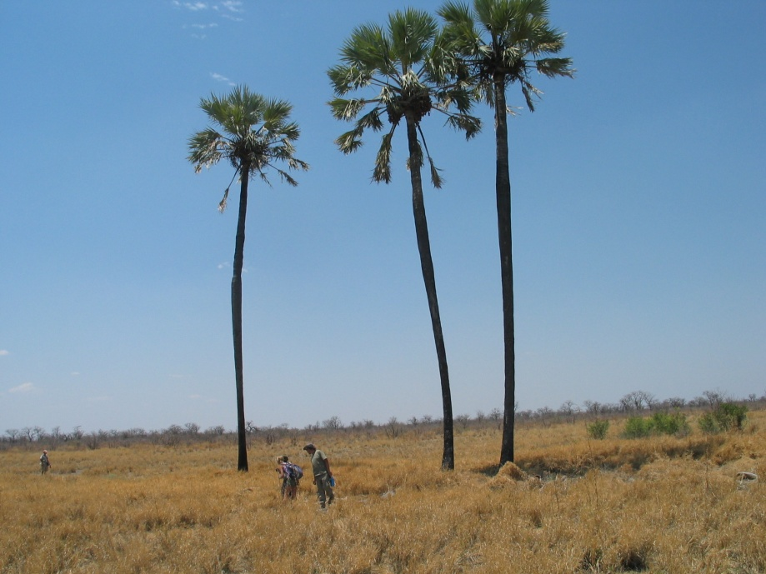
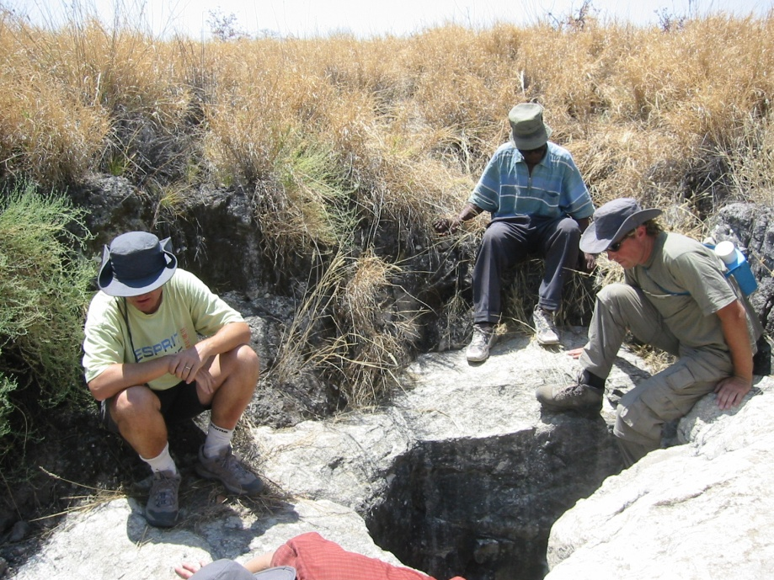
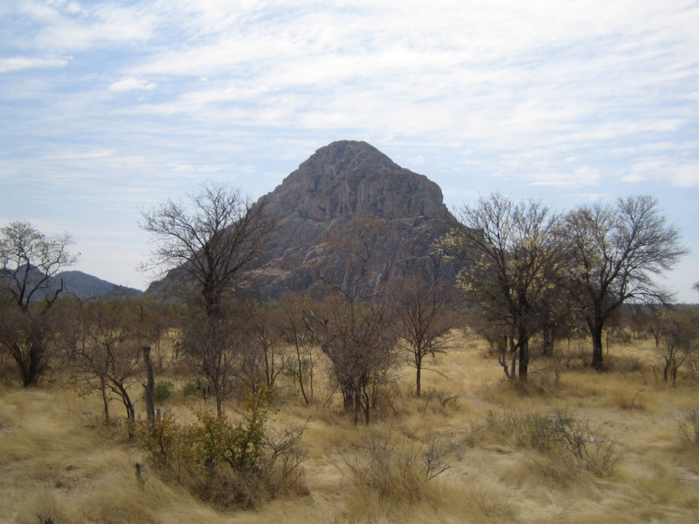
Places: natural features
Waterholes
Trees
Caves
Hills

Slide 3
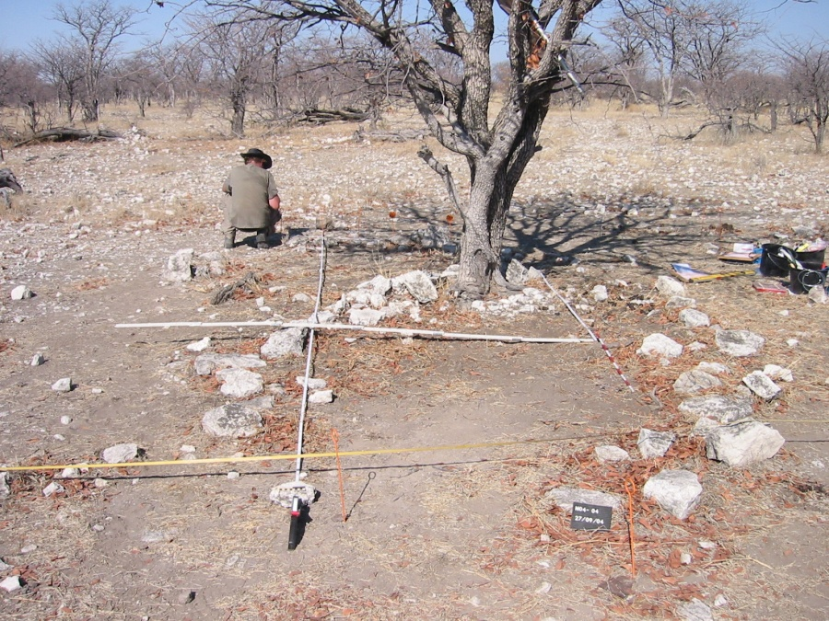
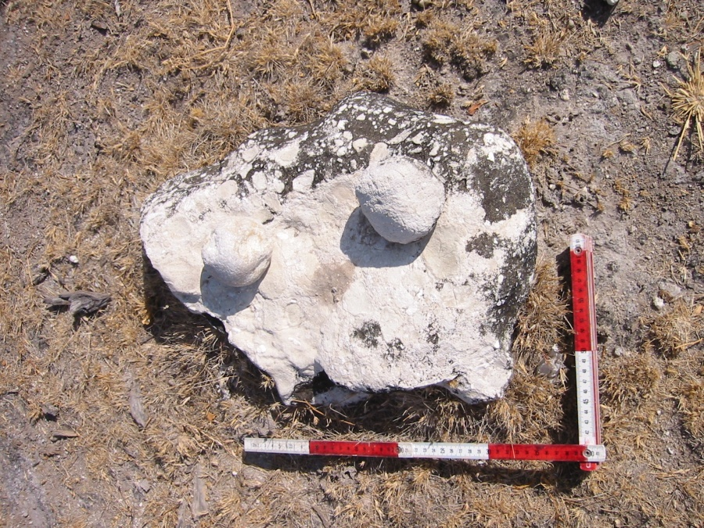
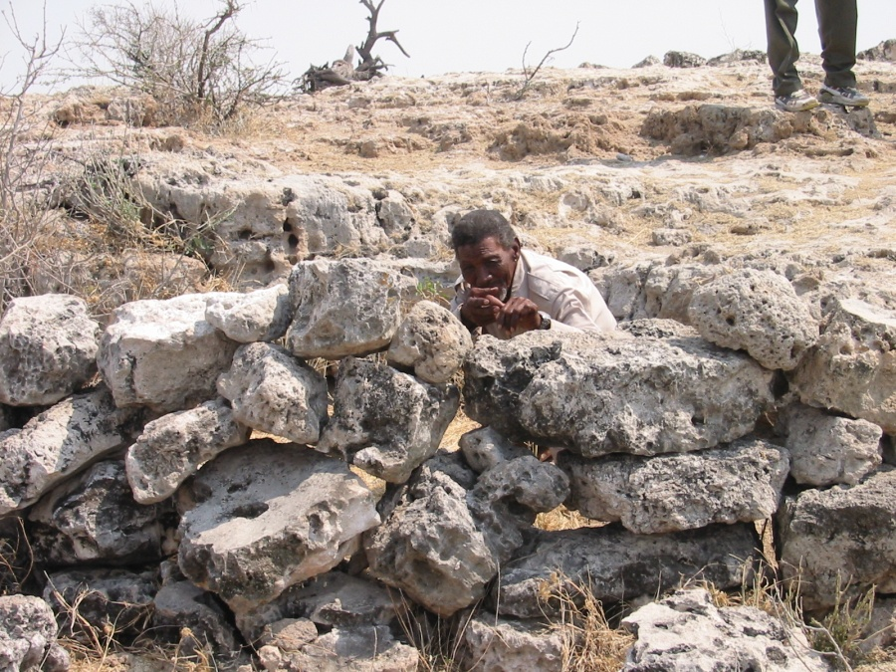
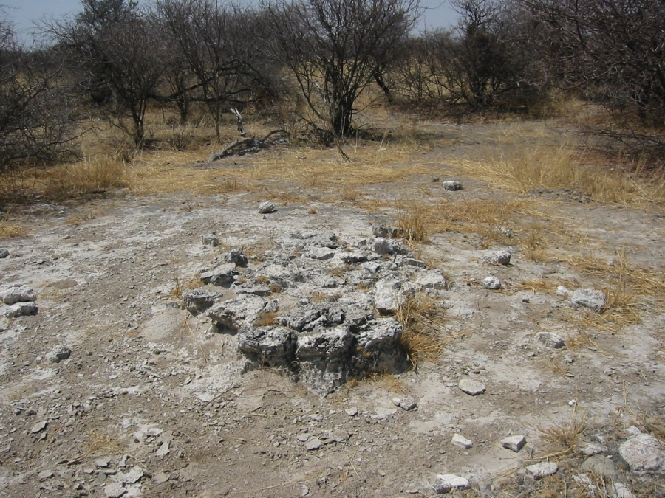
Places: cultural features
Settlements
Seasonal camps (bushfood and hunting)
Hunting blinds (!Goas)
Graves

Slide 4
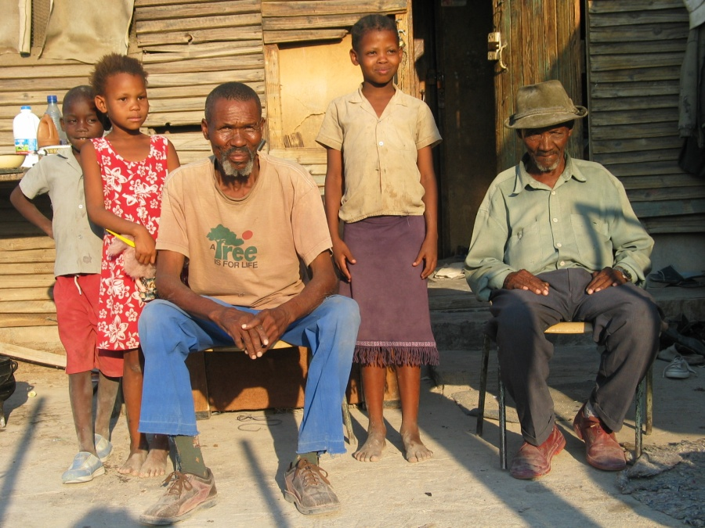
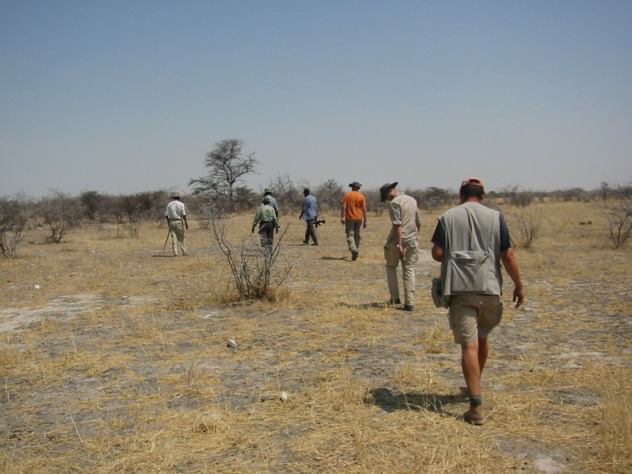
Sources of information:
interviews with HaiIIom elders were the main source of information, but how reliable is this information?
comparison with written documents and historical pictures, but these are not available for all places
archaeological survey and excavation as an independent method to check the information given by the HaiIIom elders
Etosha as an archaeological case study for transformation processes at abandoned settlements without human influence
comparison of archaeological interpretation and oral history
Jacob Iuibeb and Hans Haneb
Archaeological survey

Slide 5
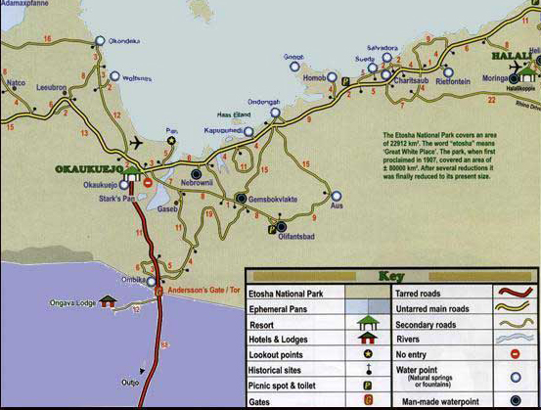
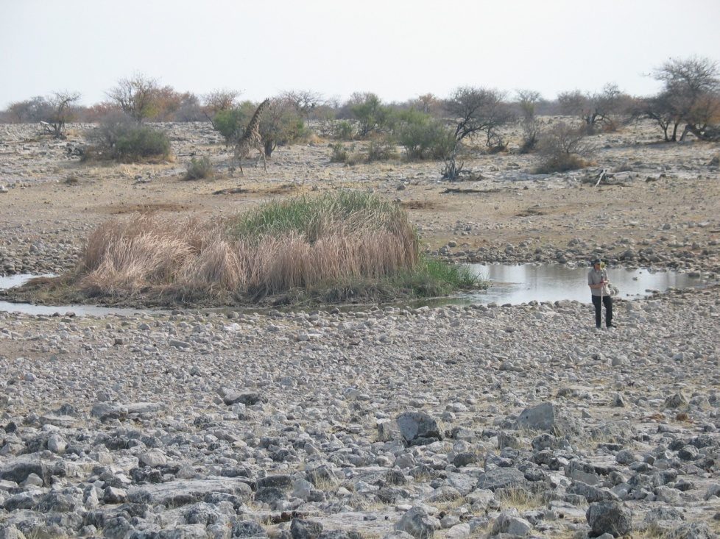
Case study: #Homob
today one of the main observation points with picnic spot and toilet
#Homob was one of the important and permanently occupied settlements of the HaiIIom (base camp)
two waterholes are about 500 metres from the former settlement
Tourist map
One of the ‘Homob waterholes

Slide 6
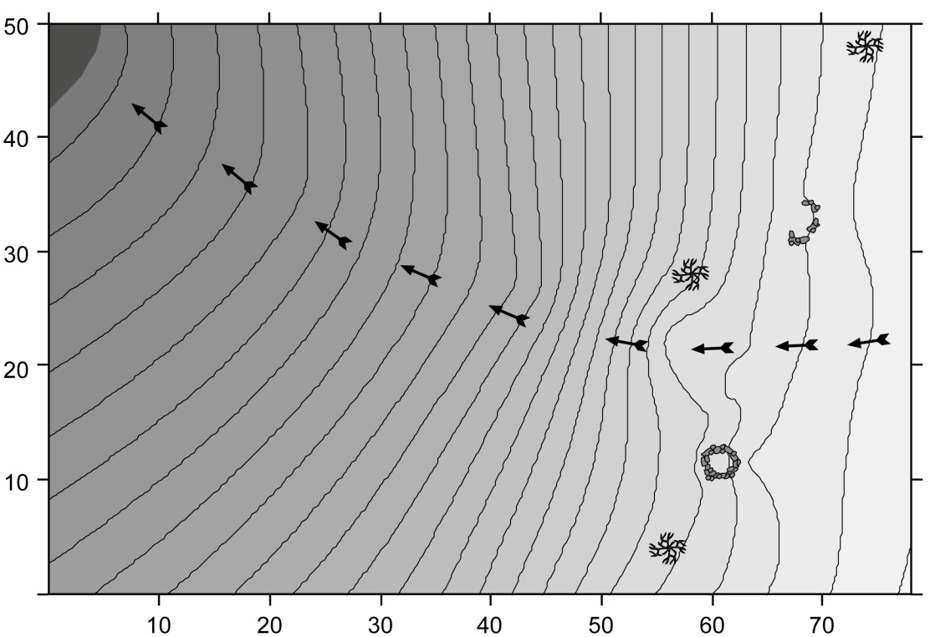
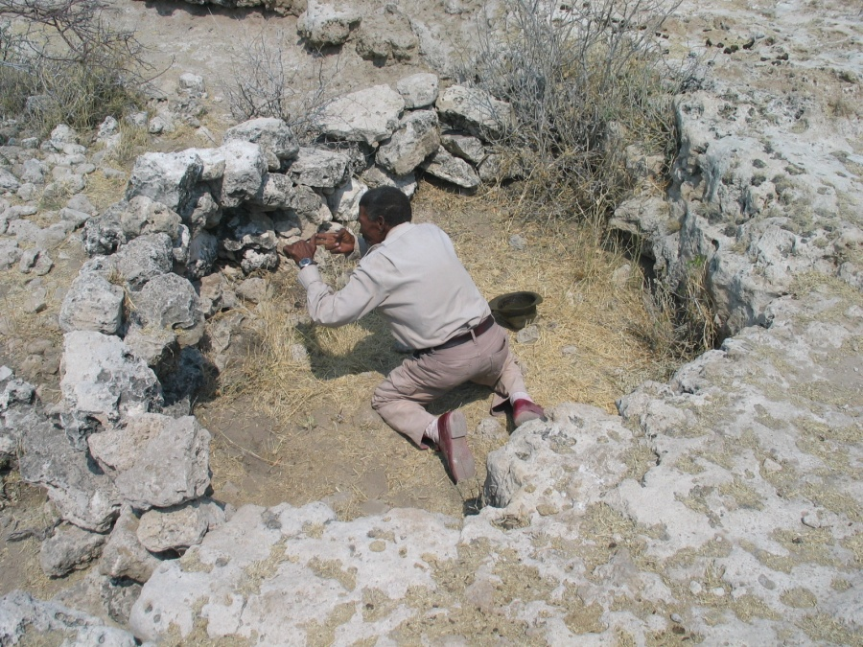
Case study: #Homob – hunting blinds
our informants distinguished between the two waterholes:“one was used mainly for hunting, and the other for human use (drinking water)”
a much frequented animal trail runs between two hunting blinds
“the hunting blinds were manned depending on the main wind direction. A small fireplace warmed the hunters and kept lions away”
#Homob waterhole (top left) and two hunting blinds (!Goas)
Hunting blind (!Goas)

Slide 7
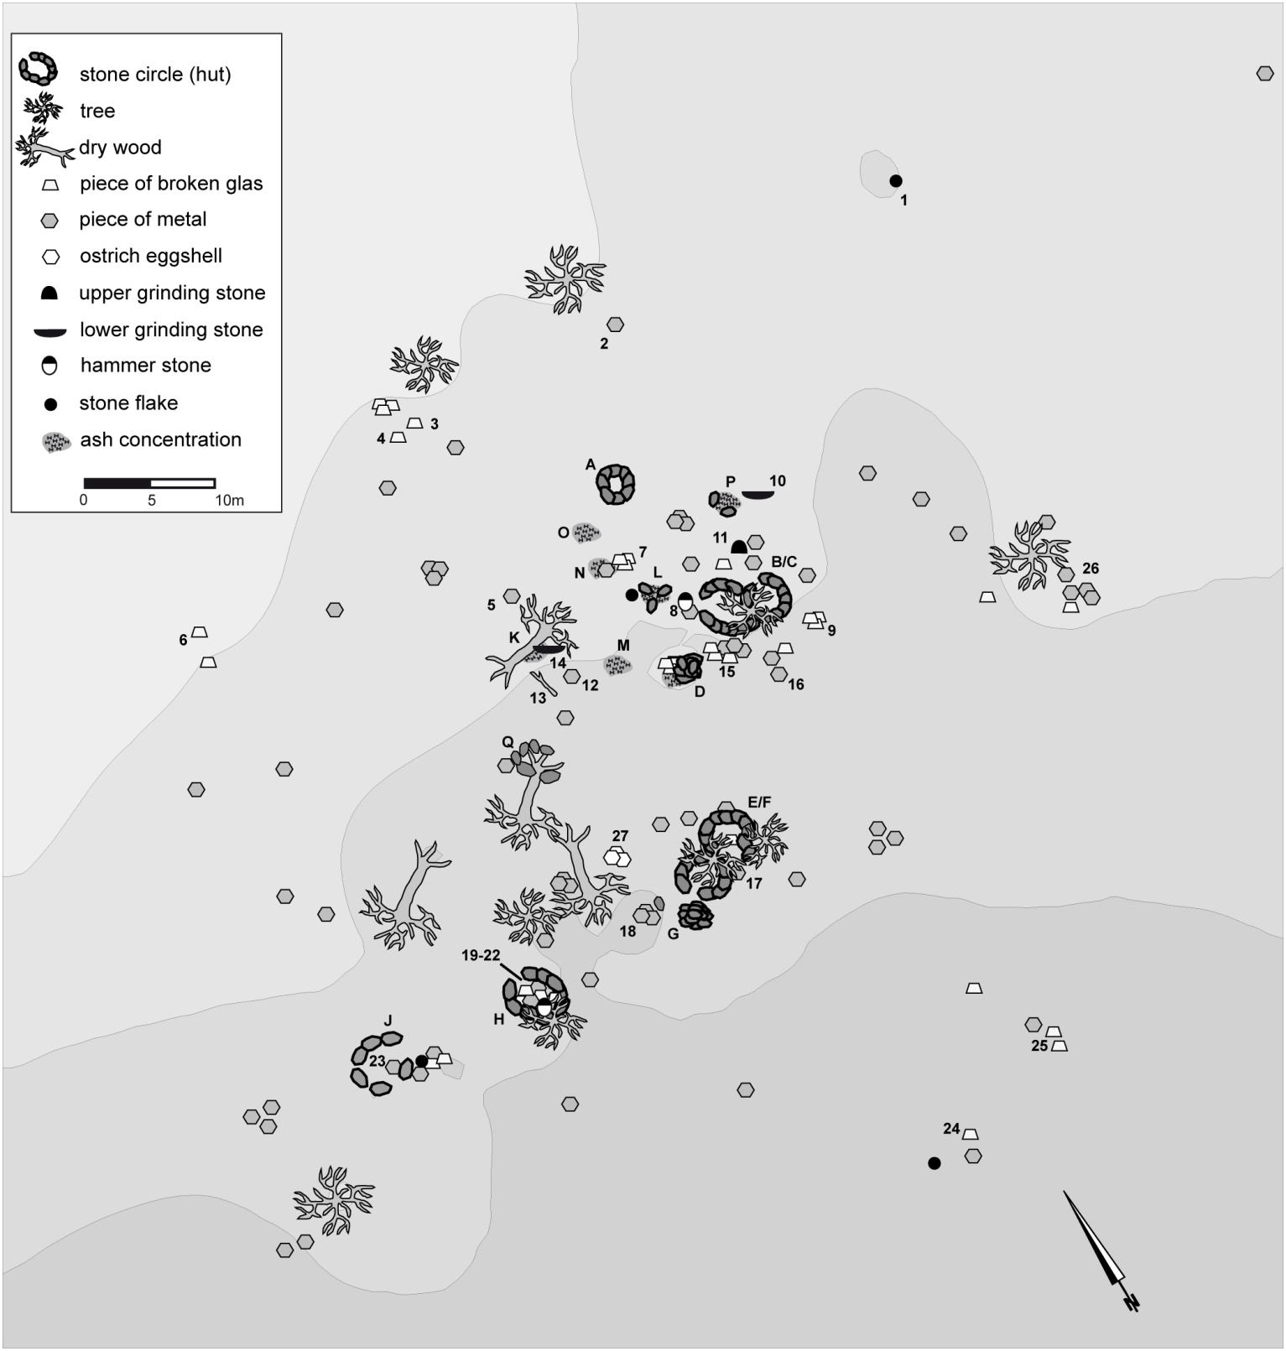
Case study: #Homob, settlement site, surface structures
6 larger stone circles
orientated on a slightly semicircular axis
settlement layout influenced by trees
double hut: smaller appendix for children who had reached puberty
two stone cairns might simply attest to surface cleaning
ash heaps

Slide 8
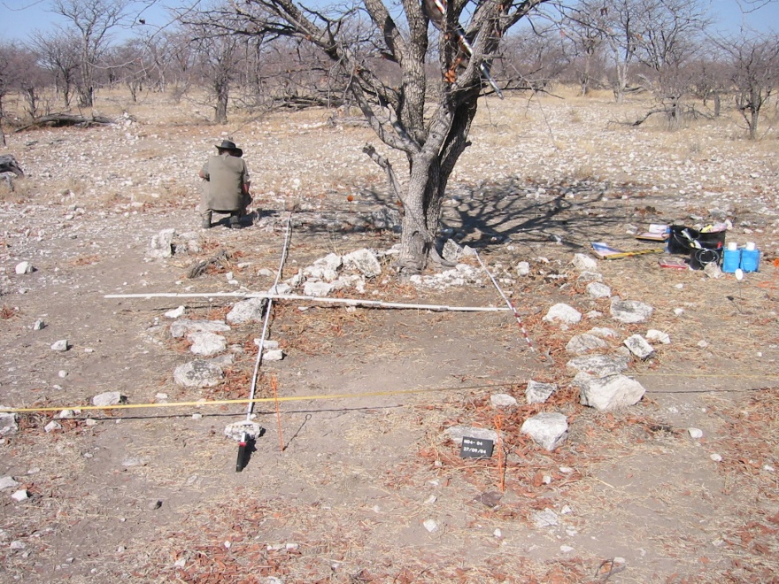
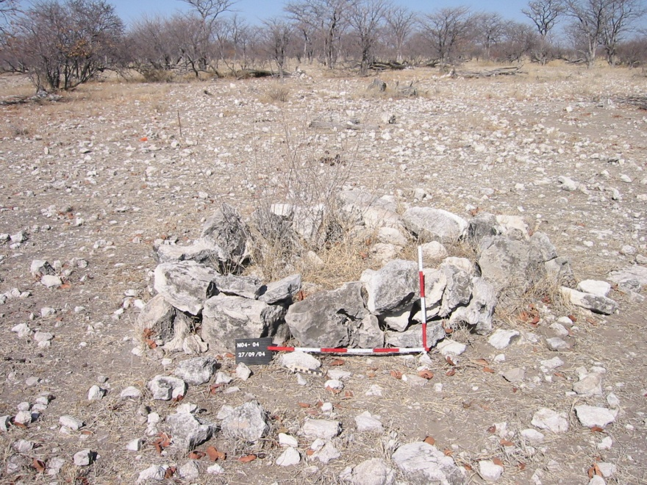
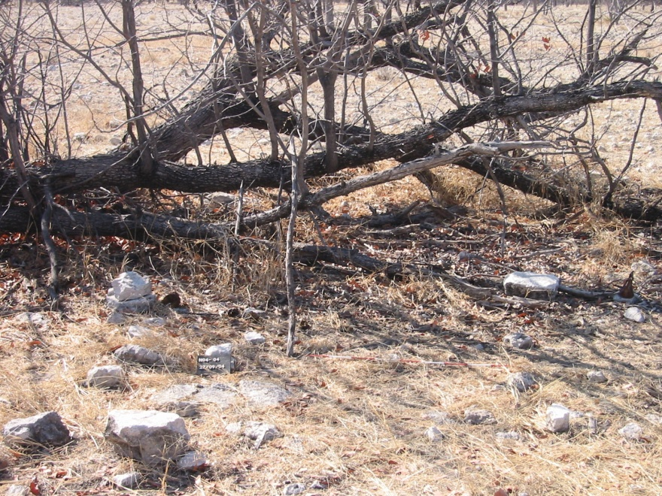
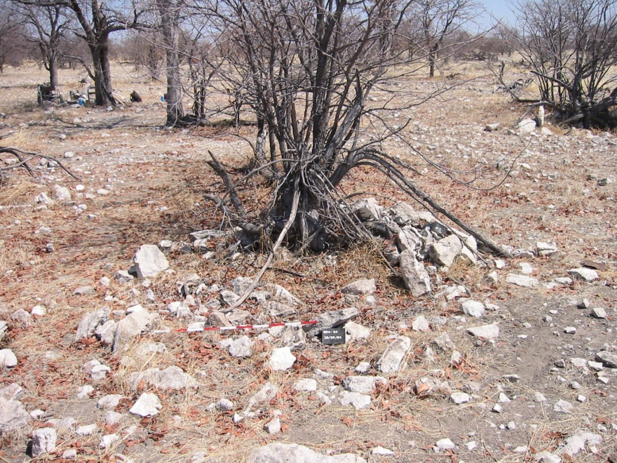
Case study: #Homob, settlement site, surface structures
Hut circle
“Dog kraal”
“Men’s kitchen” (!hais)
Tree hole

Slide 9
Case study: #Homob, settlement site, finds
most frequent are glass artefacts (n = 48)
second most frequent are metal finds (n = 21)
Stone artefacts and potsherds are extremely rare (n = 6 in each case)
although the distribution of surface finds shows a concentration around hut circle B/C, overall the number was too small to identify any activity areas

Slide 10
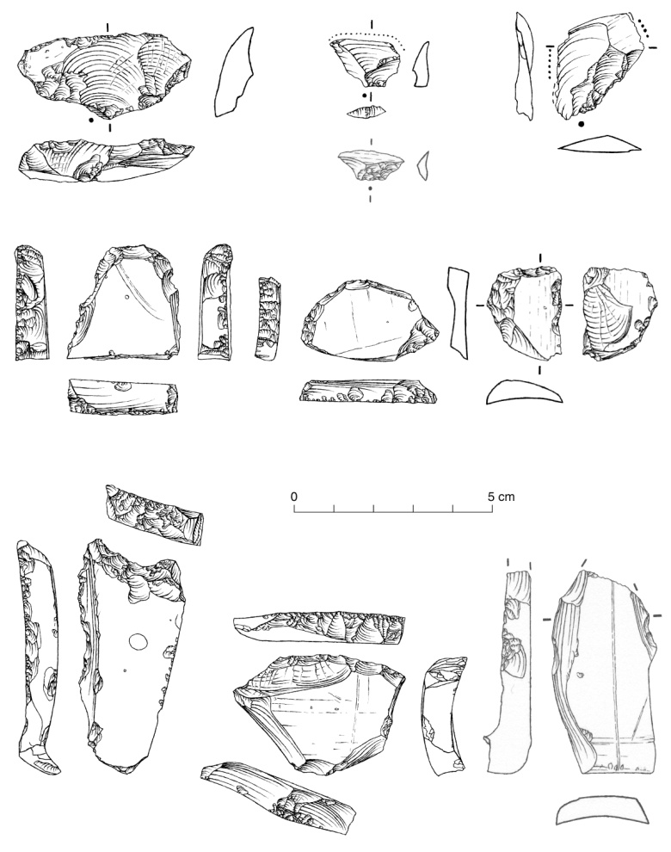
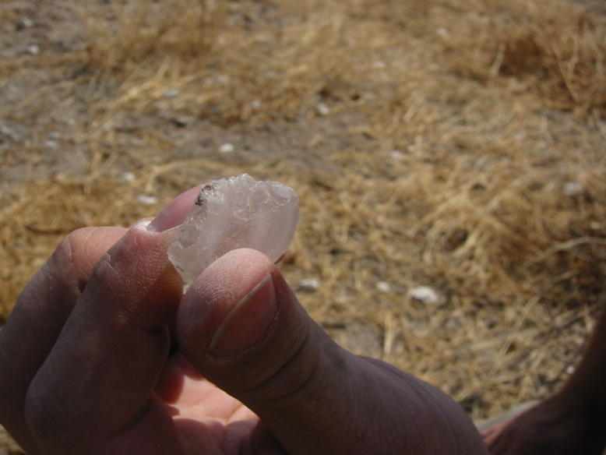
Case study: #Homob, settlement site, glass artefacts
besides unmodified pieces of broken glass, there are glass flakes, cores and retouched tools
raw materials are beer and syrup bottles. Especially the thick bottoms were preferred as cores for the production of transversal flakes
even these pieces permit only the production of small and thin yet extremely sharp flakes. These were used in ritual scarification for the purpose of curative treatment
larger pieces have been modified by a steep retouch and resemble LSA scrapers, but there use was not known to our informants

Slide 11
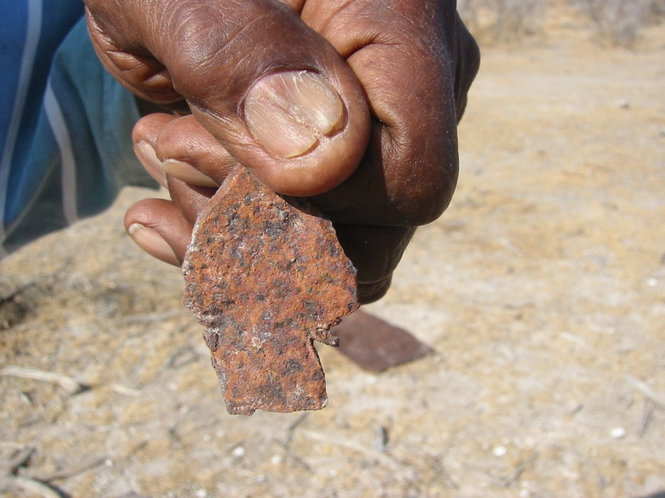
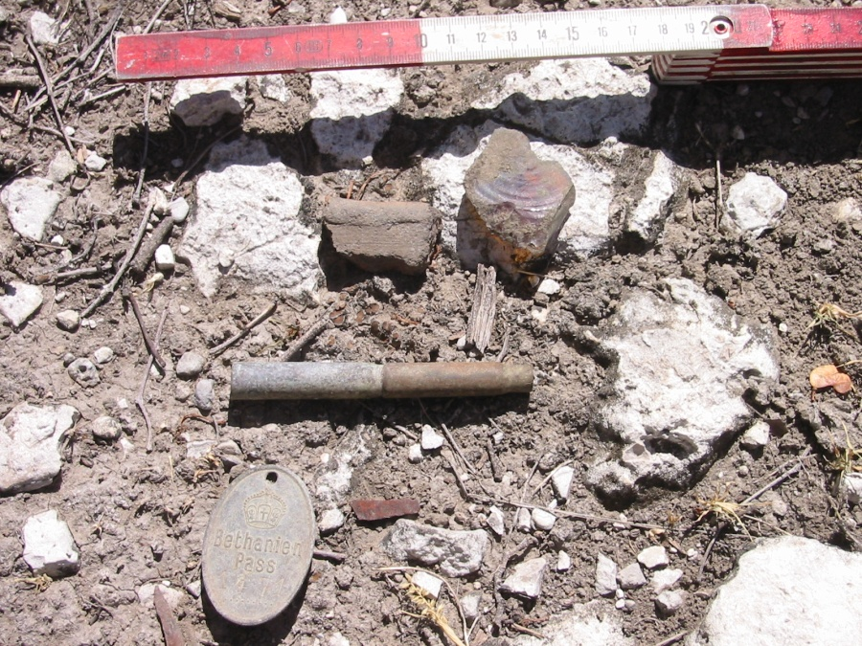
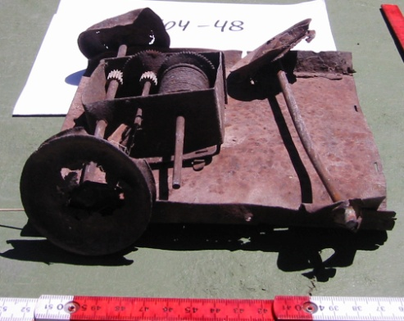
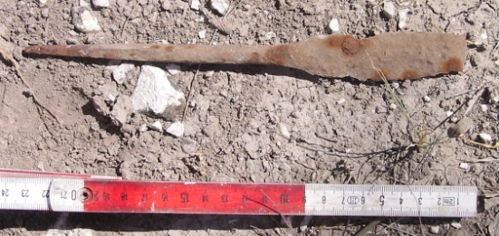
Case study: #Homob, settlement site, metal finds
tins were used as containers, but also as raw material for the production of tools, such as arrowheads
beer bottle crown caps were perforated for the use as dancing rattles
bullet casings were modified by removing the bottom and might have been used as ornaments. Two nested bullet casings were used as a smoking pipe (tube pipe)
a special find is a “native pass token” with the inscription “Bethanien Pass 1471”

Slide 12
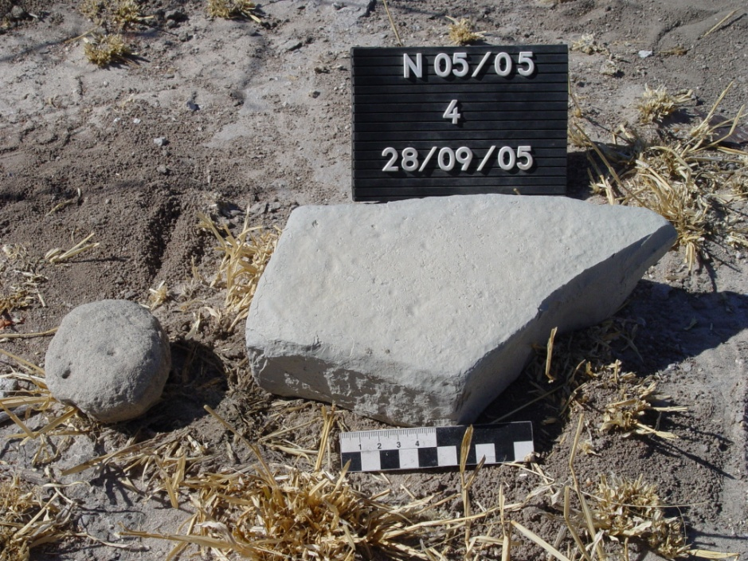
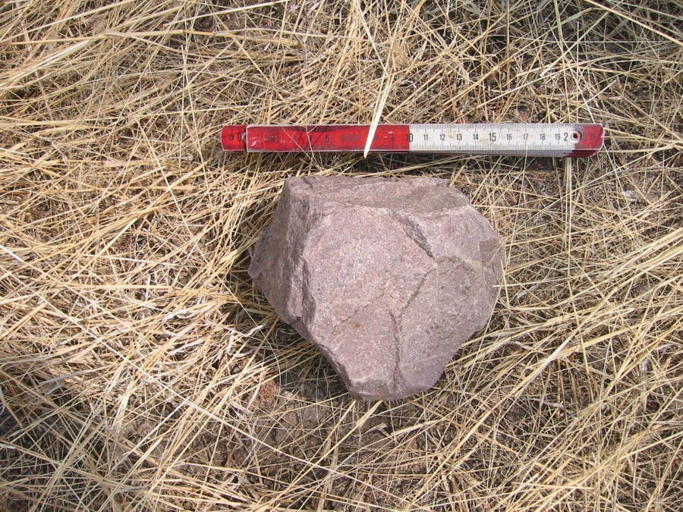
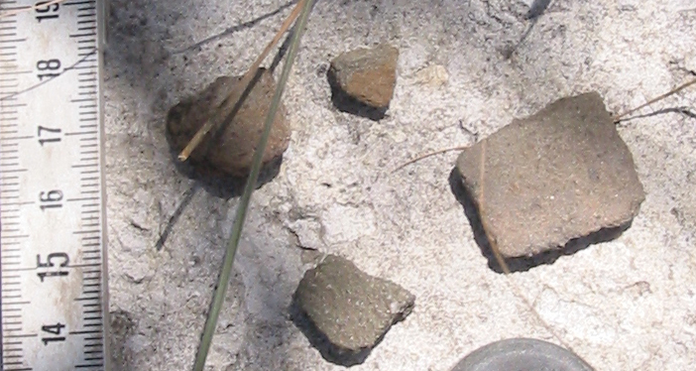
Case study: #Homob, settlement site, stone artefacts & pottery
stone artefacts are rare with one fragment of a lower grindstone, one fragment of an upper grindstone and two hammerstones of quartzitic rocks
flaked stones were completely substituted by glass artefacts. The only chert artefacts are two splintered pieces that, according to our informants, were flint stones for lighting fires
potsherds are extremely rare with only 6 fragments from a single thick-walled cooking pot

Slide 13
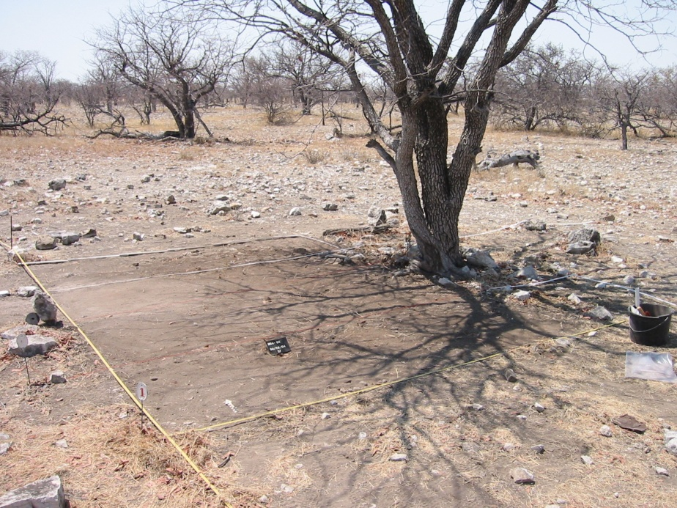
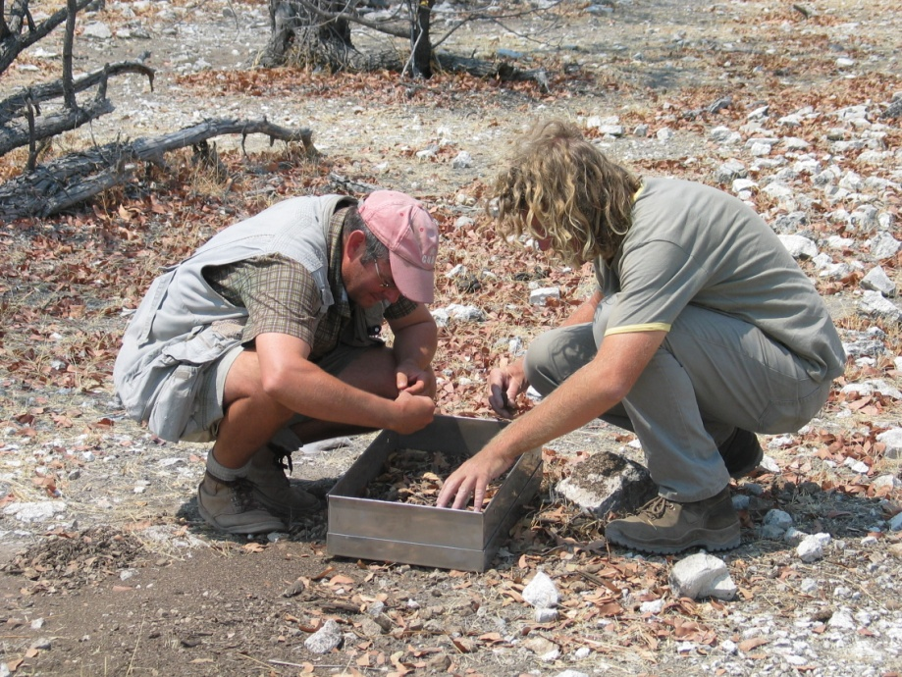
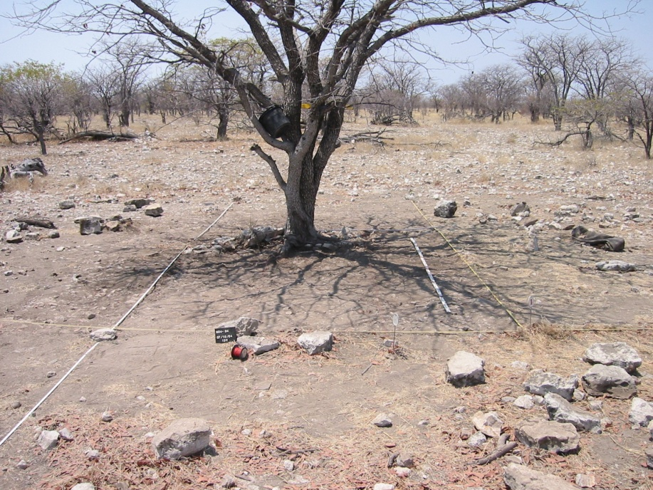
Case study: #Homob, excavation
the surface of the interior space of the huts is virtually free of any artefacts or debris
hut circles B/C were chosen for excavation ( 24 sq. metres)
the total thickness of sediment never exceeded 5 cm, nevertheless the number of artefacts increased considerably

Slide 14
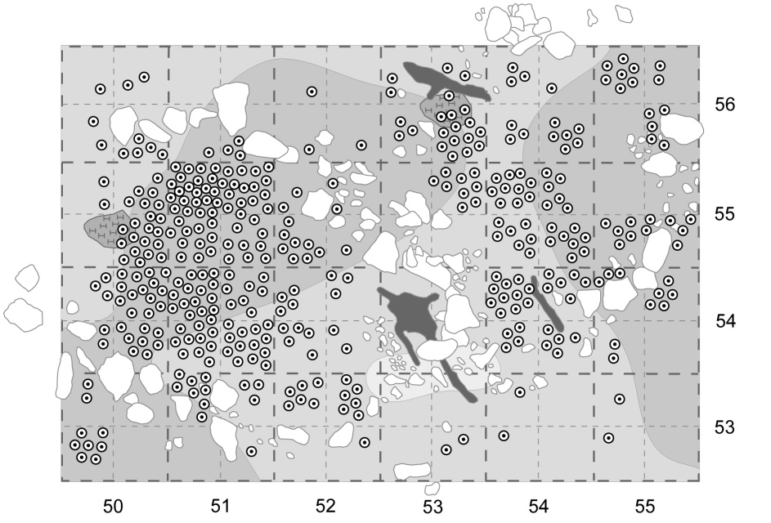
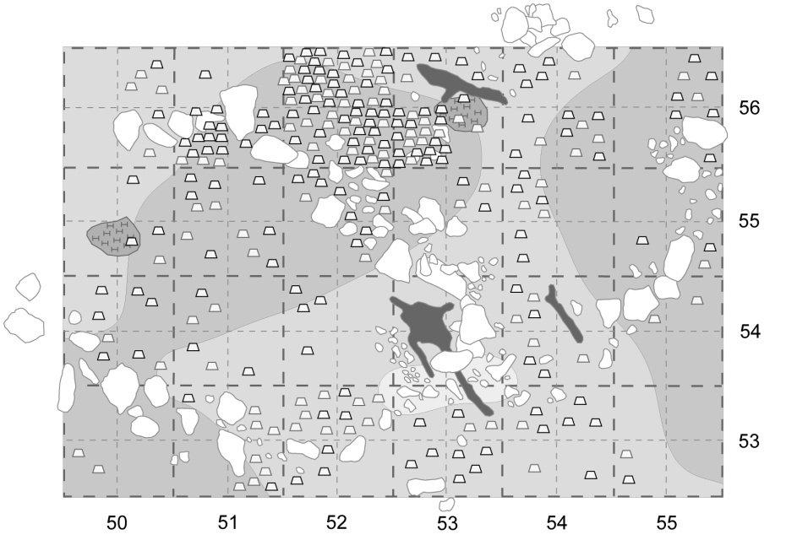
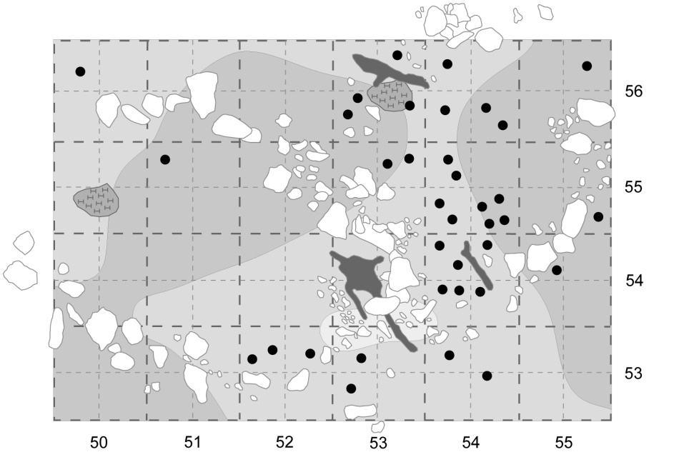
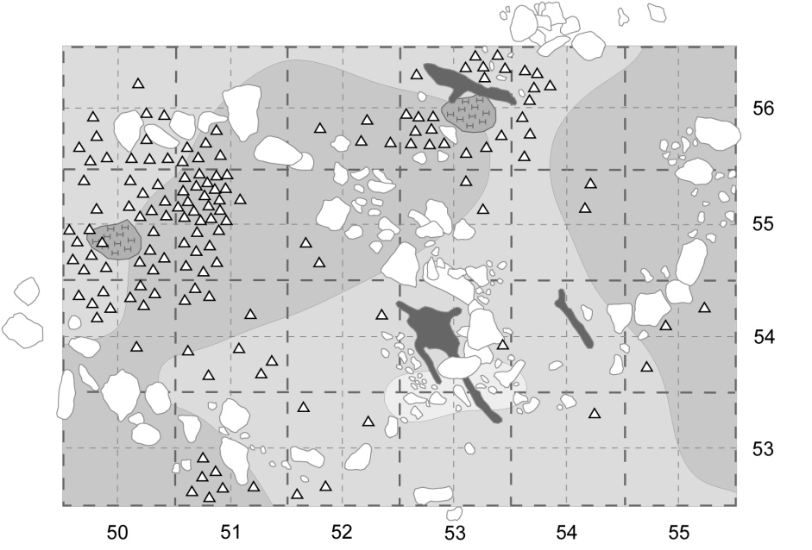
Case study: #Homob, excavation
Distribution of glass beads
Distribution glass artefacts
Distribution of stone artefacts
Distribution of bones

Slide 15
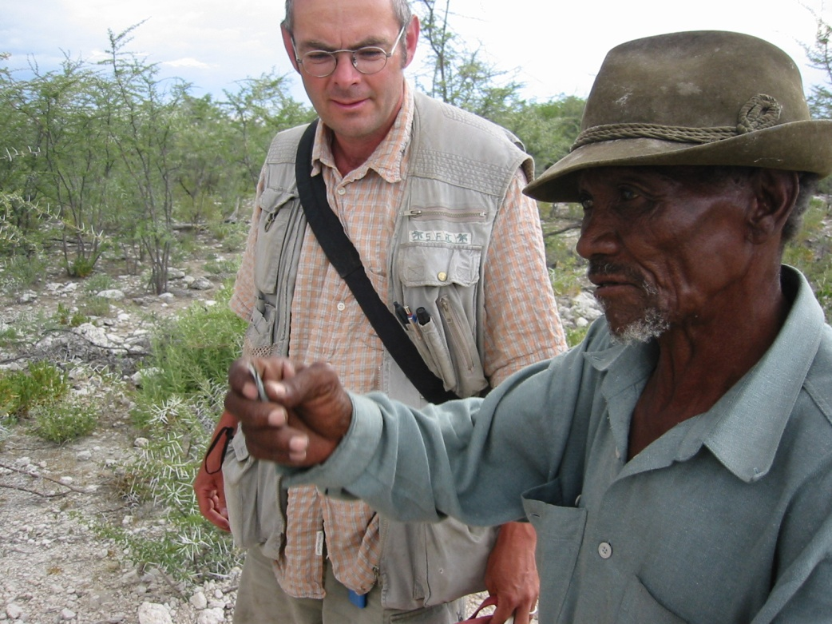
Archaeology versus oral information
archaeological evidence supports in most cases the oral information
some archaeological evidence could not be explained by our informants (e.g. glass-scrapers)
some evidence could only be explained by the oral information. For example the use of a wooden stick as a meat carrying pole is not recognizable to the archaeologist, as is the use of glass flakes for cutting medical scars

Slide 16
Archaeology results
the HaiIIom were certainly not an isolated hunter-gatherer group that persisted in a “prehistoric” way of life
the material culture reflects a time of radical change and upheaval. Even if flint stones were still lighting fires, bottle glass substituted stones in the production of flakes and retouched tools. Arrowheads were made of metal instead of stones or bone, glass beads replaced ostrich eggshell beads and tins were the common form of container
Whereas dancing rattles were made of moth cocoons in the Kalahari still in the 1960s, drilled beer bottle caps serve this purpose at #Homob. The traditional rituals were still practised in Etosha in the early 1950s, while the material culture had changed earlier than in the more remote parts of the Kalahari region
The pre-colonial trading network were partly replaced by colonial trading networks that provided a wide range of new goods
The HaiIIom showed a high degree of flexibility by exploiting new materials and by incorporating them into their culture

