Slide 1
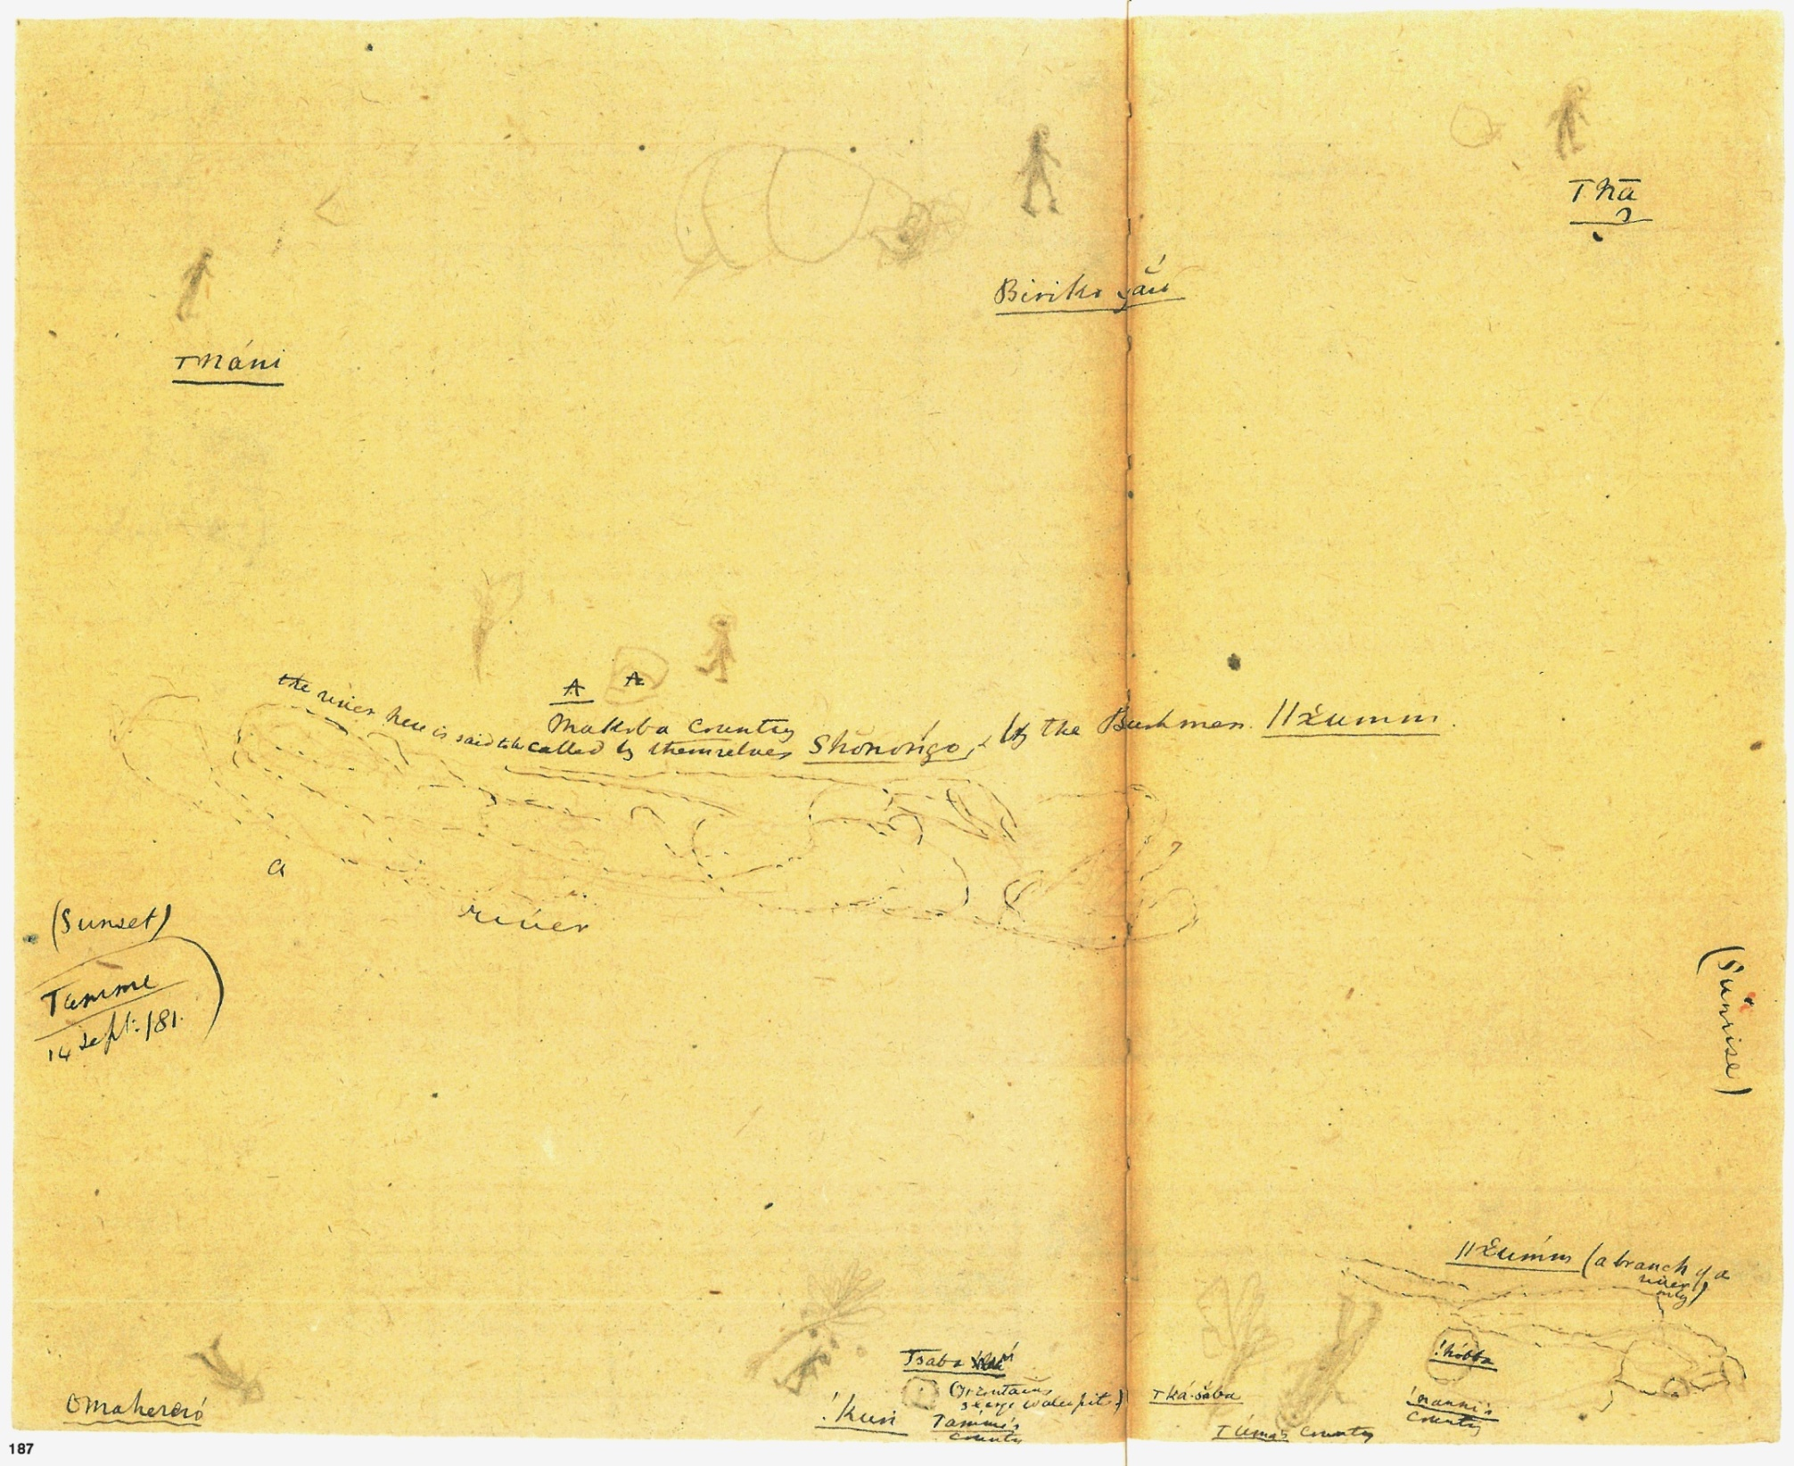
Maps, hand-drawn by San in late 19th century
Tilman Lenssen-Erz
African Archaeology, Cologne

Slide 2
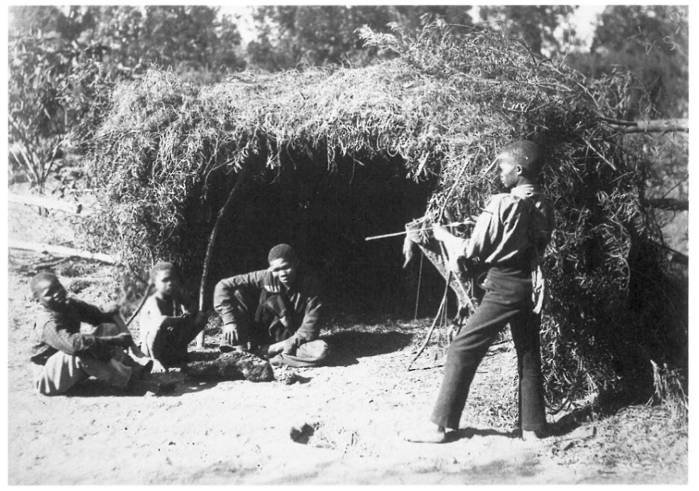
Background and setting
Linguists Wilhelm Bleek and Lucy Lloyd
Collection of oral traditions of the Southern African /Xam hunter-gatherers, 1870s-1880s
Older informants, /Xam: (former) prisoners from Brakwater prison
Younger informants, !Xun (!Kung): youth and young boys from Angola/Namibia border area; under custody for unknown reason
Staying at the Bleek family's house
Bleek at his house in Mowbray near Cape Town
Died 1914
Playing in the garden
Died 1875

Slide 3
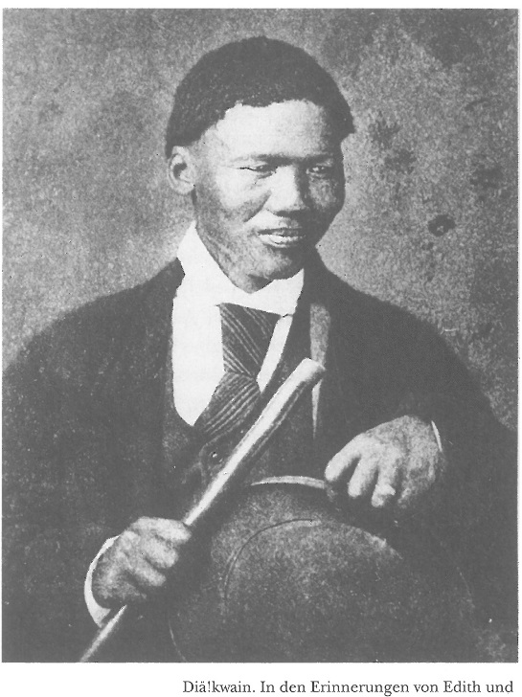
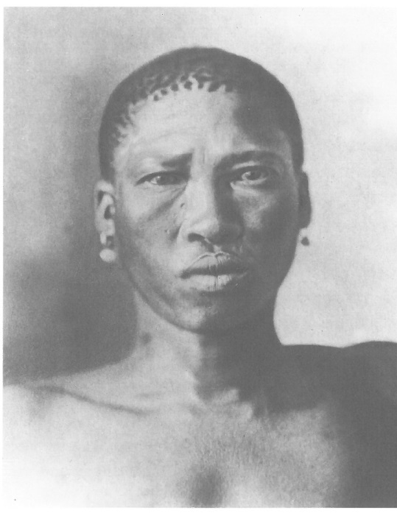
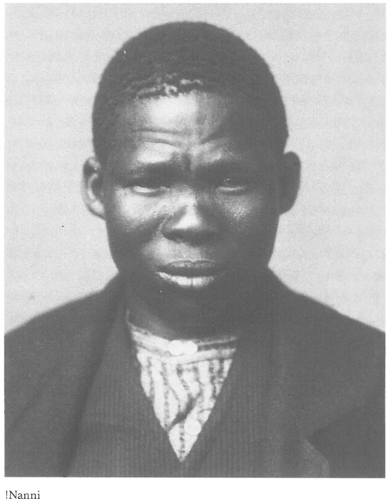
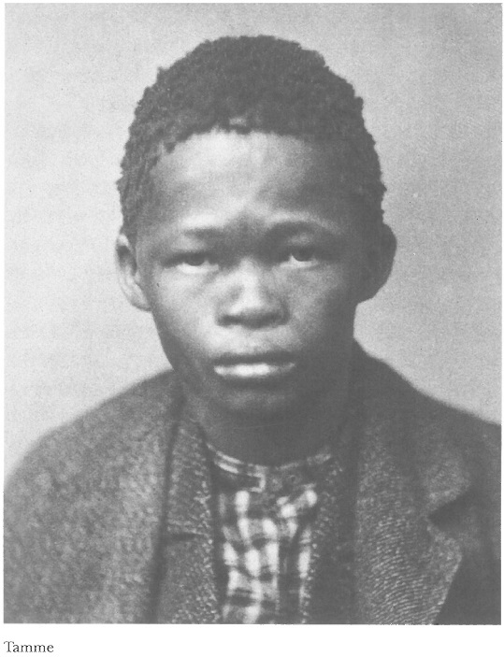
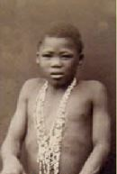
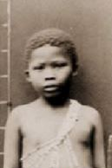
The Informants
/Xam had also European names,
i.e. they had worked on farms; they were allowed to leave prison to live with the Bleek family
!Xun (!Kung), did not have European names, never worked for Europeans; they were abducted by Makoba (Kavango) and passed from "patron" to "patron"
Diä!kwain, 1873-1876 in Mowbray, ~30 years old 1874
/Han≠kass'o, 1878-1879 in Mowbray, ~30 years old 1875
/Uma, ~ 10 years Da, ~7 years old
1880-1881 in Mowbray,
!Nanni, 1879-1882 in Mowbray, "teenager"
Tamme, 1879-1882 in Mowbray, "teenager"

Slide 4
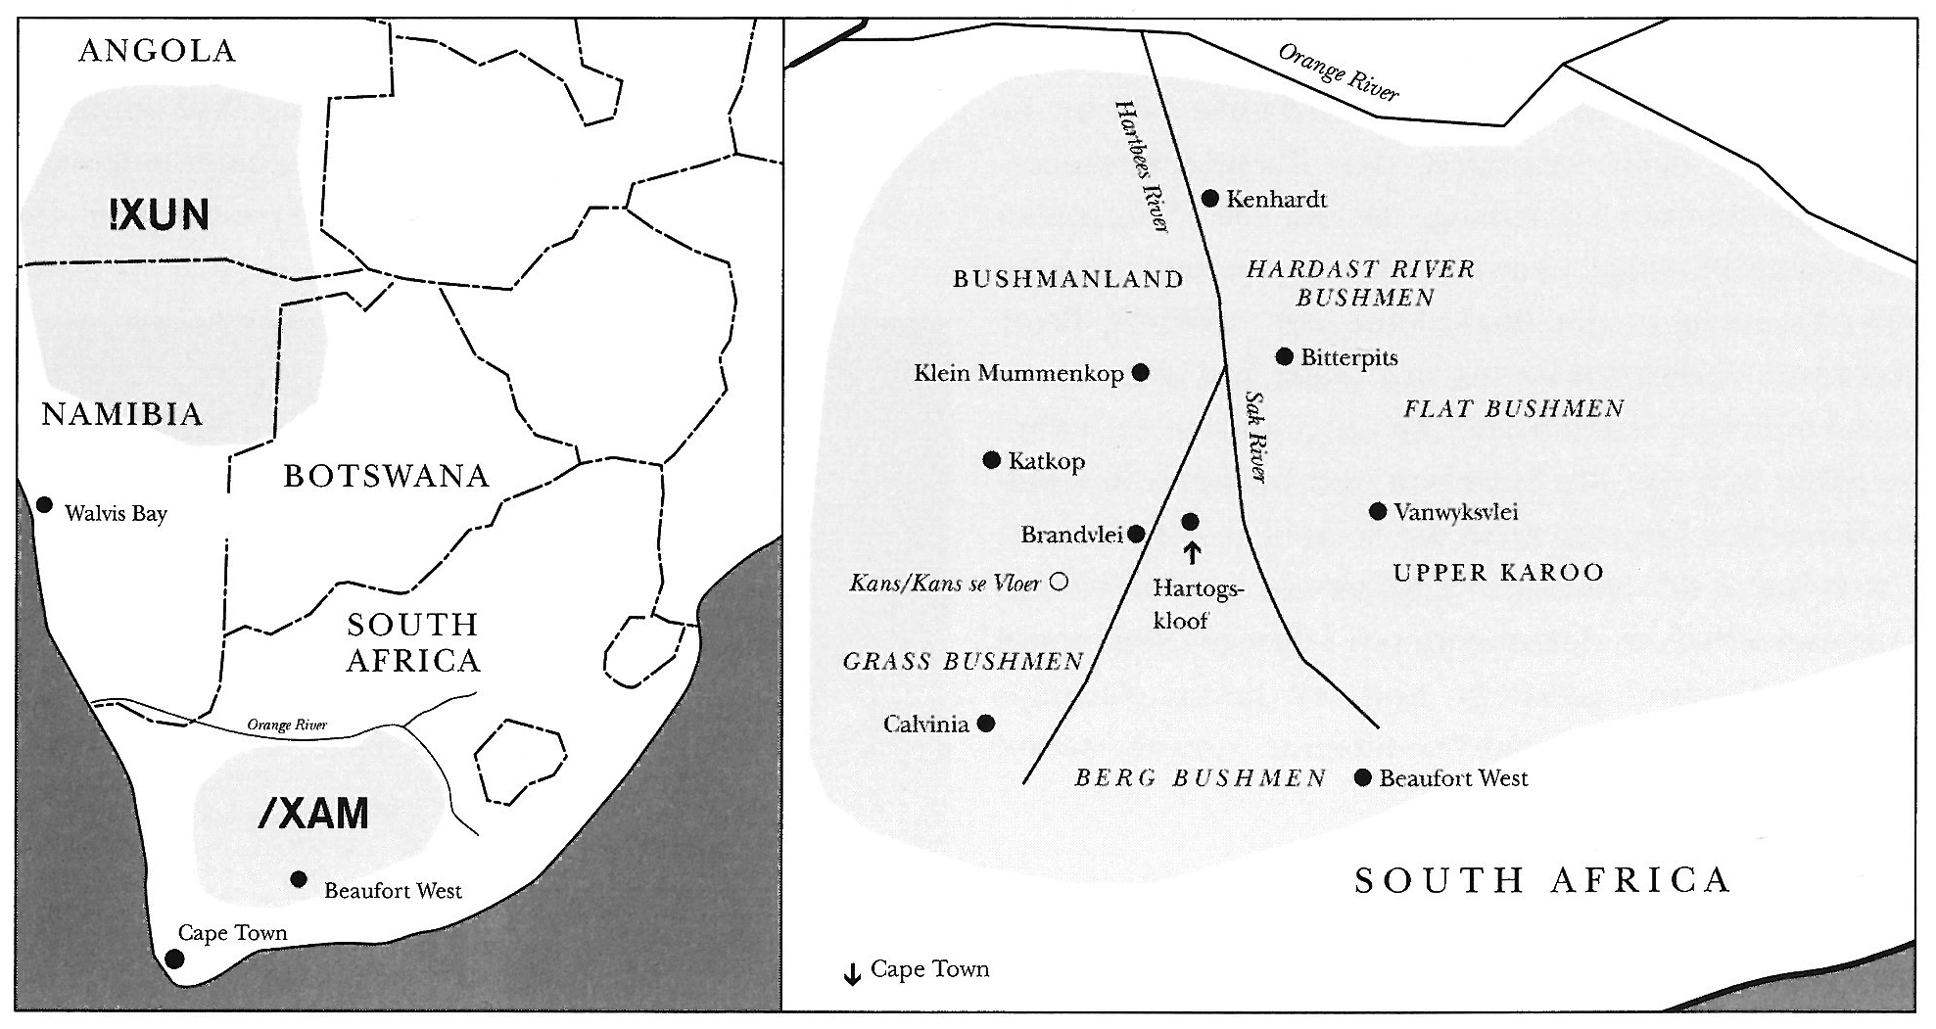
Places of origin of informants
/Uma
Da
!Nanni
Tamme
/Han≠kass'o
Diä!kwain
narrower indication of area of provenance after Lionnet 2014 From: Szalay (ed.) 2002

Slide 5
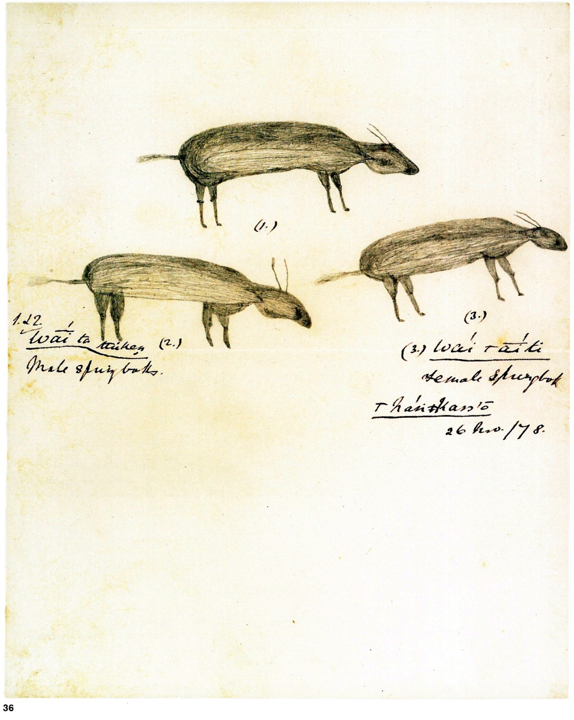
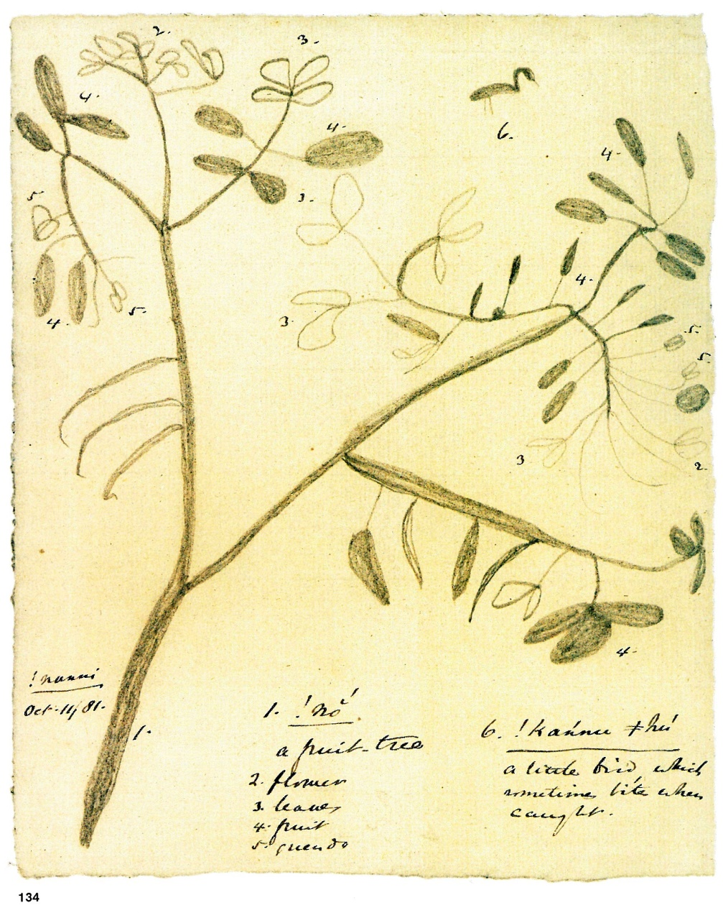
Usual motifs
/Han≠kass'o, male and female springbok
!Nanni, !No tree

Slide 6
Maps at small scale
/Han≠kass'o
Note: showing the spoor at the entrance (i.e. one of the entrances) of a porcupine's hole

Slide 7
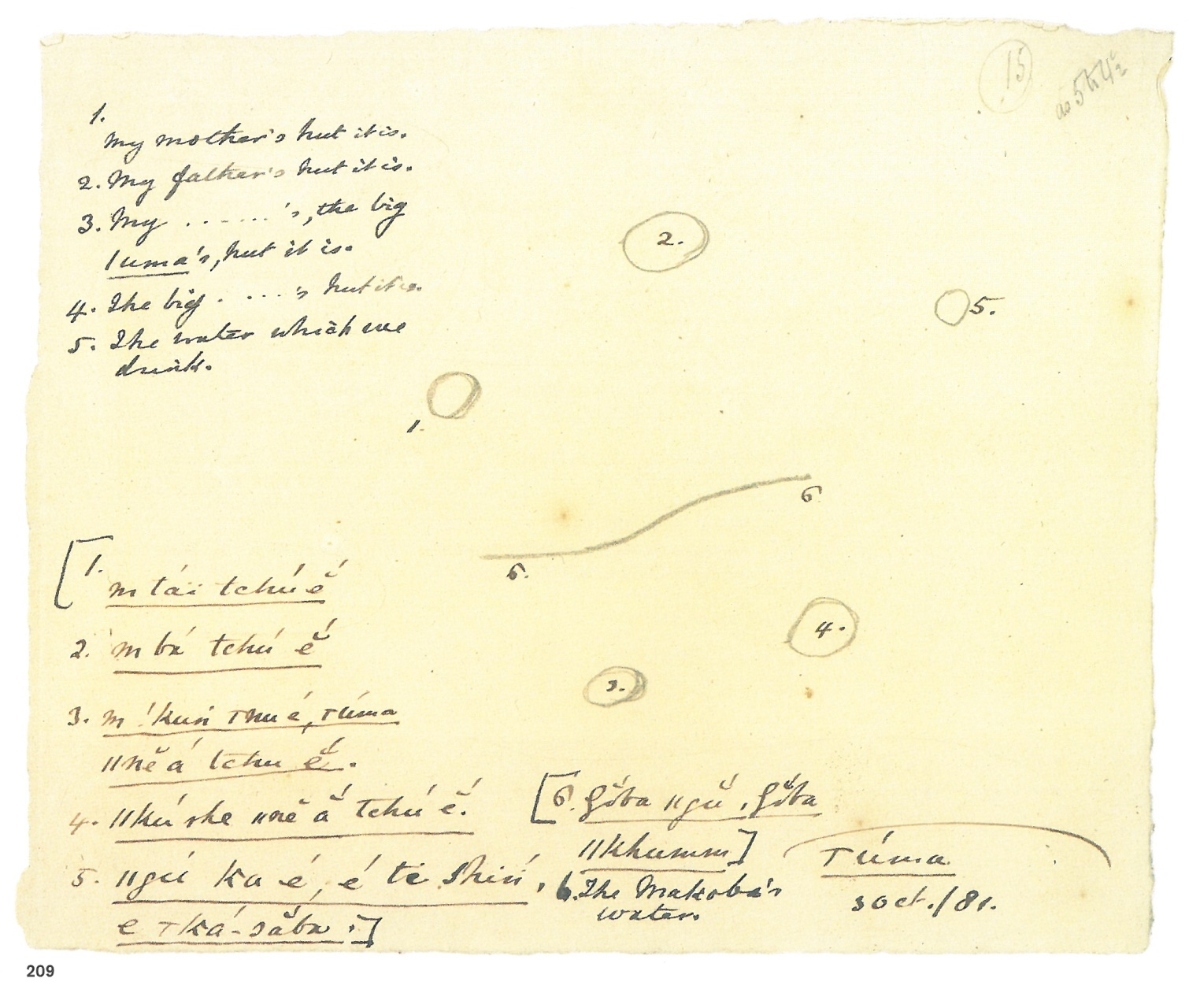
/Uma
Legend:
My mother's hut it is
My father's hut it is
My ….'s, the big /Uma's hut it is
The big [//Kushe]'s hut it is. (//Kushe is a woman's name)
The water which we drink.
The Makoba's water (= Kavango river)

Slide 8
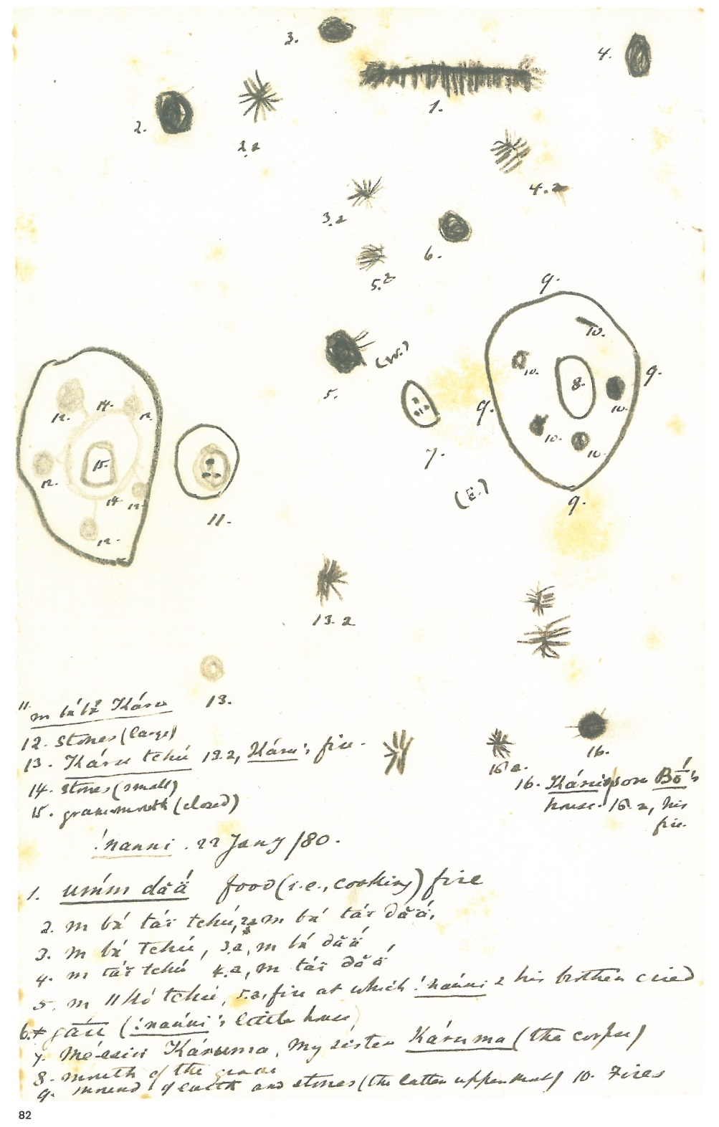
!Nanni
(This is a map of a settlement at which a death has occurred)
Legend:
Food (i.e., cooking) fire
My parental grandmother's house
2a My parental grandmother's fire
My father's house
3a My Father's fire
My mother's house
4a My mother's fire
My older brother's house
5a Fire at which !Nanni and his brother cried
!Nannis's little house (litt. "space", "place",
"compound"
My sister Karuma (the corpse)
Mouth of the grave
Mound of earth and stones (the latter uppermost)
Fires
My parental grandfather Karu
Stones (large)
Karu's house
13a Karu's fire
Stones (small)
Grave mouth (closed)
Karu's son Bo's house
16a His fire

Slide 9
!Nanni
(This is a map of a settlement at which a death has occurred)
Legend:
Food (i.e., cooking) fire
My parental grandmother's house
2a My parental grandmother's fire
My father's house
3a My Father's fire
My mother's house
4a My mother's fire
My older brother's house
5a Fire at which !Nanni and his brother cried
!Nannis's little house (litt. "space", "place",
"compound"
My sister Karuma (the corpse)
Mouth of the grave
Mound of earth and stones (the latter uppermost)
Fires
My parental grandfather Karu
Stones (large)
Karu's house
13a Karu's fire
Stones (small)
Grave mouth (closed)
Karu's son Bo's house
16a His fire

Slide 10
!Nanni
(This is a map of a settlement at which a death has occurred)
Legend:
Food (i.e., cooking) fire
My parental grandmother's house
2a My parental grandmother's fire
My father's house
3a My father's fire
My mother's house
4a My mother's fire
My older brother's house
5a Fire at which !Nanni and his brother cried
!Nannis's little house (litt. "space", "place",
"compound"
My sister Karuma (the corpse)
Mouth of the grave
Mound of earth and stones (the latter uppermost)
Fires
My parental grandfather Karu
Stones (large)
Karu's house
13a Karu's fire
Stones (small)
Grave mouth (closed)
Karu's son Bo's house
16a His fire

Slide 11
!Nanni
(This is a map of a settlement at which a death has occurred)
Legend:
Food (i.e., cooking) fire
My parental grandmother's house
2a My parental grandmother's fire
My father's house
3a My Father's fire
My mother's house
4a My mother's fire
My older brother's house
5a Fire at which !Nanni and his brother cried
!Nannis's little house (litt. "space", "place",
"compound"
My sister Karuma (the corpse)
Mouth of the grave
Mound of earth and stones (the latter uppermost)
Fires
My parental grandfather Karu
Stones (large)
Karu's house
13a Karu's fire
Stones (small)
Grave mouth (closed)
Karu's son Bo's house
16a His fire
Fires
Houses

Slide 12
!Nanni
(This is a map of a settlement at which a death has occurred)
Legend:
Food (i.e., cooking) fire
My parental grandmother's house
2a My parental grandmother's fire
My father's house
3a My Father's fire
My mother's house
4a My mother's fire
My older brother's house
5a Fire at which !Nanni and his brother cried
!Nannis's little house (litt. "space", "place",
"compound"
My sister Karuma (the corpse)
Mouth of the grave
Mound of earth and stones (the latter uppermost)
Fires
My parental grandfather Karu
Stones (large)
Karu's house
13a Karu's fire
Stones (small)
Grave mouth (closed)
Karu's son Bo's house
16a His fire
The graves

Slide 13
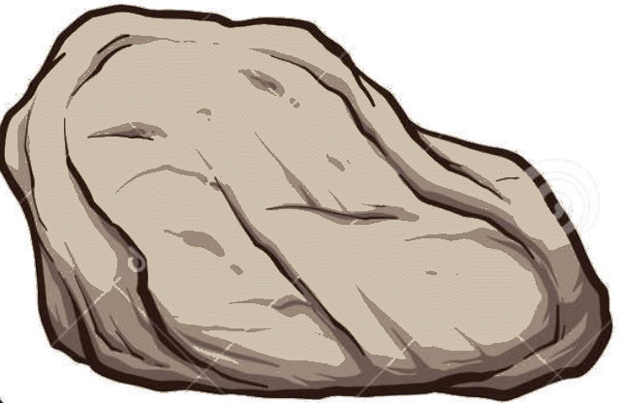
!Nanni
(This is a map of a settlement at which a death has occurred)
Legend:
Food (i.e., cooking) fire
My parental grandmother's house
2a My parental grandmother's fire
My father's house
3a My Father's fire
My mother's house
4a My mother's fire
My older brother's house
5a Fire at which !Nanni and his brother cried
!Nannis's little house (litt. "space", "place",
"compound"
My sister Karuma (the corpse)
Mouth of the grave
Mound of earth and stones (the latter uppermost)
Fires
My parental grandfather Karu
Stones (large)
Karu's house
13a Karu's fire
Stones (small)
Grave mouth (closed)
Karu's son Bo's house
16a His fire
Mouth of grave
mound of earth
Grandfather
Sister
small stones

Slide 14
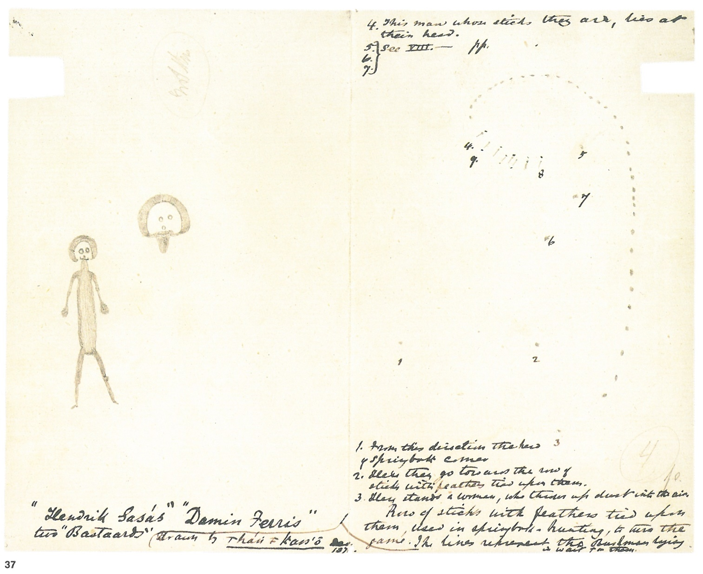
/Han≠kass'o
Diagram of tactics in springbok hunting
1. From this direction the herd of springbok comes
2. Here they go towards the row of sticks with feathers tied upon them
3. Here stands a woman, who throws up dust into the air.
[Rows of sticks with feathers tied upon them, used in springbok hunting, to turn the game. The lines represent the Bushmen lying in wait for them. L.L.]
4. This man whose sticks they are, lies at their head.
5. (from Bleek & Lloyd 1911: 284ff.) This man has ostrich feathers upon sticks.
6. He sticks (into the little bushes) a large stick with ostrich feathers.
7. He goes also to stick in a little feather brush (…) to drive the springbok.
8. The man who lies … the man who lies to leeward. He lies … "with a red head"
Narrative map/diagram
9. (he intends) to drive the springbok, as he wishes that the foremost one may run, passingthrough, may run passing by the man who lies between; he is one to whom the man (who drives the springbok) intends the foremost [springbok] to run

Slide 15
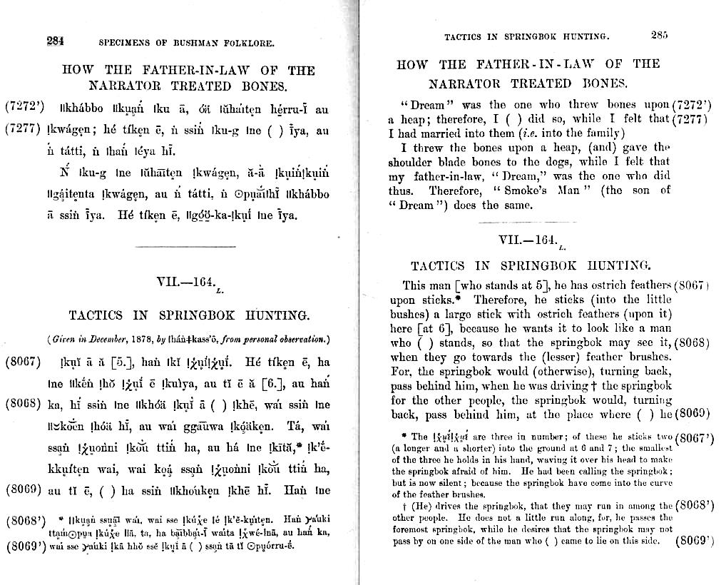
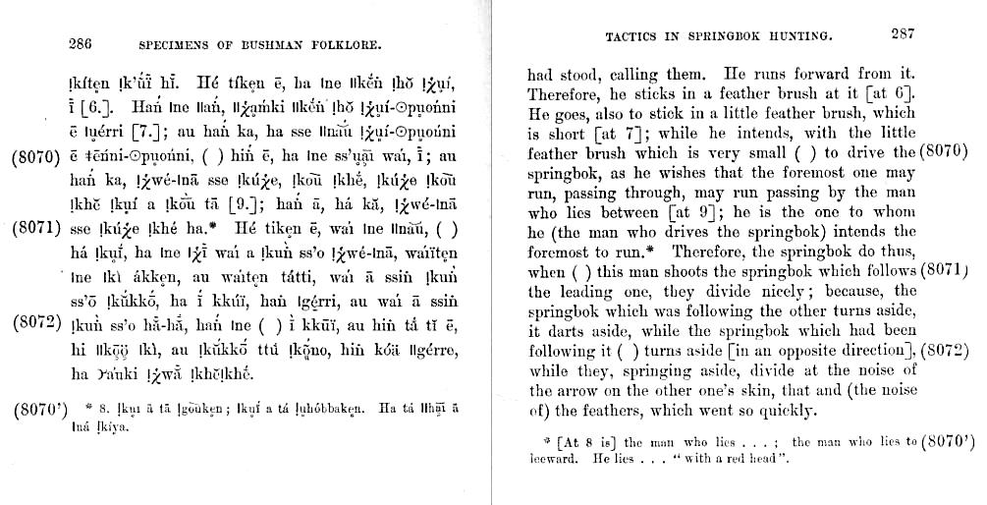
"(he intends) to drive the springbok, as he wishes that the foremost one may run, passing through, may run passing by the man who lies between; he is one to whom the man -who drives the springbok- intends the foremost to run"

Slide 16
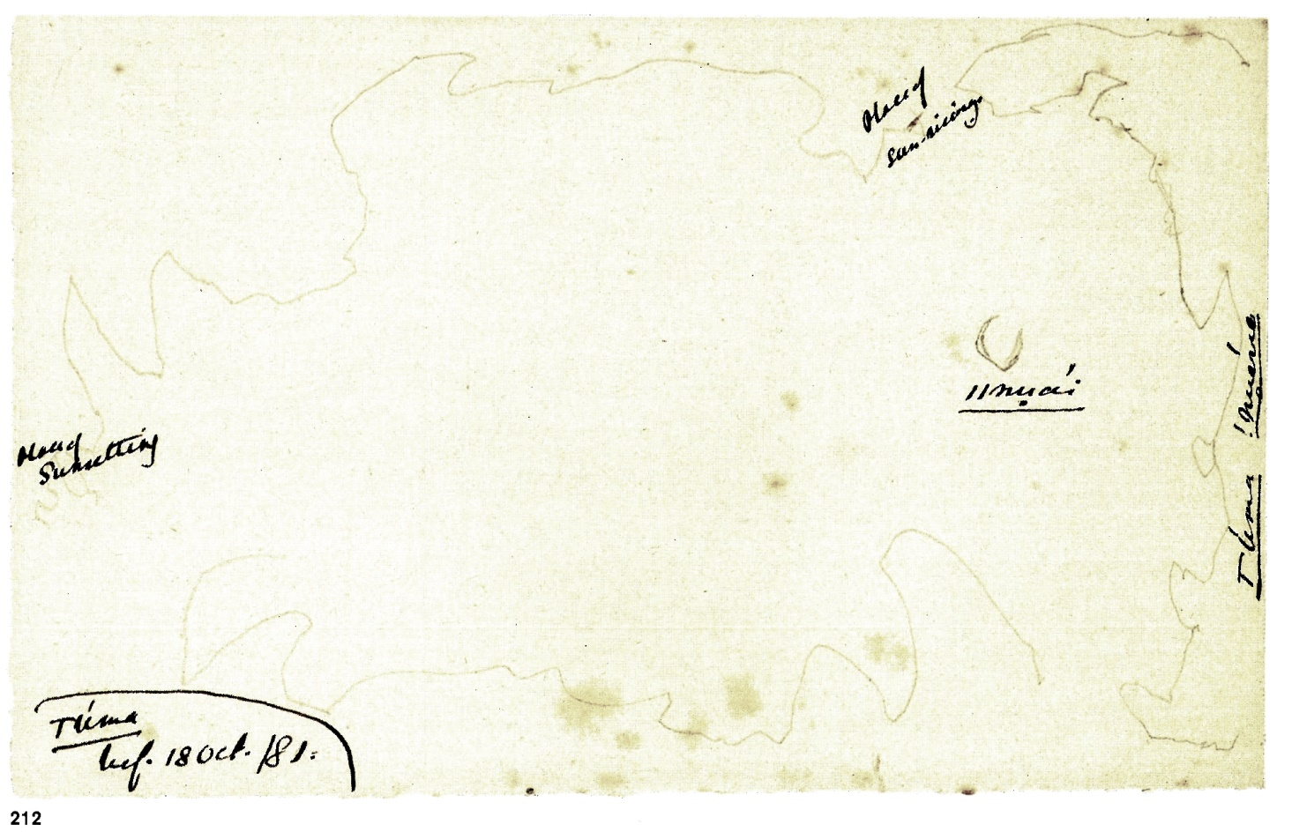
Maps of large scale
/Uma – map of his country?

Slide 17
Maps of large scale
/Uma – map of his country?
Place of sun-rising
//nuai (moon)
/Uma !nuerre (country)
Place of sunsetting

Slide 18
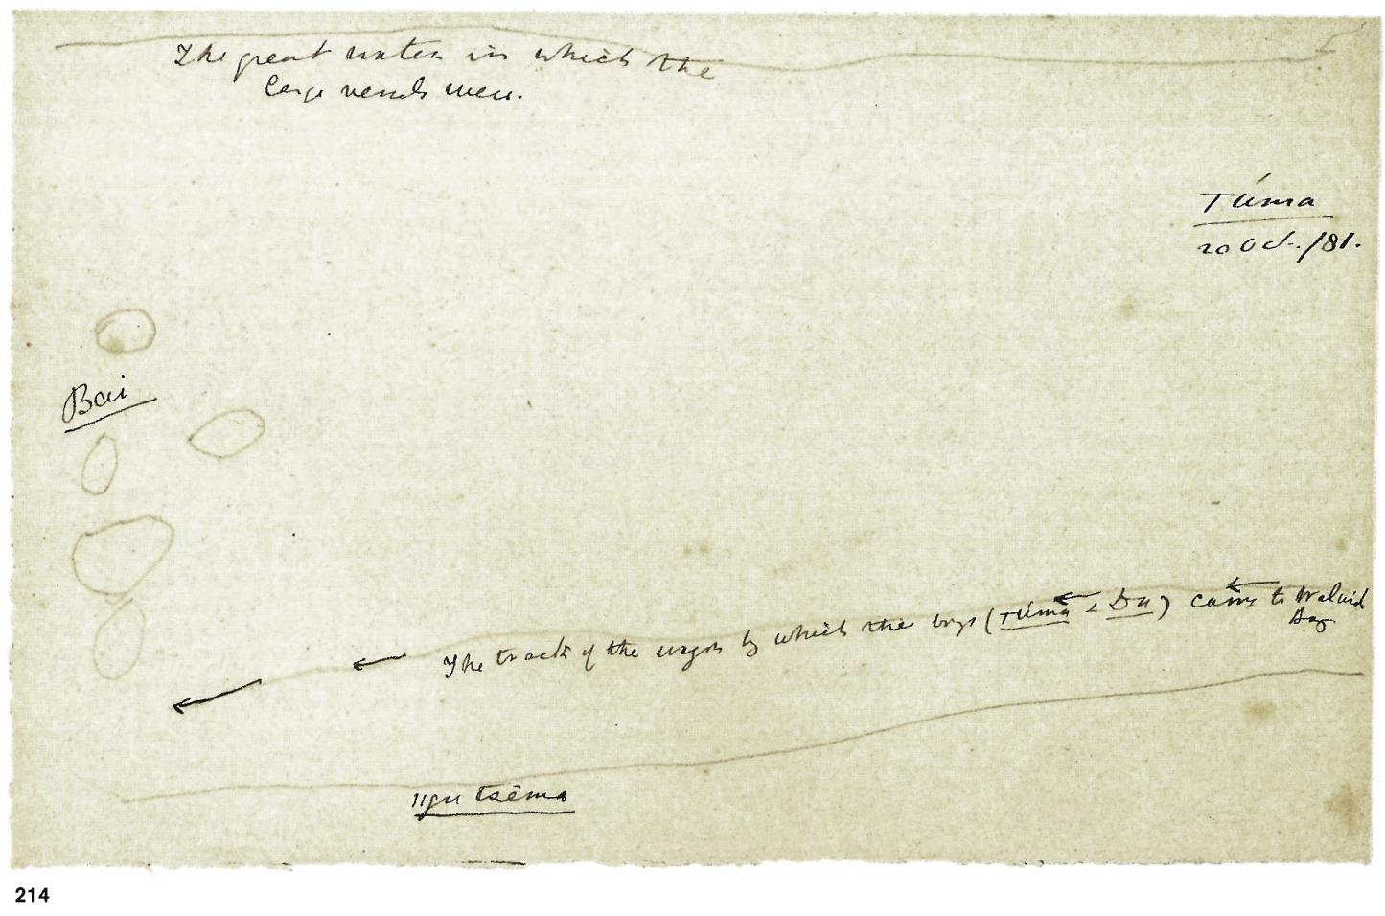
/Uma – the way to Walvish Bay (on the way to Cape Town)

Slide 19
The great water in which the large vessels were
The track of the wagon by which the boys (/Uma & Da) came to Walvish Bay
//gu tsema [the little water]
/Uma – the way to Walvish Bay (on the way to Cape Town)

Slide 20
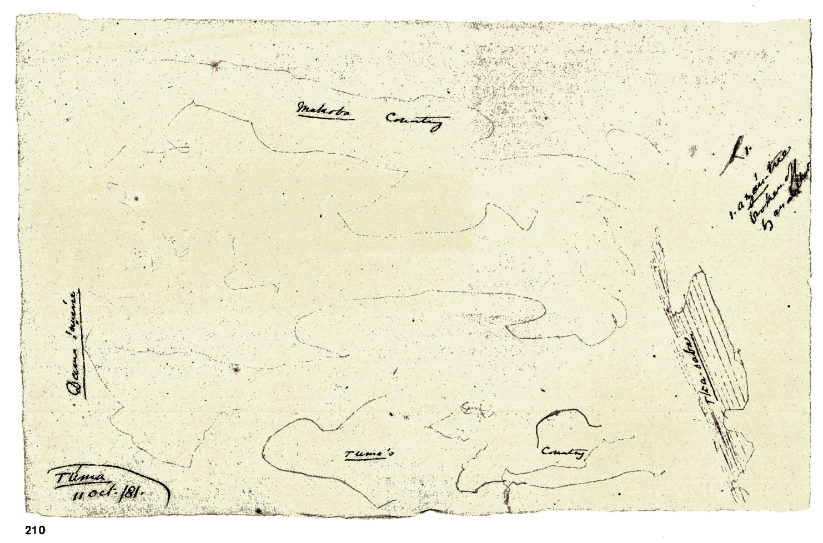
/Uma – map of home region

Slide 21
/Uma – map of home region
Zau-tree broken off by an elephant
Makoba country
Dama country
/Ka-saba (a water source in !Xun country)
/Uma's country

Slide 22
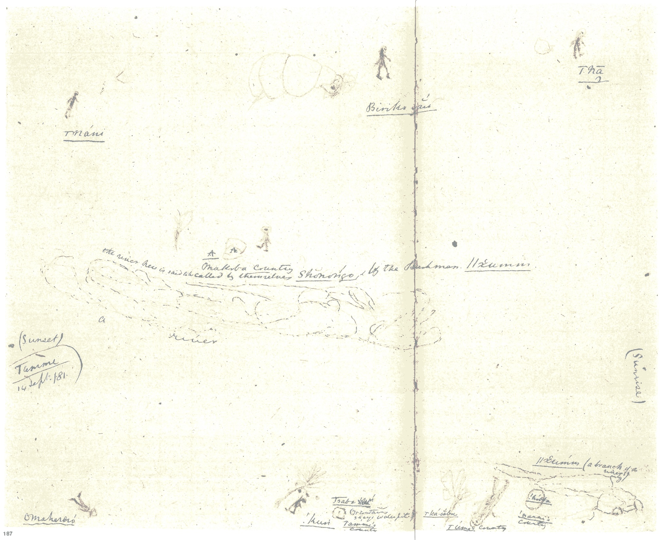
Detailed Maps – large scale
Tamme – map of home region

Slide 23
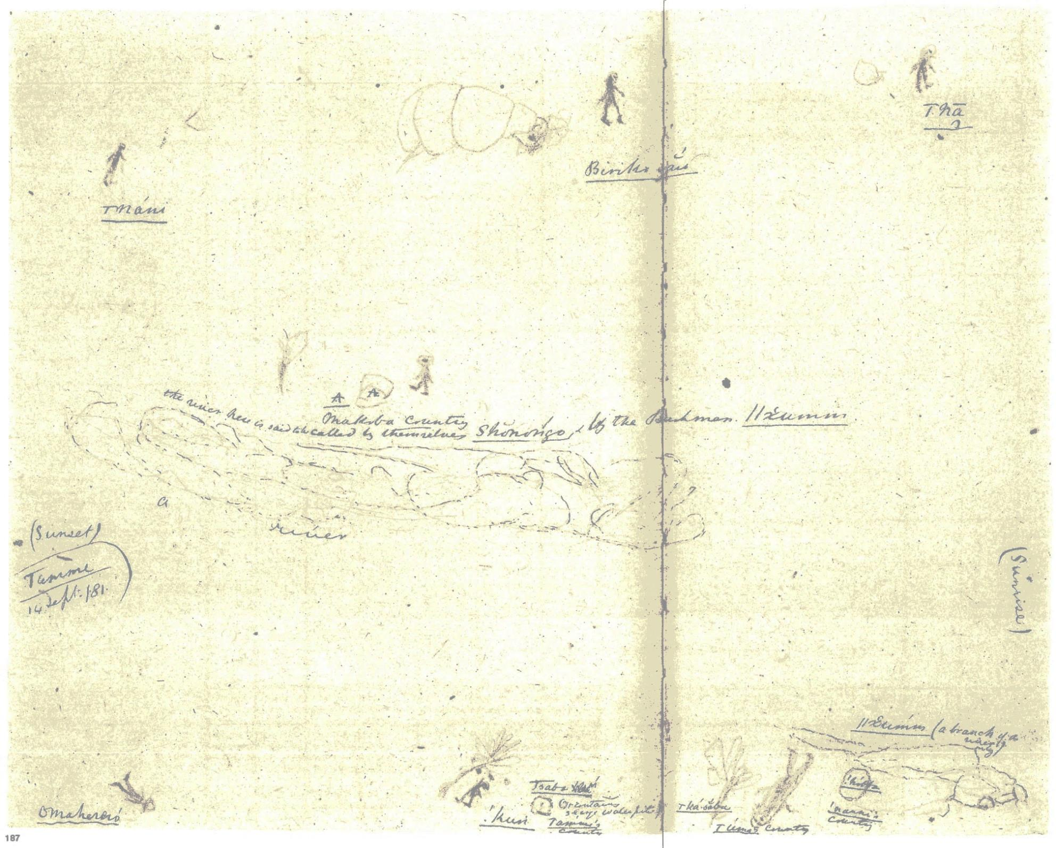
/Na
[!Xun speaking group]
Biriko kxau
[!Xun speaking group]
/Nani
[Chokwe]
A. Makoba country
The river here is said to be called by themselves Shonongo, and by the Bushmen //xumm
Sunset
a river
Sunrise
Tsaba
Mountain *** waterpits
//xumm (a branch of the river only)
Omahereo
!Kun Tamme's
country
/Ka-saba /Uma's !Nanni's !hobba
[water source] country country

Slide 24
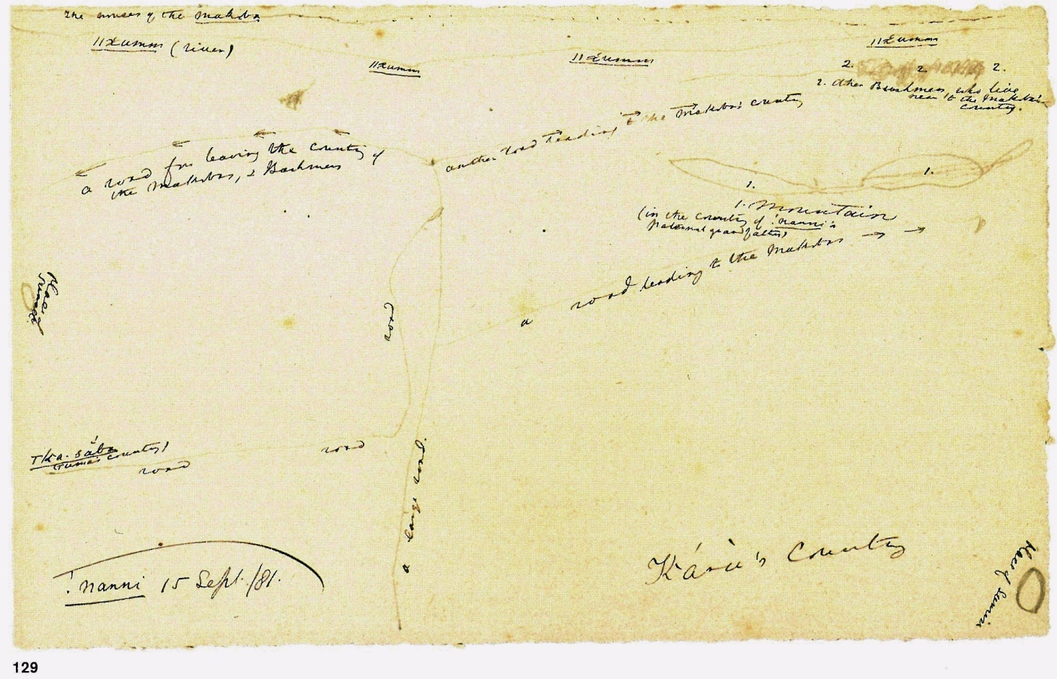
!Nanni – Country of Makoba

Slide 25
The owners of the Makoba
//Kumm
//Kumm (river)
//Kumm
//Kumm
another road leading to the Makobas' country
a road for leaving the country of the Makobas, and Bushmen
place of sunset
2. Other Bushmen who live near to the Makobas' country
road
a road leading to the Makobas
1. Mountain (in the country of !Nanni's paternal grandfather)
/Ka-saba [name of a watersource]
(/Uma's country)
a large road
road
road
place of sunrise
Karu's country
[!Nanni's grandfather]
!Nanni – Country of Makoba

Slide 26
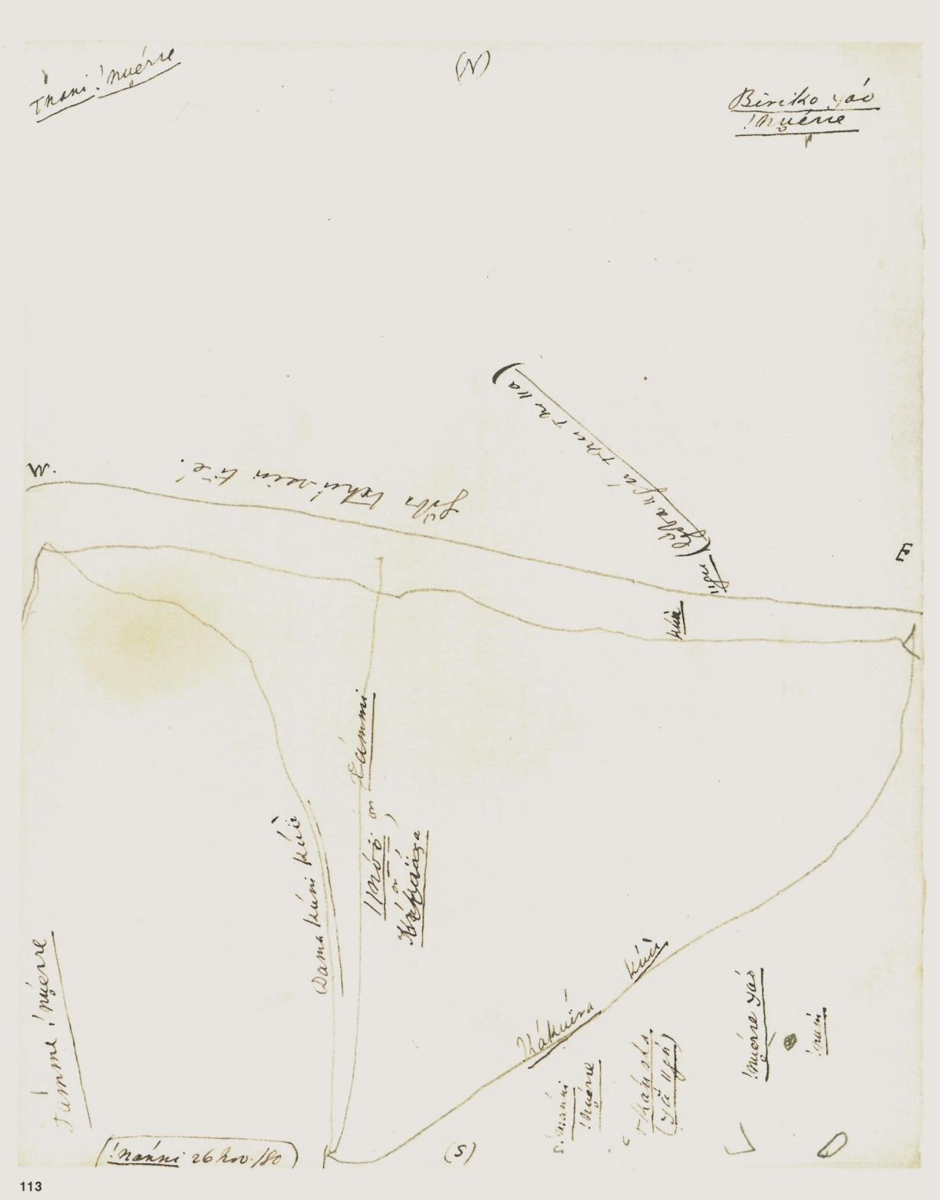
!Nanni – Map of home region
Note: the direction of Lloyds annotations does not cogently suggest that !Nanni initially conceived north up
Most likely the Kavango River

Slide 27
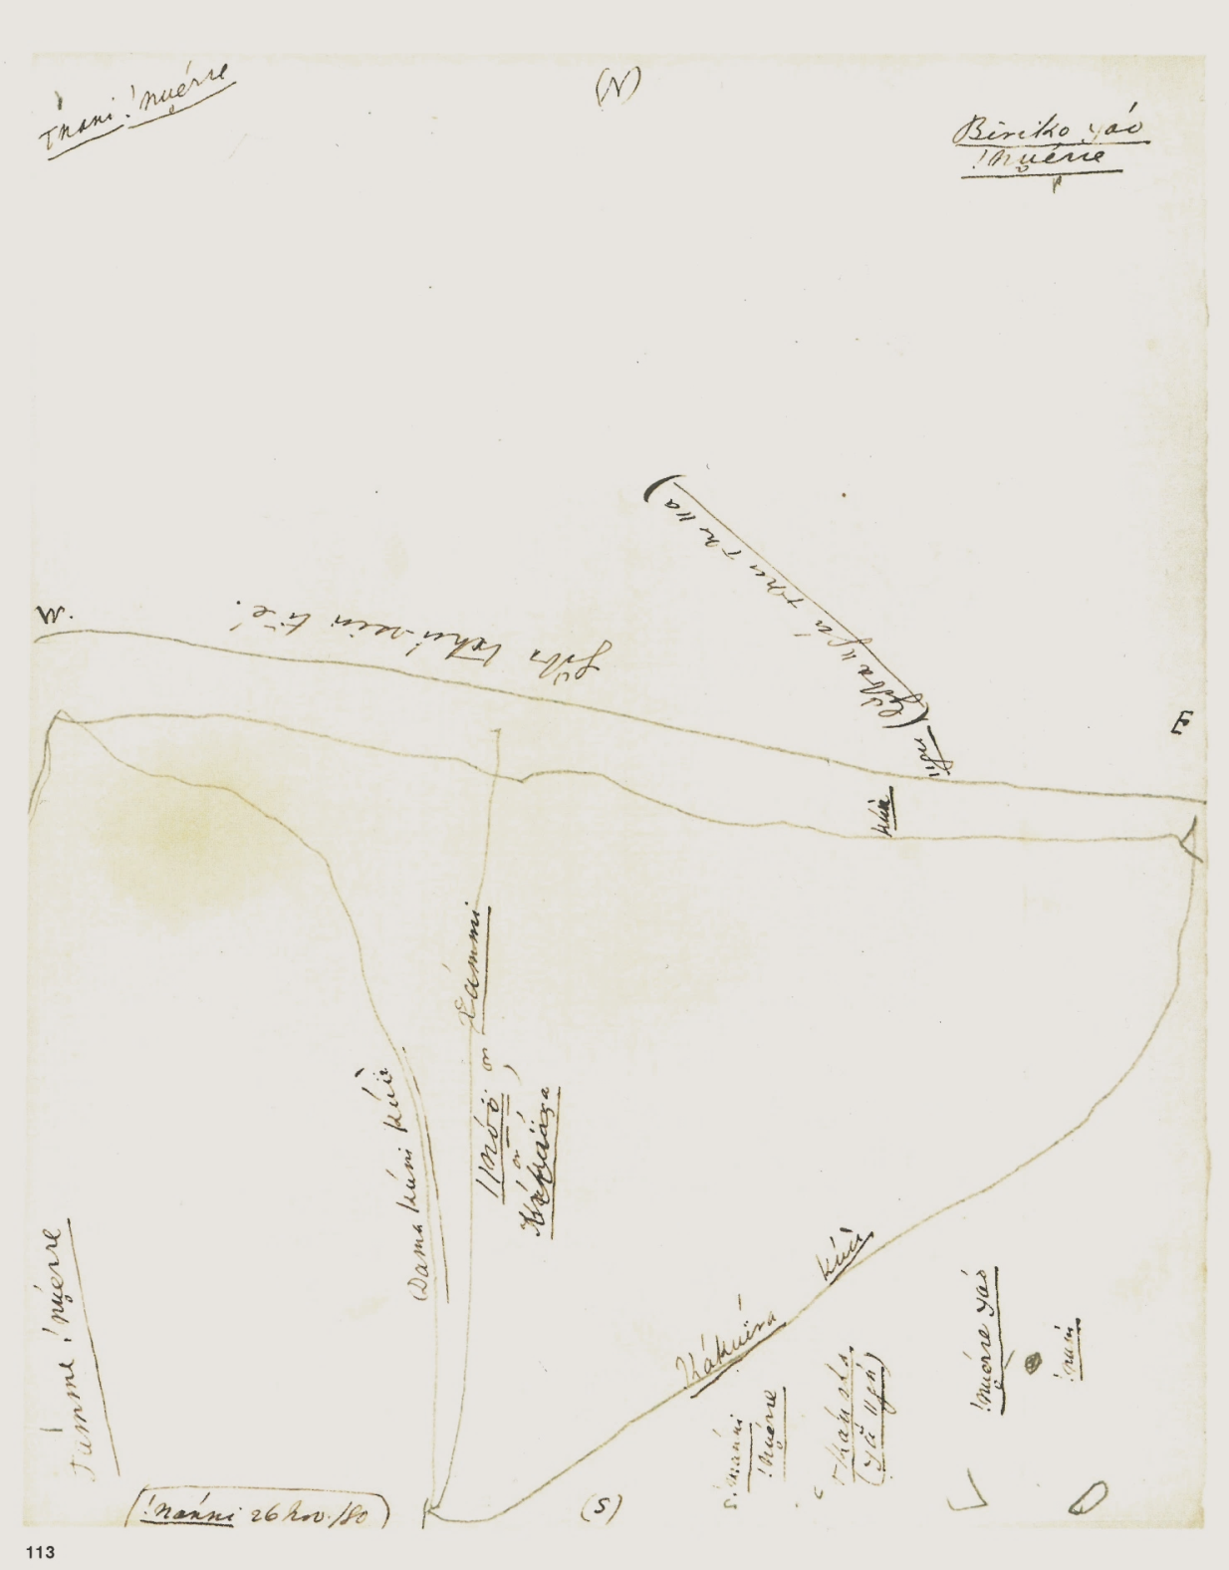
!Nanni – Map of home region
(N)
W E
(S)
/Nani !nuerre
Chokwe country
Biriko kxau !nuerre
!Xun group country
Goba thu-ssin ti e
These are Makoba houses
//gu (Goba //hu/nu/nu//a)
[water, may have to do with mokoros, dugout canoes]
Most likely the Kavango River
//Noo or Xammi
[/Xun speaking San]
Kuu
[burned areas?]
Dama kuni kuu
[Dama wagon (road?)]
Kakuira kuu
[road to Kakuira=country of //Noo San]
!Nuerre Kxao
[owner/inhabitant of country]
Tamme!nuerre
[T.'s country]
!num
[rock]
/Kau sha /kxa //gu)
[/Kau sha = name of spring?]
!Nanni !nuerre
!N.'s country

Slide 28
Compilation of Tamme's, !Nanni's and /Uma's maps of their home regions
N
/Na [!Xun]
/Nani [Chokwe]
Biriko kxao
Biriko kxao
/Nani [Chokwe]
Makoba [Kavango]
Makoba [Kavango]
The Makoba's water
W
E
River Shanongo or //Xumm
Makoba
country
//gau [mokoro canoes?]
//Kumm [on map 129]
Dama country
Dama road
/Uma's
country
/Ka-saba
water source
Omaherero
/Ka-saba
water source
Tamme's
country
Tamme's
country
!Nanni's
country
!Nanni's
country
S
/Uma's
country
/Ka-saba
water source
/Uma's
country

Slide 29
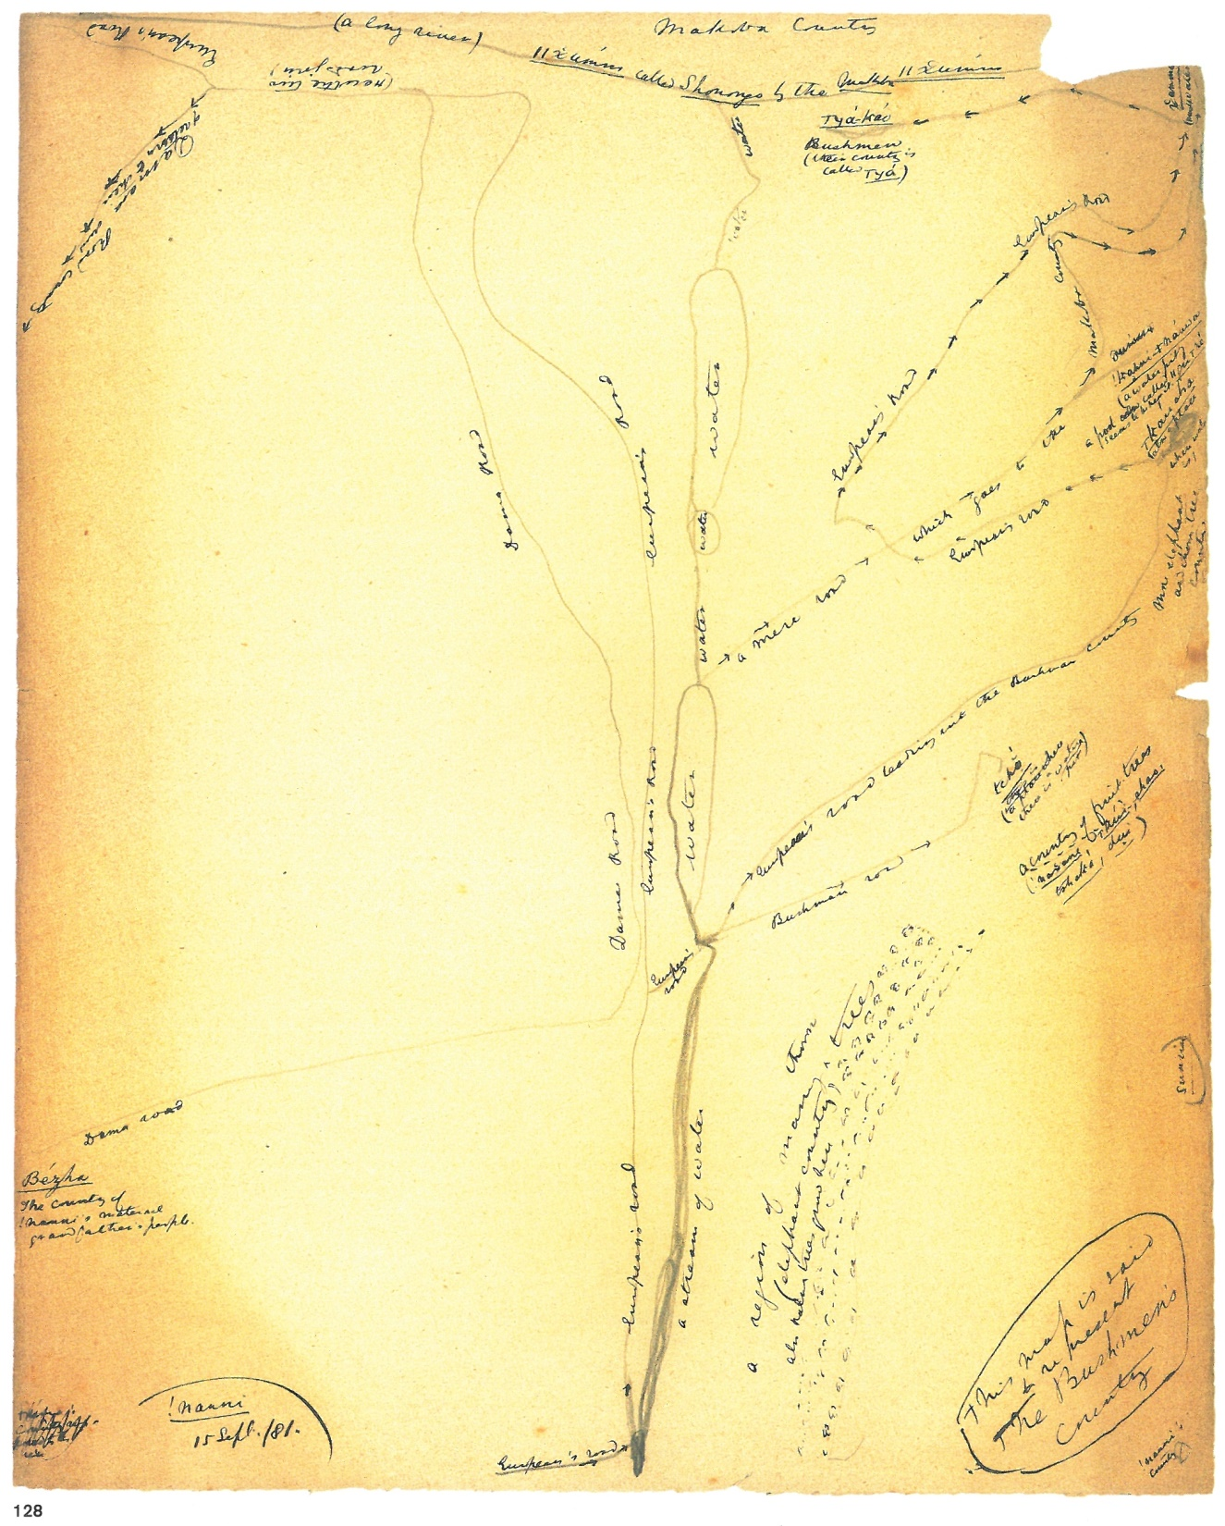
!Nanni
"This map is said to represent the Bushmen's country"

Slide 30
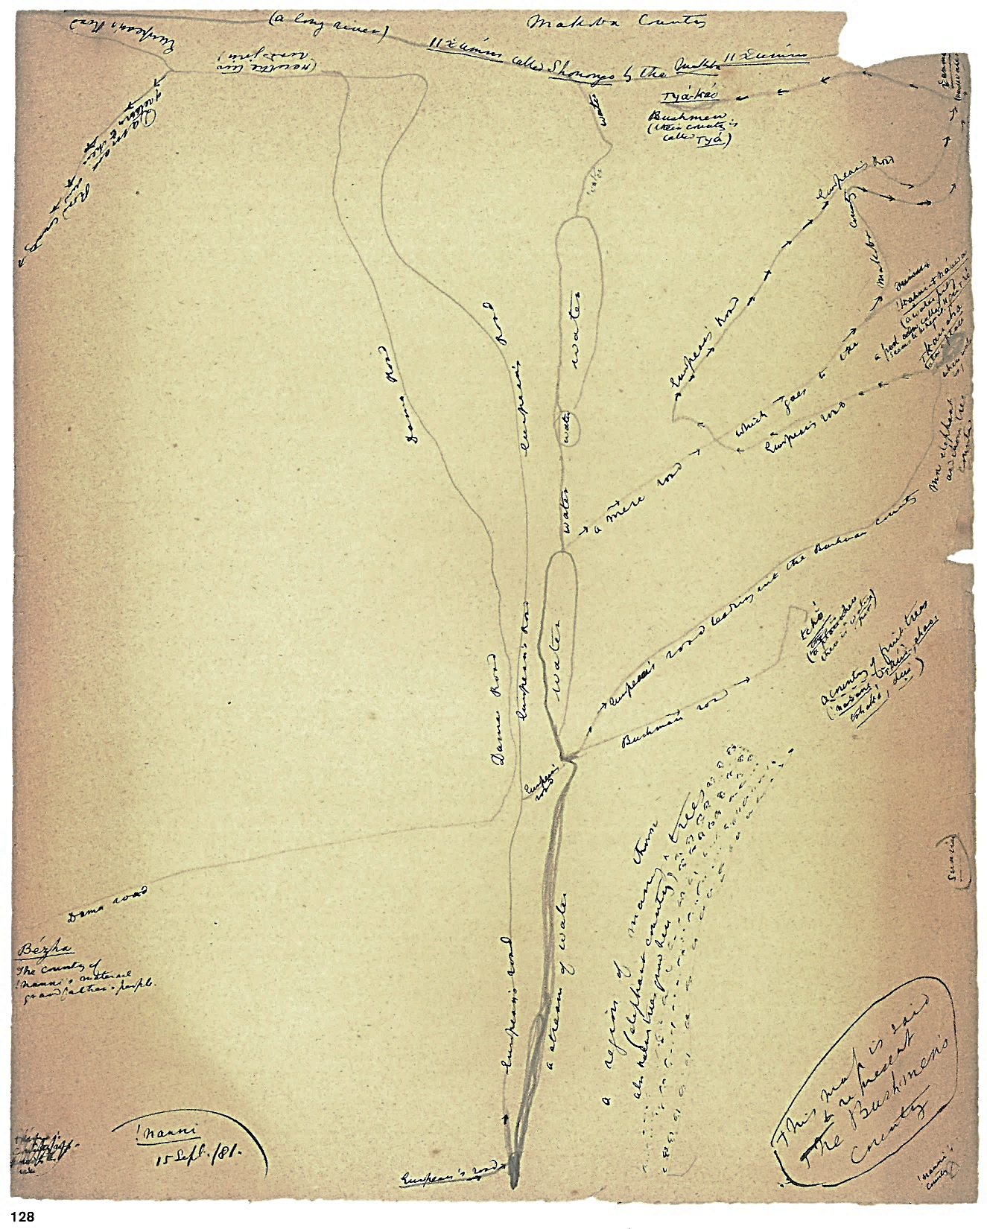
Makoba country
European's road
(a large river) //xumm called Shanongo by the Makoba
//xumm
(*** water)
Here the
roads join
/Kxa-kao Bushmen (their country is called /Kxa)
Damara road of return to their own country
Water
European's road
!Khani ≠nauwa
A water pit – a pool called //pu/ne – seems to be ***
/Kau sha also a place where water is
Here elephant and thorn-tree country
Tchó (a place where there is a water pit
A country of fruit trees (!naxane, /kui, shas, tshaka, dui)
country
a mere road which goes to the Makoba
European's road
European's road
European's road leading to the Bushman country
Water
Dama road
Bushman road

Slide 31
Makoba country
European's road
(a large river) //xumm called Shanongo by the Makoba
//xumm
(*** water)
Here the
roads join
/Kxa-kao Bushmen (their country is called /Kxa)
Damara road of return to their own country
Water
European's road
!Khani ≠nauwa
A water pit – a pool called //pu/ne – seems to be ***
/Kau sha also a place where water is
Here elephant and thorn-tree country
Tchó (a place where there is a water pit
A country of fruit trees (!naxane, /kui, shas, tshaka, dui)
country
a mere road which goes to the Makoba
European's road
European's road leading to the Bushman country
Water
Dama road
Bushman road
Dama road
Sunrise
A region of many thorn trees (elephant country) also palm trees grow here
Bezha
The country of !Nanni's maternal grandfather's people
A stream of water
European's road
This map is said to represent Bushmen's country
!Nanni's country

Slide 32
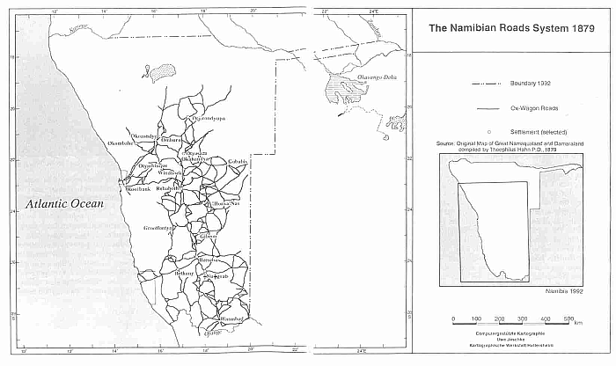
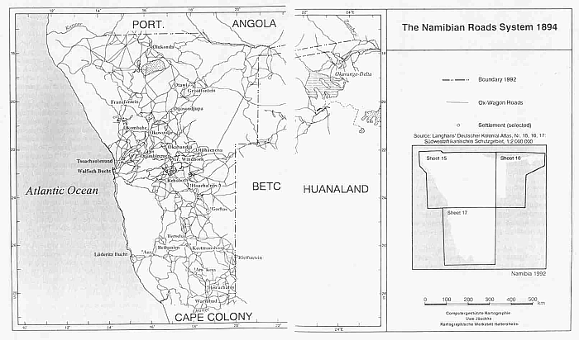

Slide 33
Graphic elements used for mapping
Circles, ovoids
Blots
Regularly running lines
Erratic running lines
Radial strokes (for fires)
Human figures (largely observing a walking line parallel to lower edge of paper)
Trees (Tamme)
Hatching (/Uma)
Perspectives used in mapping
Bird's eye view
Cardinal points (?) – at least one map with North up
Horizon?
Physical elements mapped in high resolution maps
Houses (of relatives)
Fires
Graves
Stones
People

Slide 34
Physical elements of the landscape
in maps of low resolution
!Nanni
Roads
Water
Ethnic groups
Relatives
Vegetation
Animals
Topographic elements
Celestial features (?)
Tamme
Water
Ethnic groups
Vegetation
Topographic elements
Celestial features (?)
/Uma
Road (n=1)
Water
Ethnic groups
Relatives
Vegetation
Topographic elements
Celestial features
The two 'maps' of /Han≠kass'o are rather illustrations for narratives

Slide 35
When were the maps drawn?
Mutual influence?
 | Sept. 1878 | Jan. 1880 | Nov. 1880 | Sept. 1881 |  | October 1881
 |  |  |  | 14 | 15 | 3 | 11 | 18 | 20
/Han≠kass'o | x
!Nanni |  | x | x |  | xx
Tamme |  |  |  | x
/Uma |  |  |  |  |  | x | x | x | x

Slide 36
(Not a) conclusion
Not entirely clear which influence was exerted by the European hosts
Unclear how the San influenced one another mutually
Unlikely that the San had intense previous exposure to maps
All maps, irrespective of scale, reproduce spatial units that the San had experienced personally
The maps contain many elements common in western mapping
Maps only reproduce elements of the empirical landscape
Maps give a proportionate rendering of real spatial configurations
The general perspective is bird's eye view
Maps can be oriented by the cardinal points (sunrise, sunset)
Maps at landscape scale with these characteristics were only made by !Xun (teenagers and a boy of 10 years)
Comment: a surprising lack of narrative elements in the maps (not linked to personal experiences in the landscape)

Slide 37
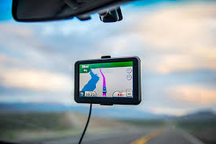
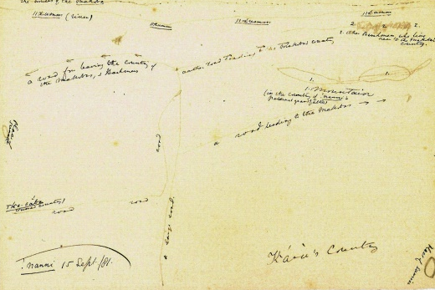
Thank you

